Slide 1


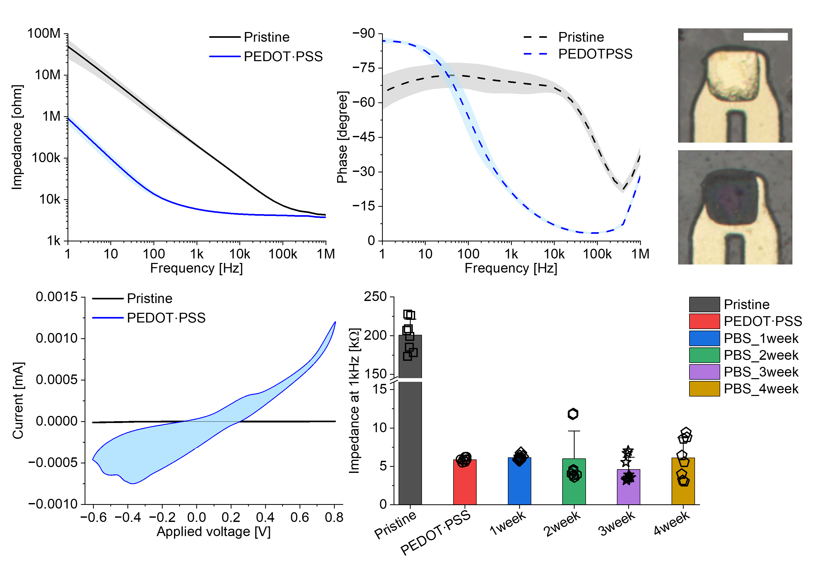
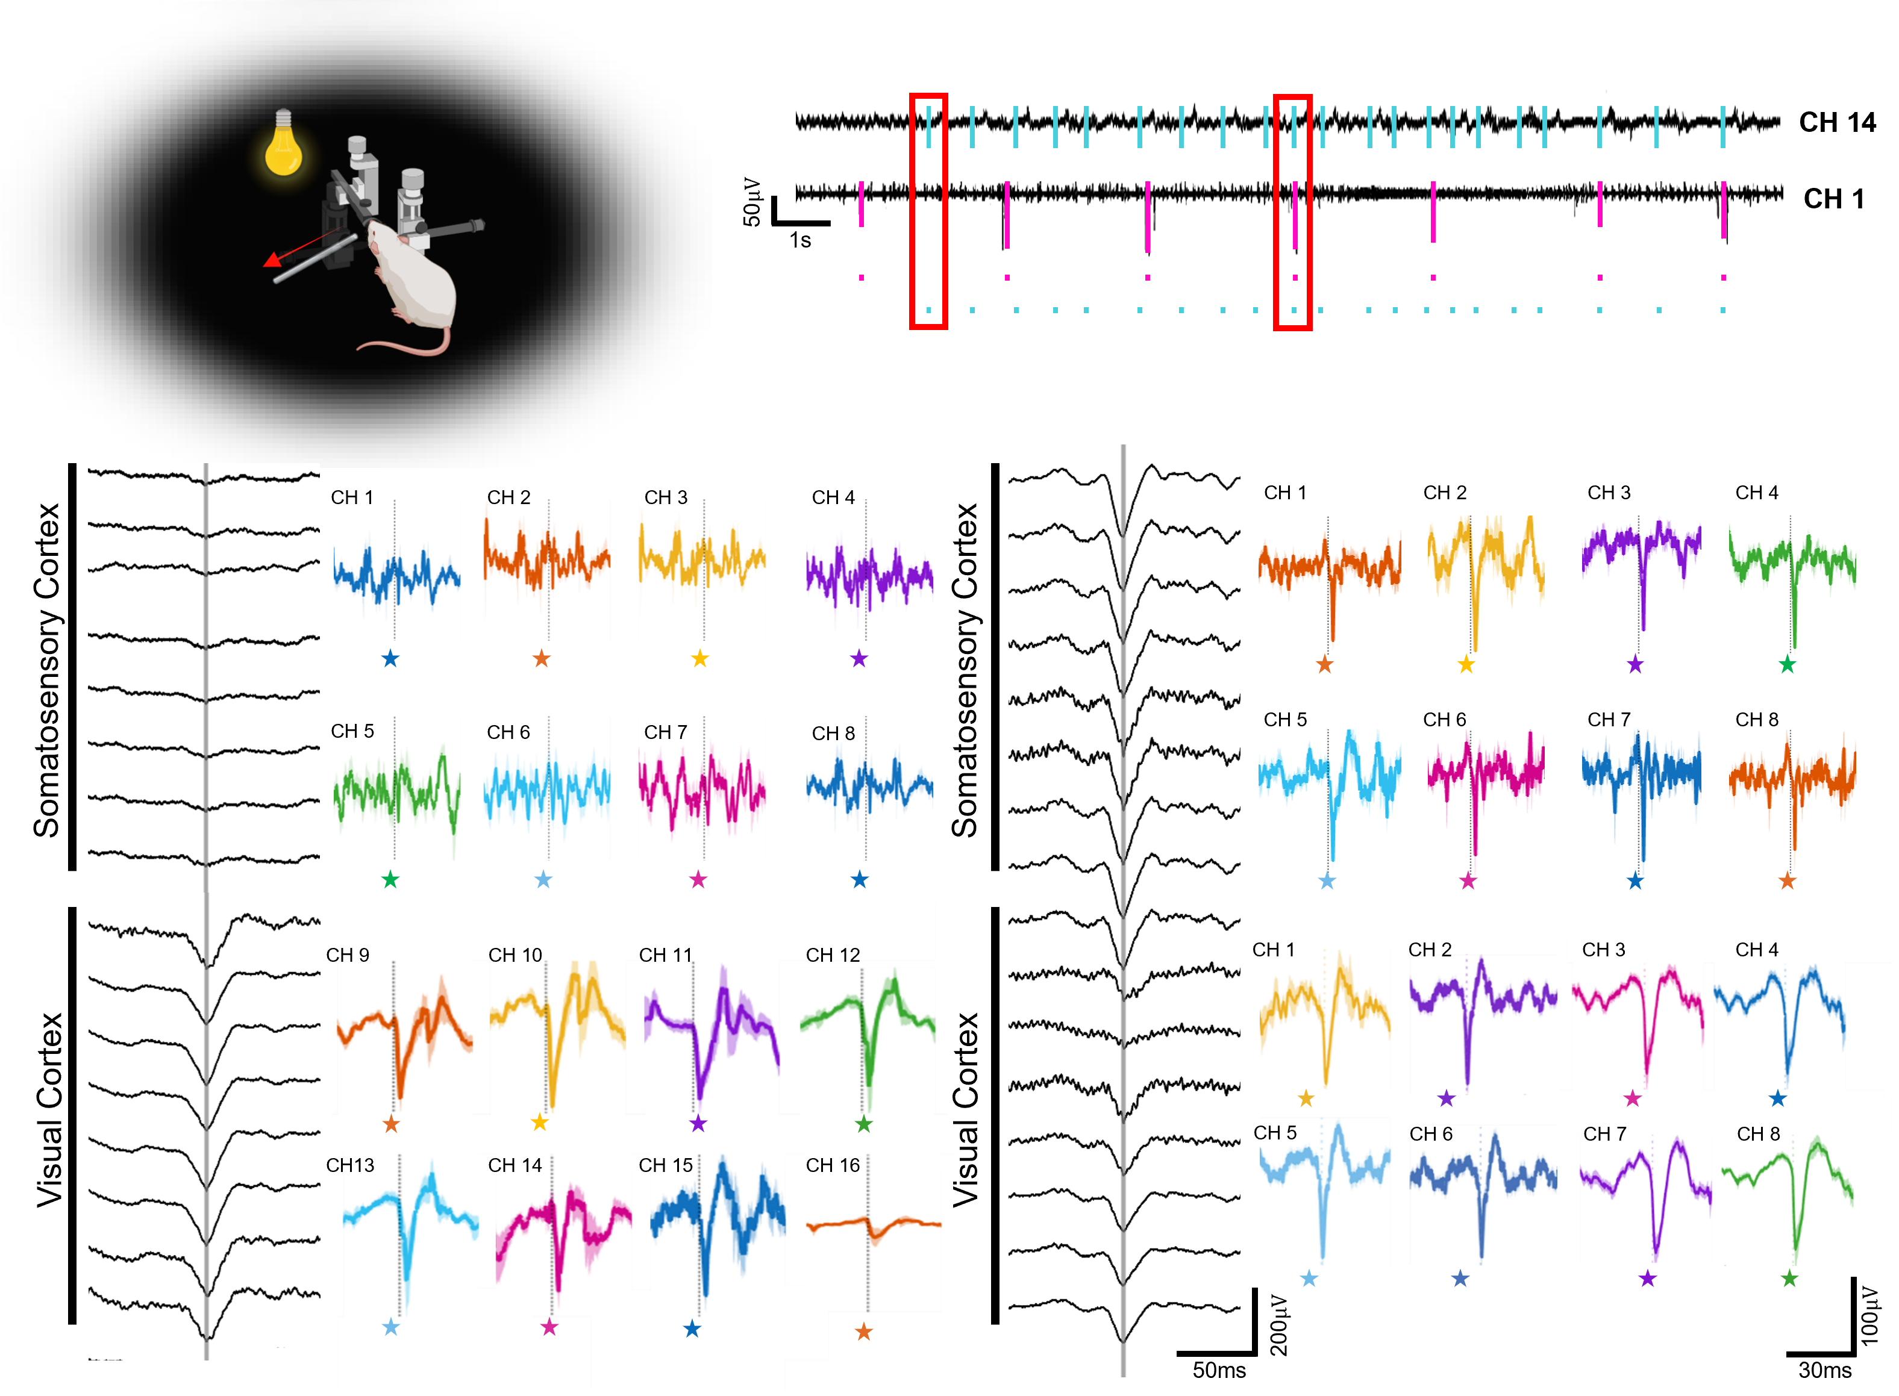
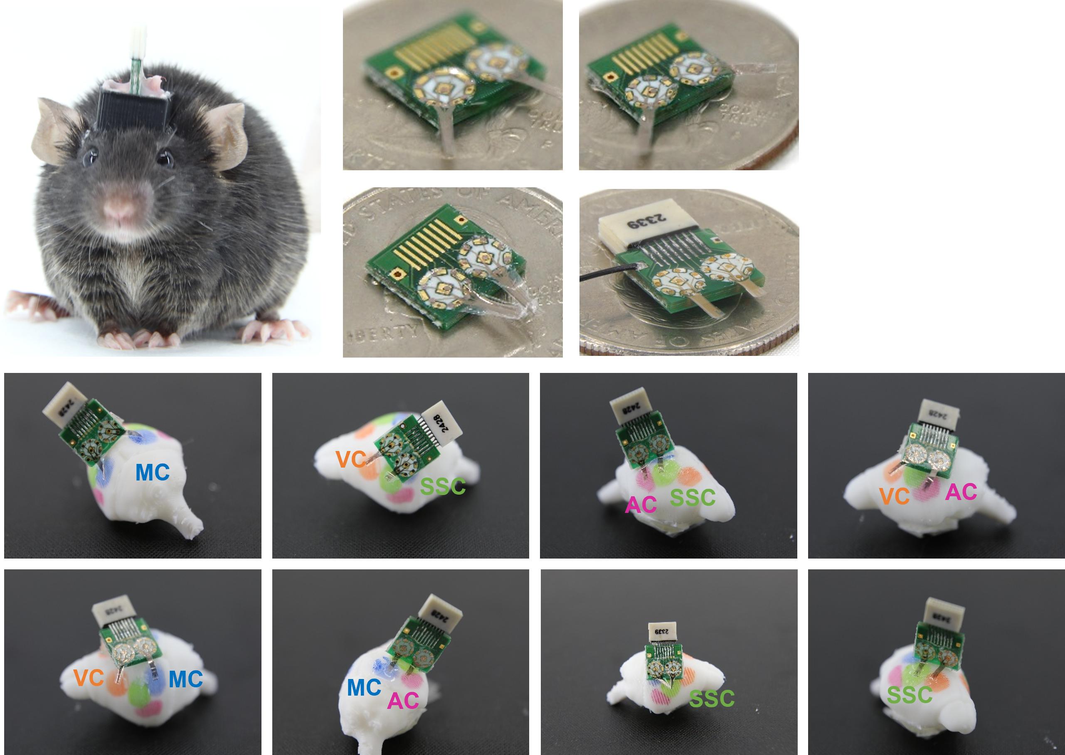
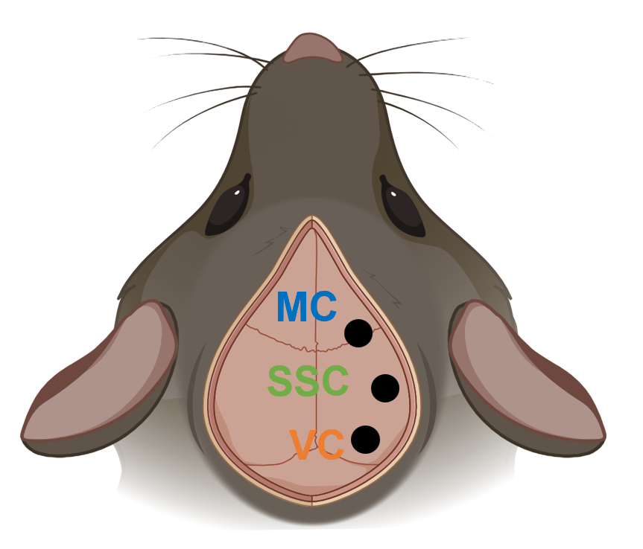
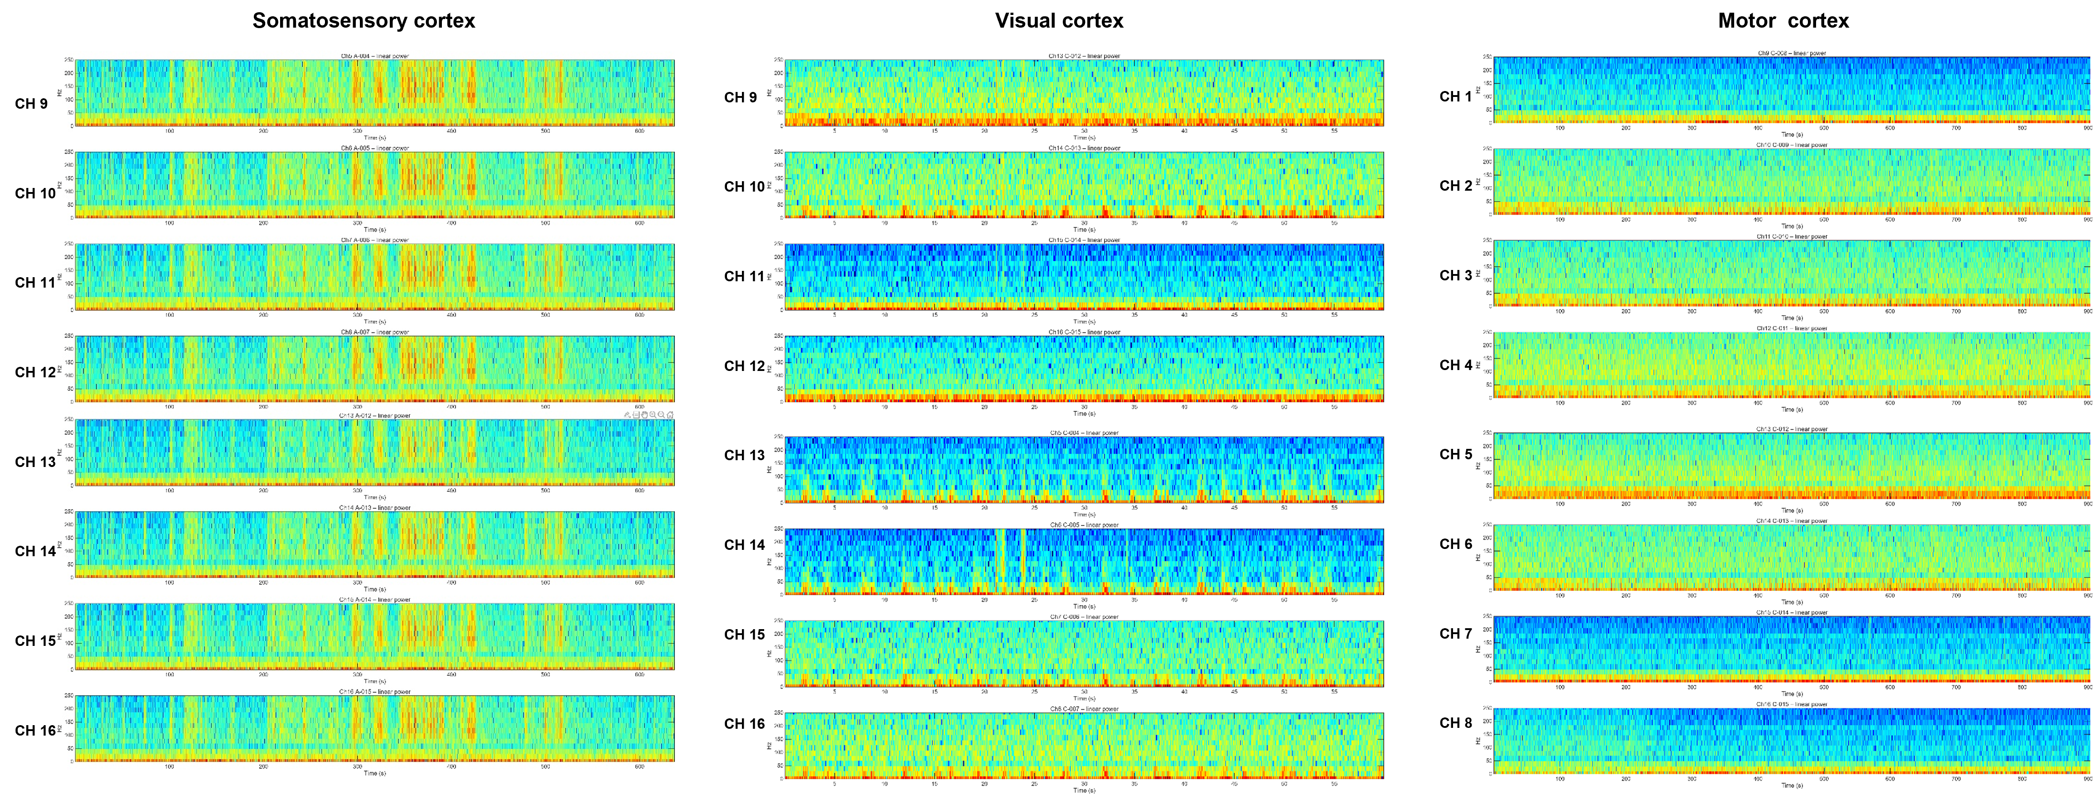
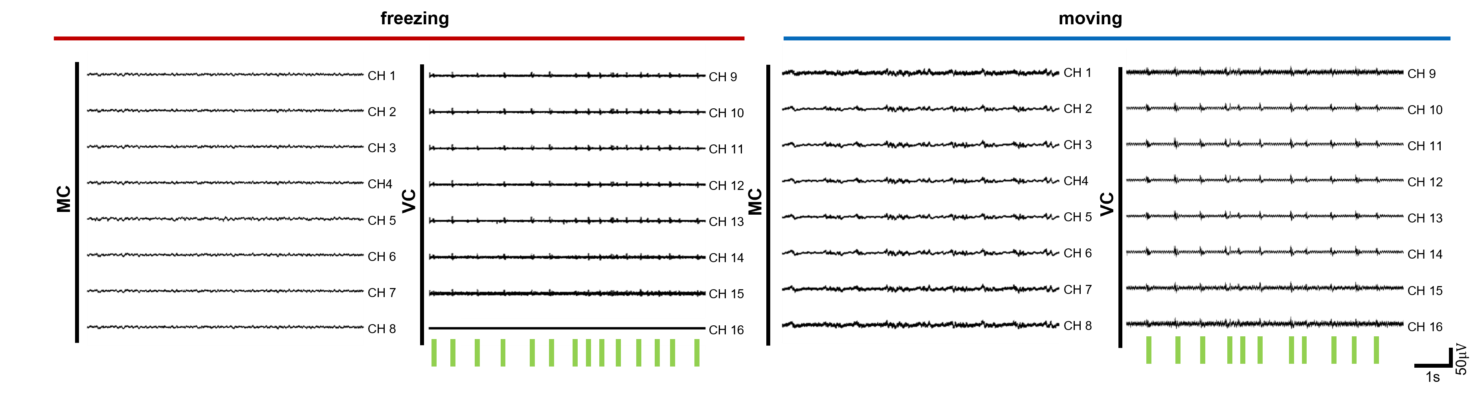
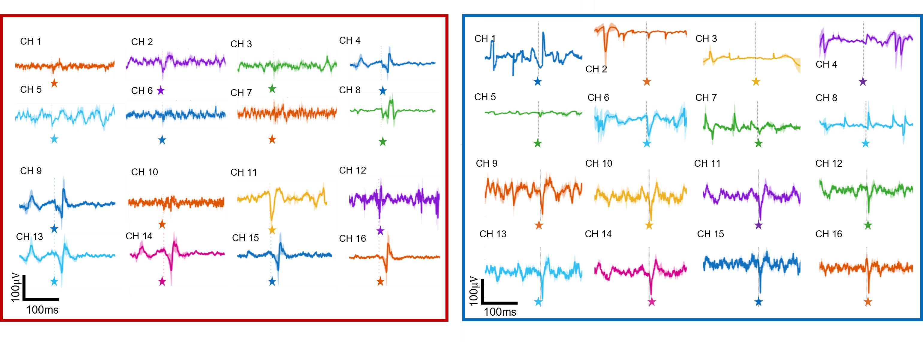
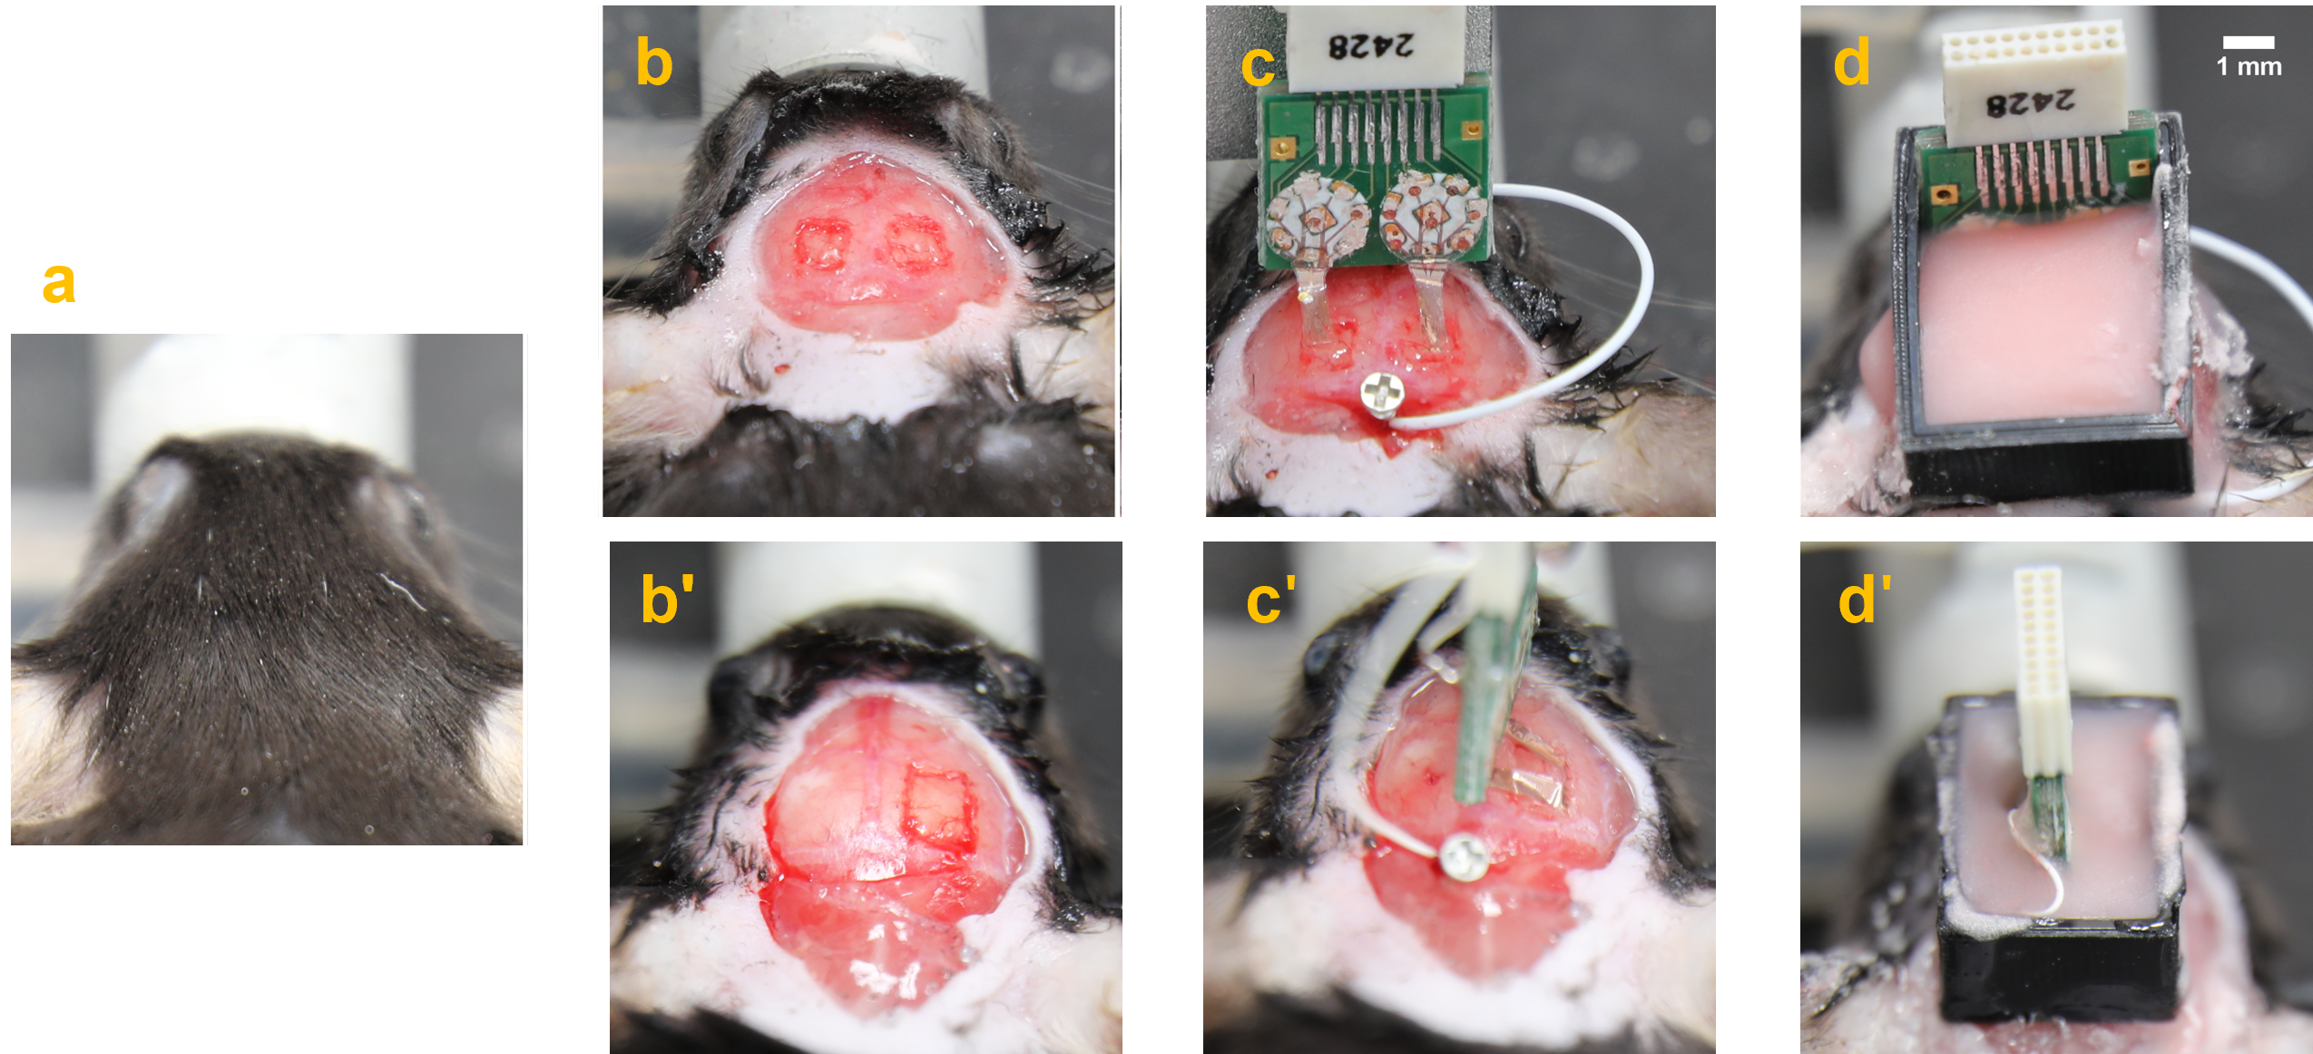

A Reconfigurable Multisite ECoG Array for Recording from Multiple Cortical Regions
Jimin Lee^{1.2†}, Jonghee Eun^{1†}, Juhyun Kim^{1*}, Namsun Chou^{1,3*}
¹Emotion, Cognition & Behavior Research Group, Korea Brain Research Institute (KBRI), Daegu 41062, Korea
²Department of Robotics and Mechatronics Engineering, Daegu Gyeongbuk Institute of Science and Technology (DGIST), Daegu, 42988, Republic of Korea
³Graduate School, Daegu Gyeongbuk Institute of Science & Technology (DGIST), Daegu, 42988 Republic of Korea
* Corresponding Email : nschou@kbri.re.kr
Abstract
Electrochemical Characterizations
Power spectrograms recorded from multiple cortical regions reveal clear, stimulus-specific neural activity. Visual and somatosensory stimulations elicit distinct patterns in their corresponding cortical areas, with well-separated peaks and temporal dynamics that highlight the specificity and robustness of the recorded responses.
In vivo Recording-SSC & VC
Understanding distributed cortical dynamics requires simultaneous access to multiple brain regions. However, current approaches face significant limitations. Commercial ECoG electrodes typically require a large craniotomy to cover multiple areas, resulting in a highly invasive implantation procedure. Furthermore, MEMS-based ECoG arrays often demand extensive redesign to target different cortical area combinations, leading to increased fabrication time and complexity. Building upon the limitations of existing technologies, this work presents a reconfigurable multisite ECoG platform that offers significant advancements:
It targets diverse cortical areas through a single, less invasive implantation.
(2) It enables adjustable access by simply changing the packaging of the electrode array and the custom-designed PCB.
(3) This approach eliminates the need for redesign, overcoming the issues of increased fabrication time and complexity.
(4)Ultimately, it facilitates practical and versatile studies of large-scale neural processes in vivo.
00
a
a
b
c
b
Visual
(light)
VC
SSC
Whisker
Stimuli
Whisker
c
d
Visual
d
e
Packaging & Implantation of ECoG Platform
00
In vivo implantation
a
b
c
(a) Illustration of VEP & SSEP experiments, (b) Time-series ECoG signals simultaneously recorded from the somatosensory and visual cortex during whisker and visual stimulation (c, d) VEPs and somatosensory evoked potentials (SEPs) during visual(light)-only and simultaneous visual + somatosensory(whisker) stimulation
(a and b) Impedance and (d) cyclic voltammetry (CV) comparison between pristine and PEDOT-coated electrodes (c) SEM images comparing the surface morphology of electrodes with and without PEDOT:PSS (e) Aging test of electrodes for 4 weeks
a
somatosensory cortex
b
visual cortex
c
Motor cortex
(a) In-vivo implantation of the ECoG platform (b and c) Adjustable packaging between the ECoG array and the PCB, featuring a circular pad design for easily targeting multiple brain regions.
In vivo Recording-MC & VC
Schematic illustration of target regions
(MC: motor cortex, VC: visual cortex, AC: Auditory cortex)and SSC: somatosensory cortex)
00
d
Power spectrograms from multiple cortical regions showing distinct, stimulus-specific neural activity. Somatosensory (a), visual (b), and motor (c) stimulations evoke clear, region-specific response patterns.
stimulation(VC)
stimulation(VC)
Conclusion
e
The proposed ECoG platform successfully achieved stable, region-specific recordings of neural responses across multiple cortical areas in the mouse. Distinct visual-, motor-, and sensory-evoked activity was captured without cross-area signal crosstalk, demonstrating reliable spatial selectivity. These results validate the platform as a scalable and minimally invasive solution for systems-level neuroscience, enabling flexible cortical targeting solely through packaging orientation rather than redesigning the electrode itself. This unique reconfigurability supports efficient cortical mapping and high-throughput multimodal studies.
Surgical procedures
SSC(L) & SSC(R)
b
c
d
(a) Fixing the head in a stereotaxic frame
(b) Performing scalp and cranial incisions
(c) Positioning the ECoG electrode
(d) Fixing the device using dental cement
a
Acknowledgement
b'
c'
d'
This work was supported by grants of the National Research Foundation (grant no.: NRF-2021R1C1C2011489) and Korea Brain Research Institute (grant no.: 25-BR-02-02, 25-BR-07-01) funded by the Ministry of Science and ICT of Korea.
(a, b) Time-series ECoG signals simultaneously recorded from the motor and visual cortex during rest, movement, and visual stimulation. (c, d) Visual evoked potentials (VEPs) during freezing and moving states.
SSC & VC
Advanced NeuroTechnology Lab.
https://sites.google.com/view/adv-neurotech-lab :

