Slide 1
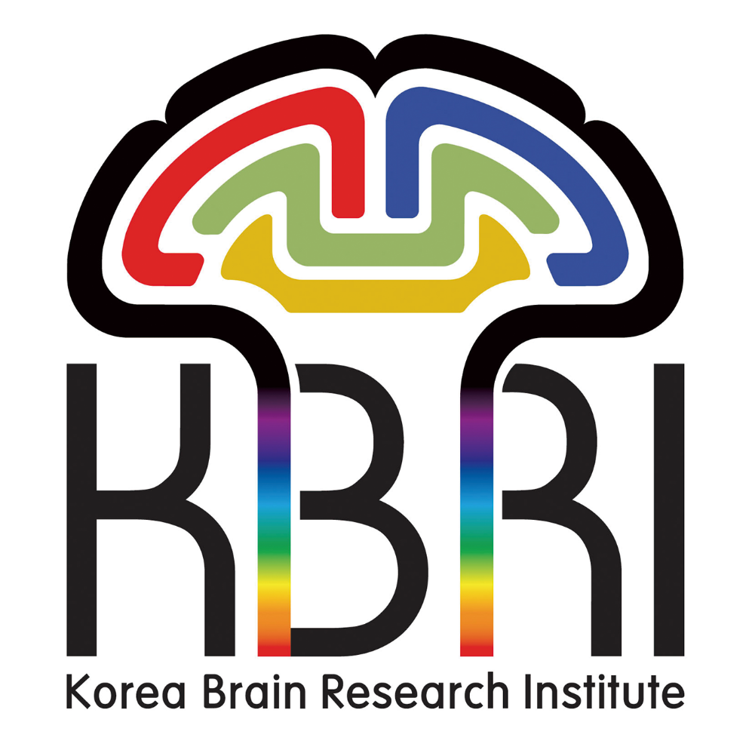
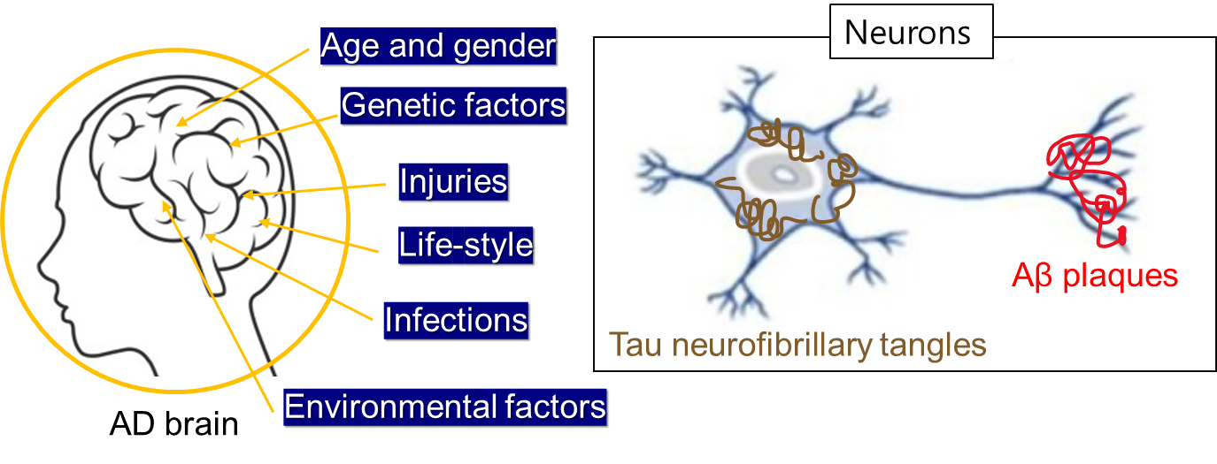
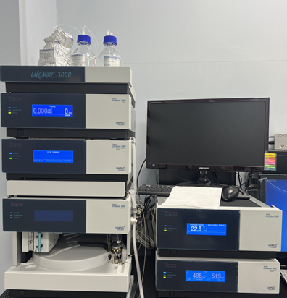
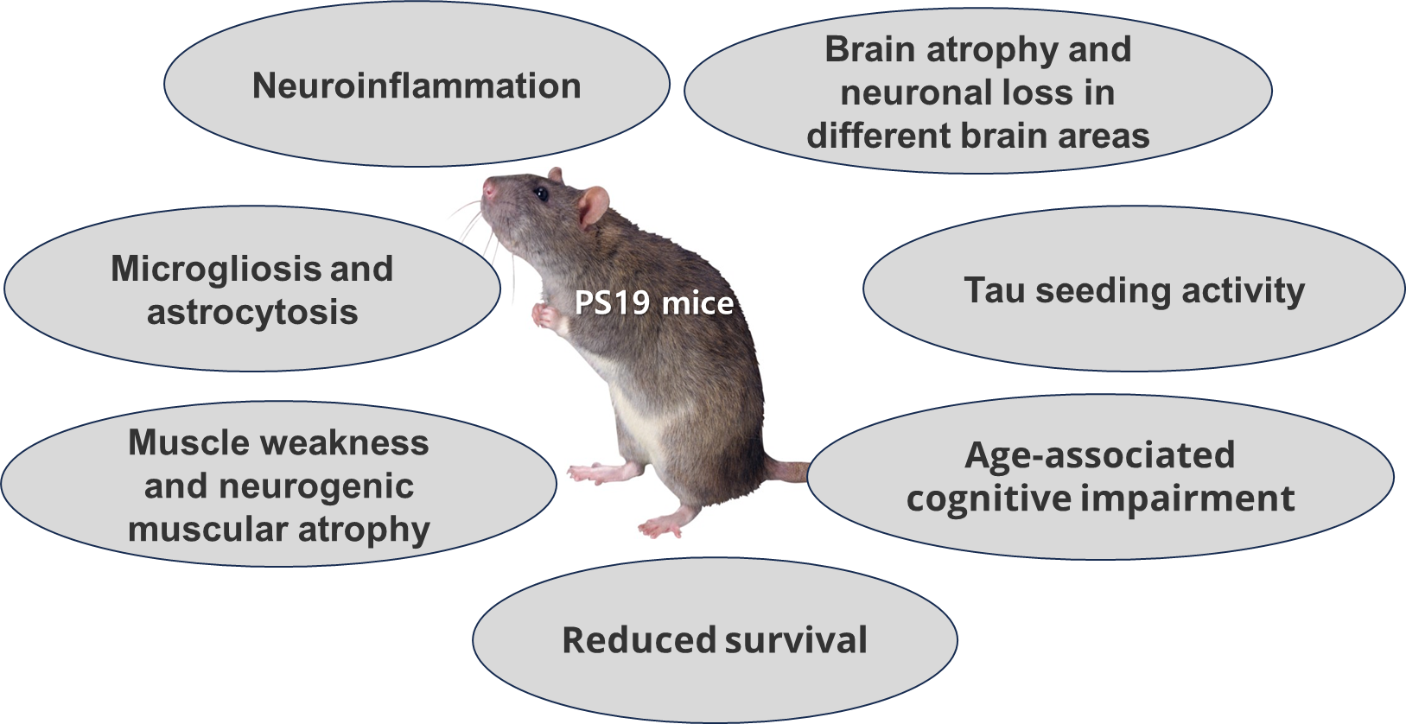
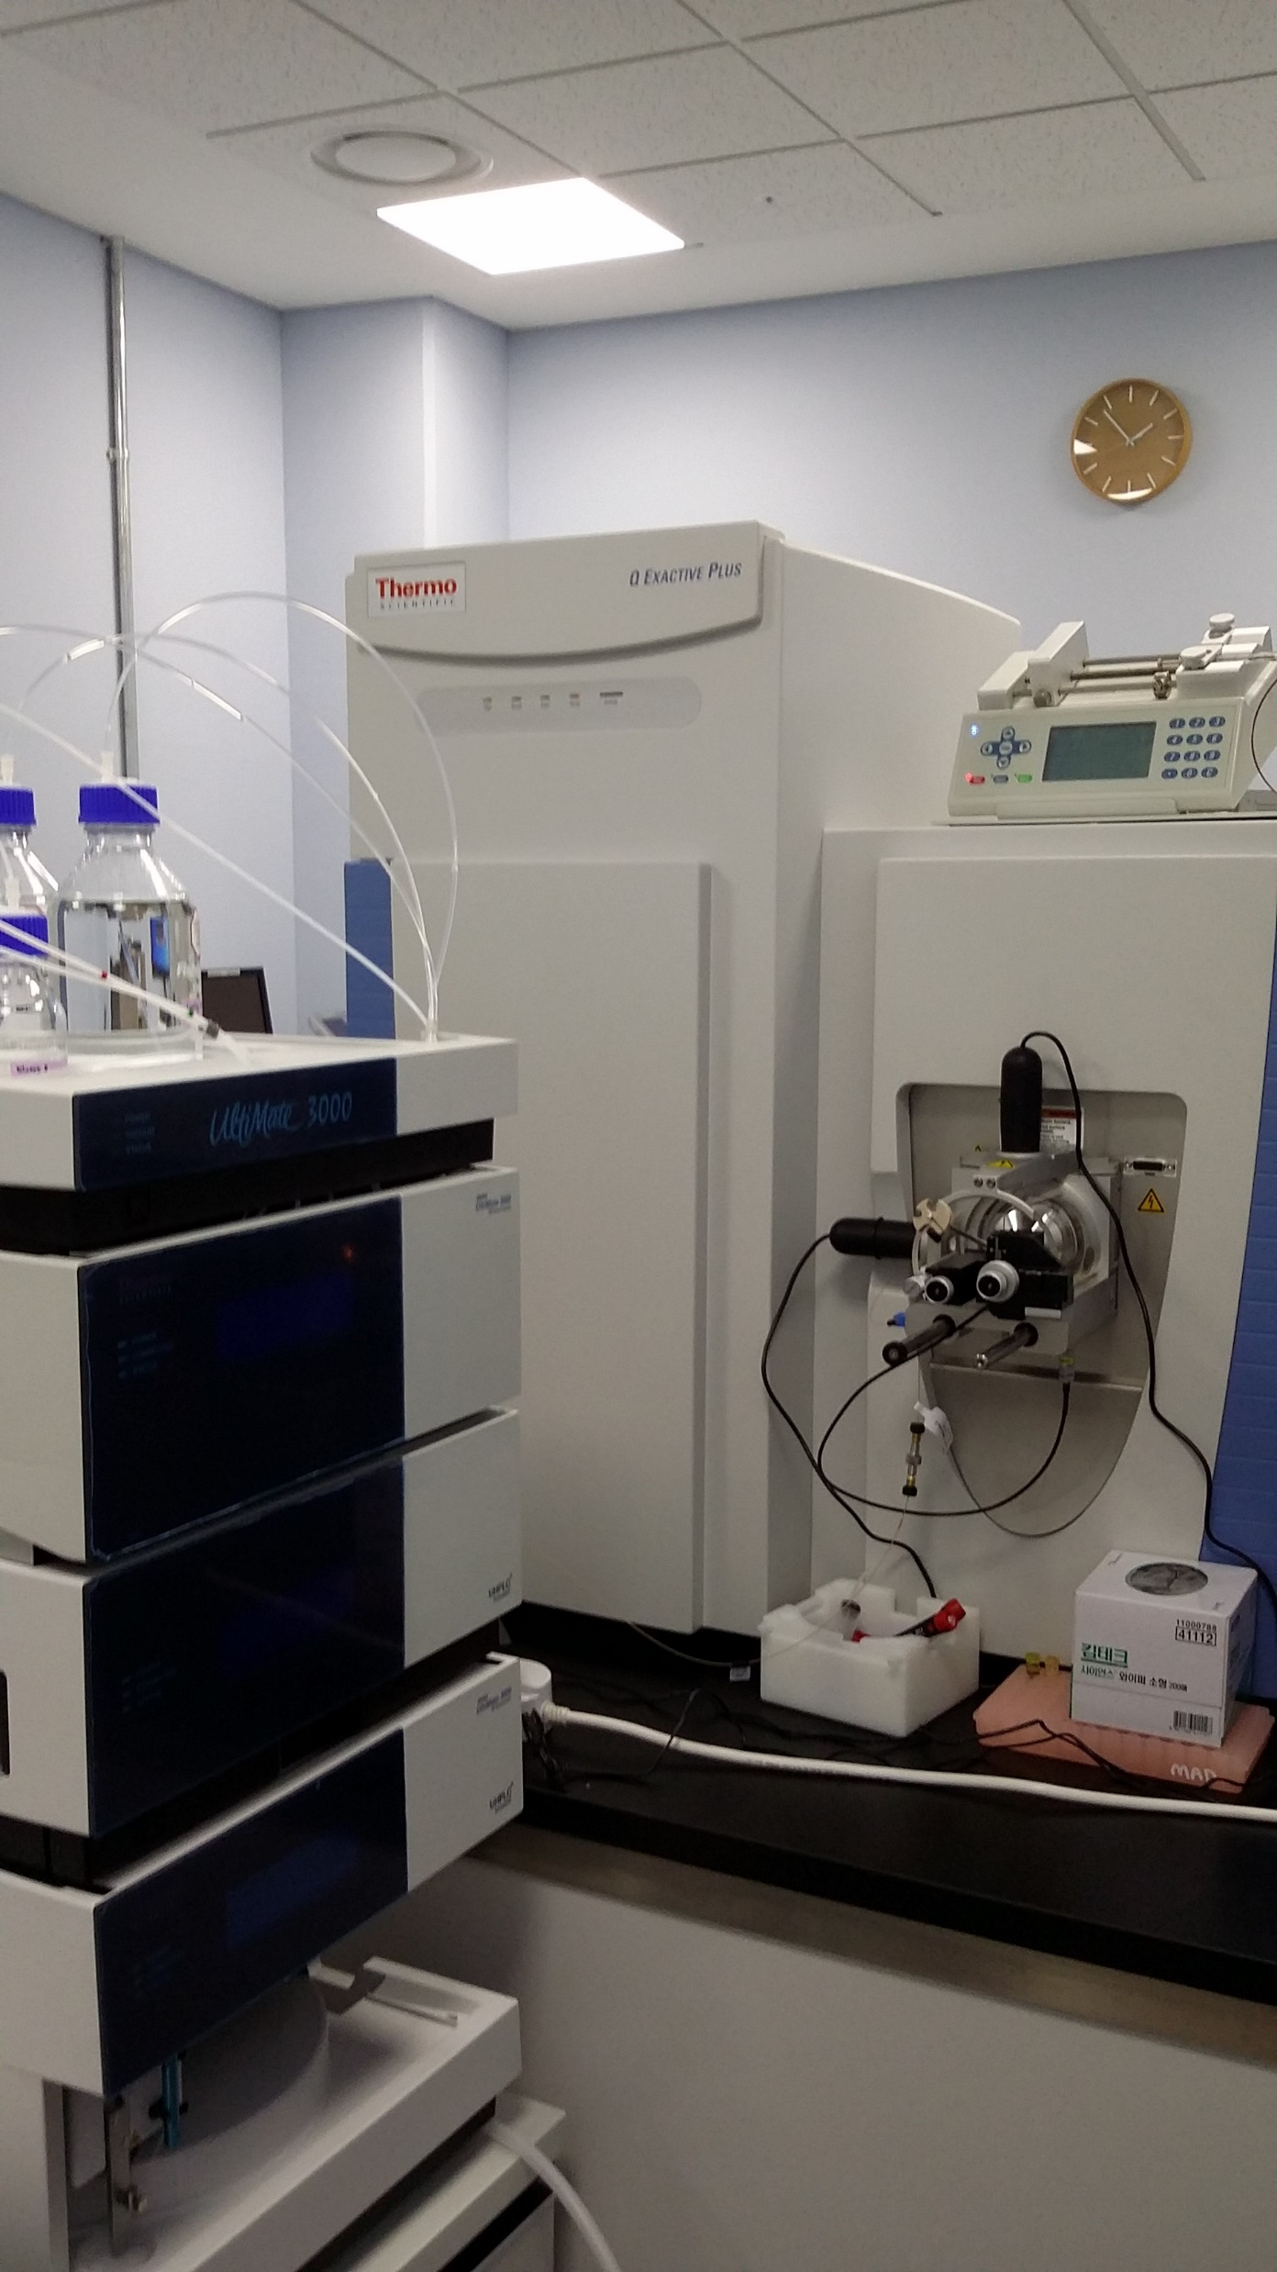
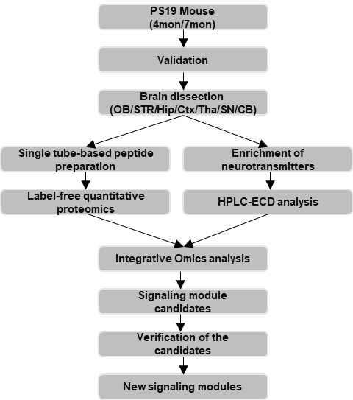
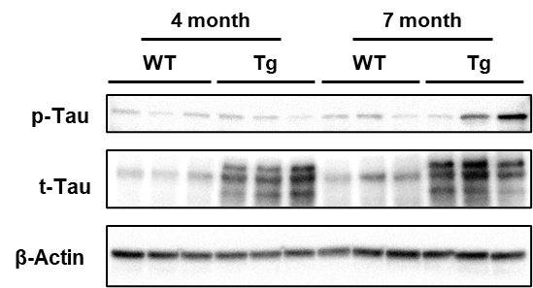
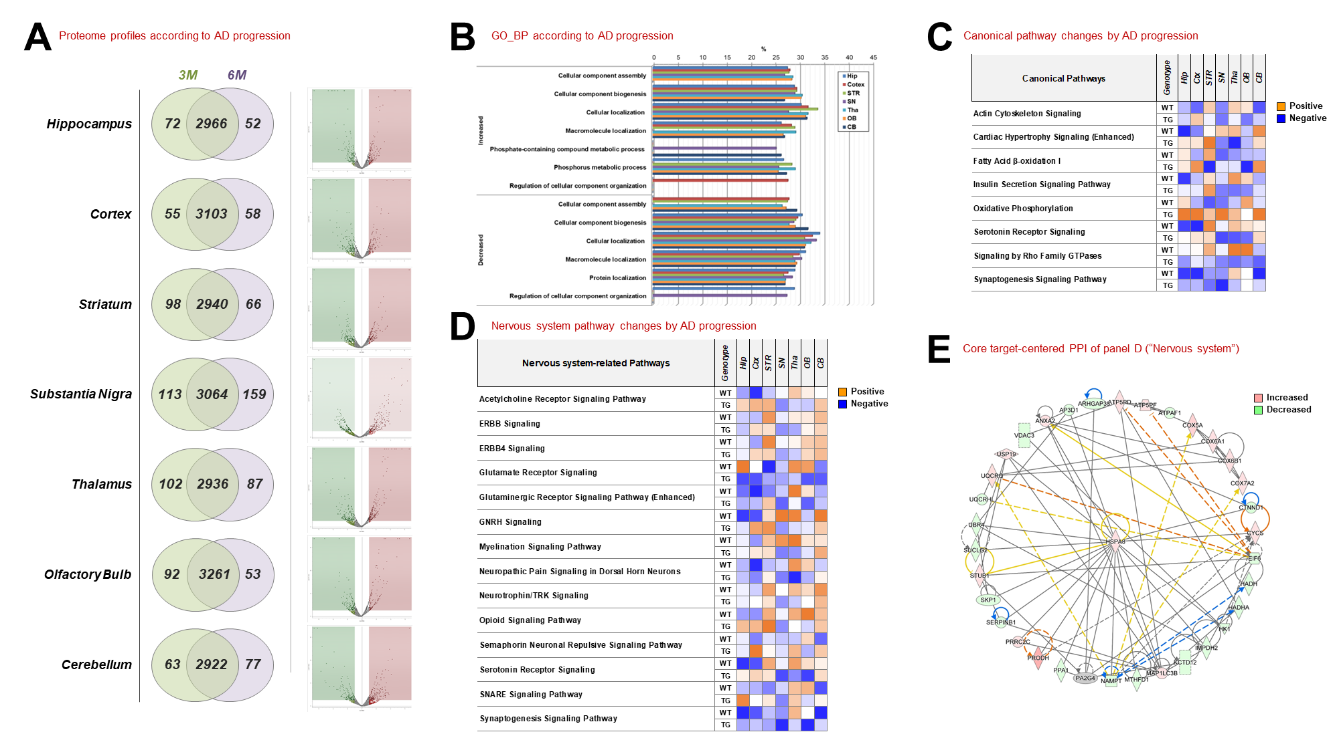
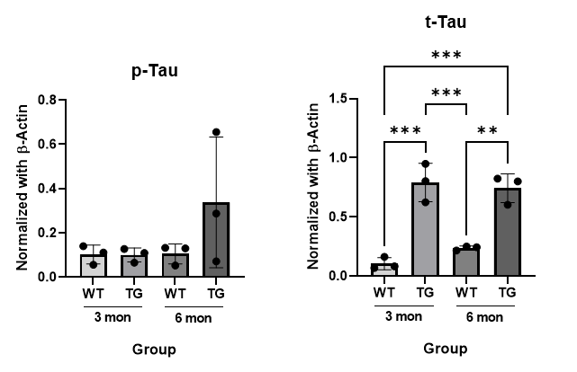
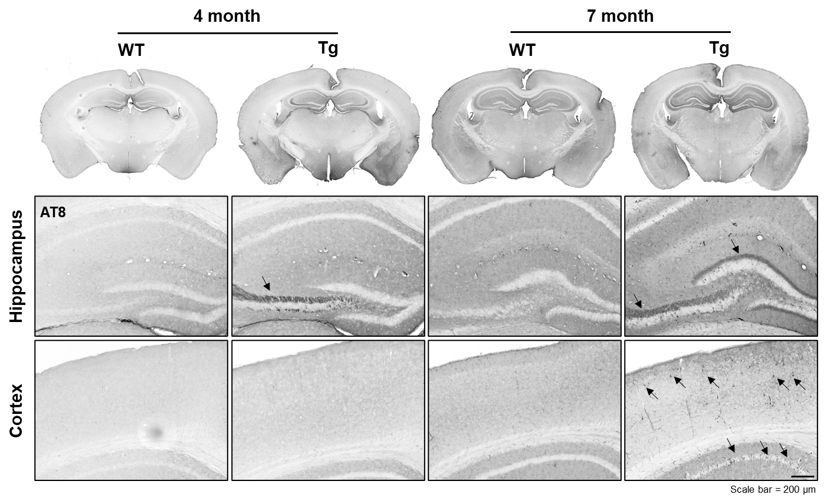
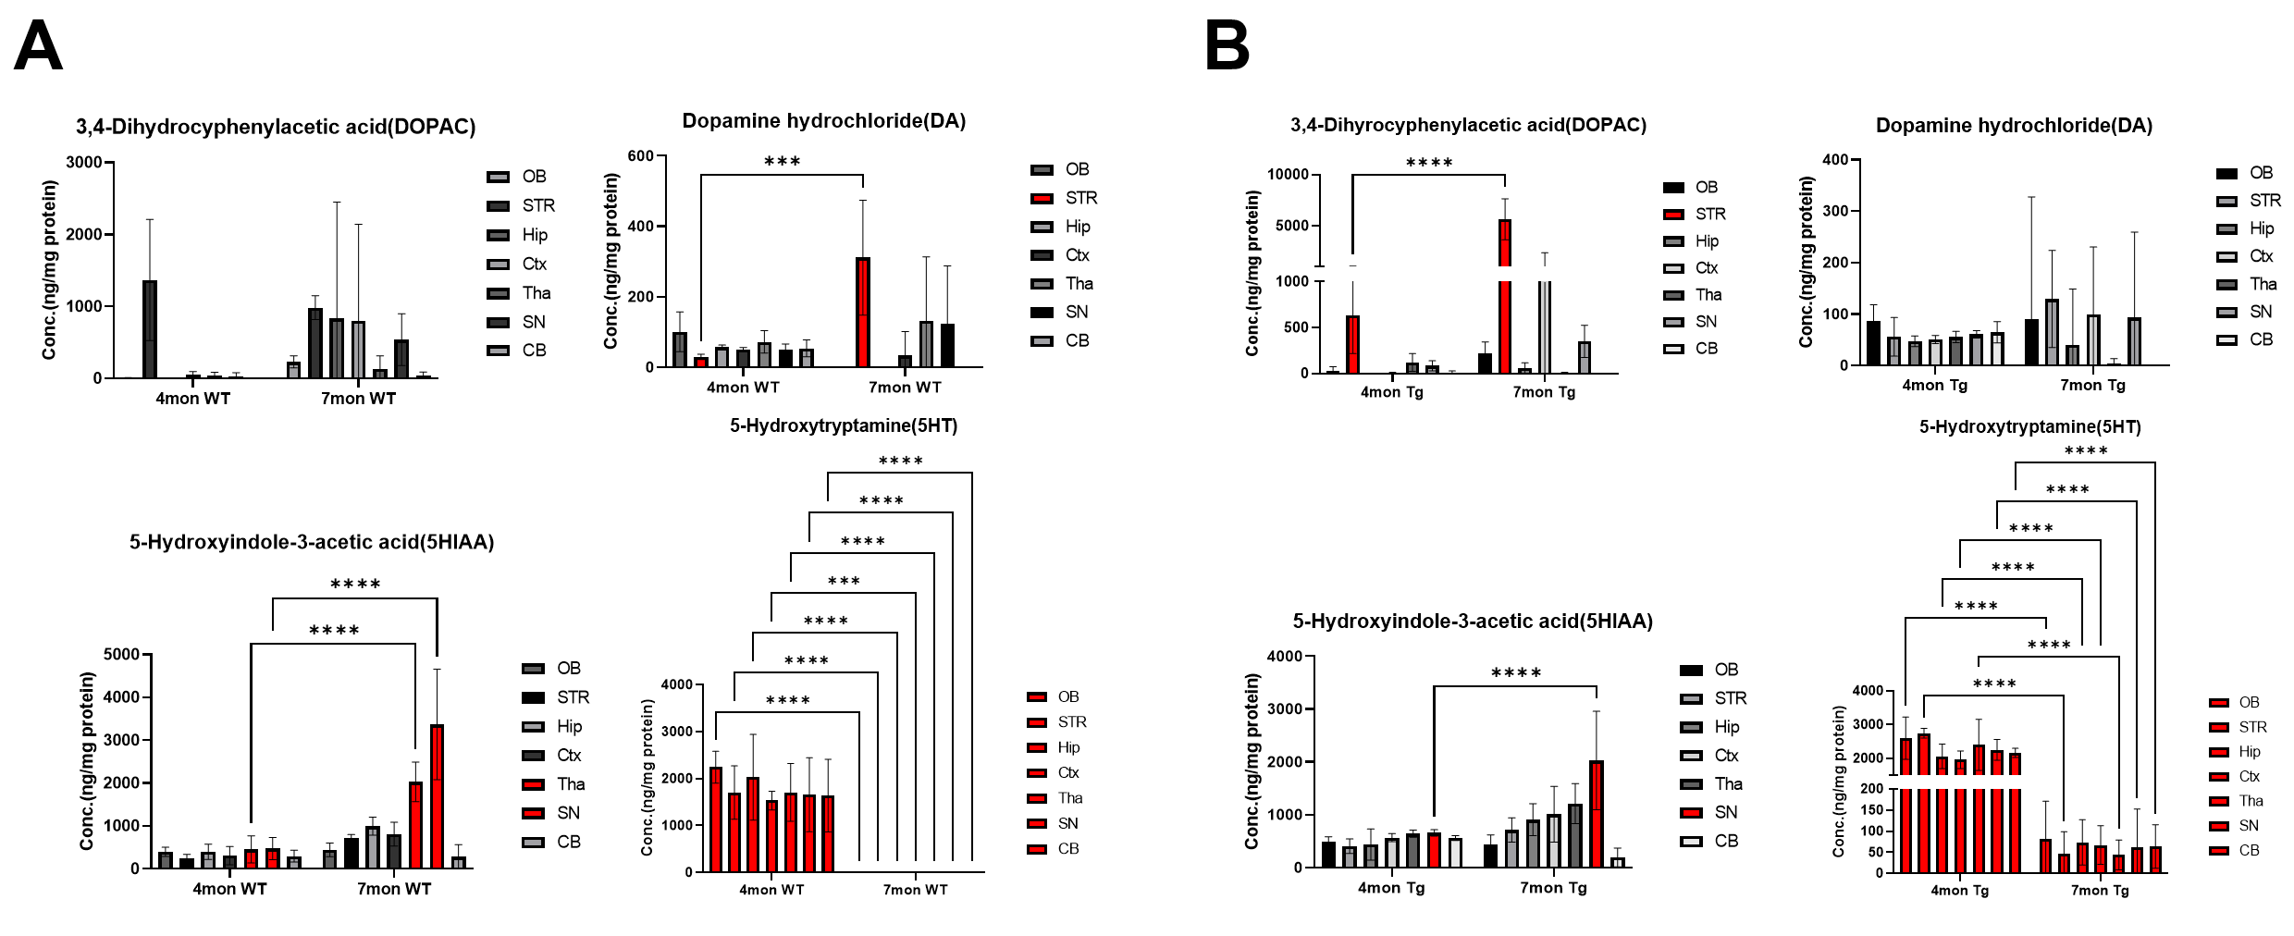
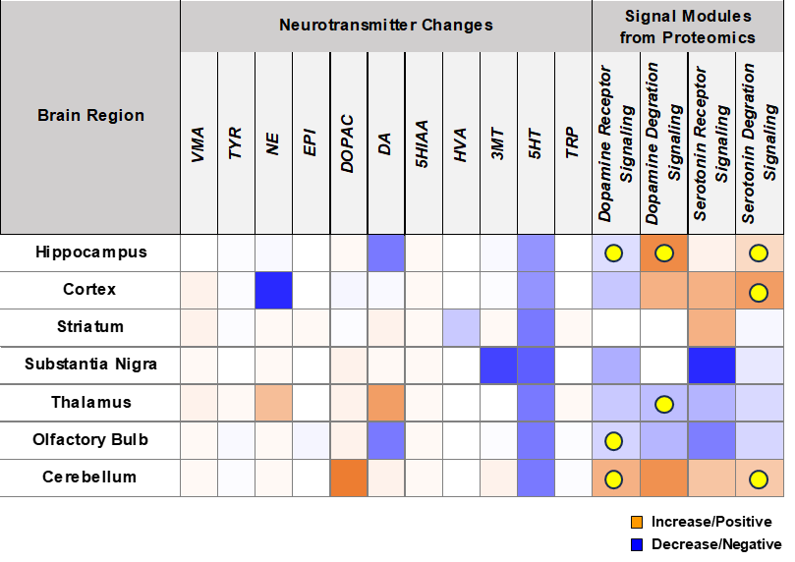
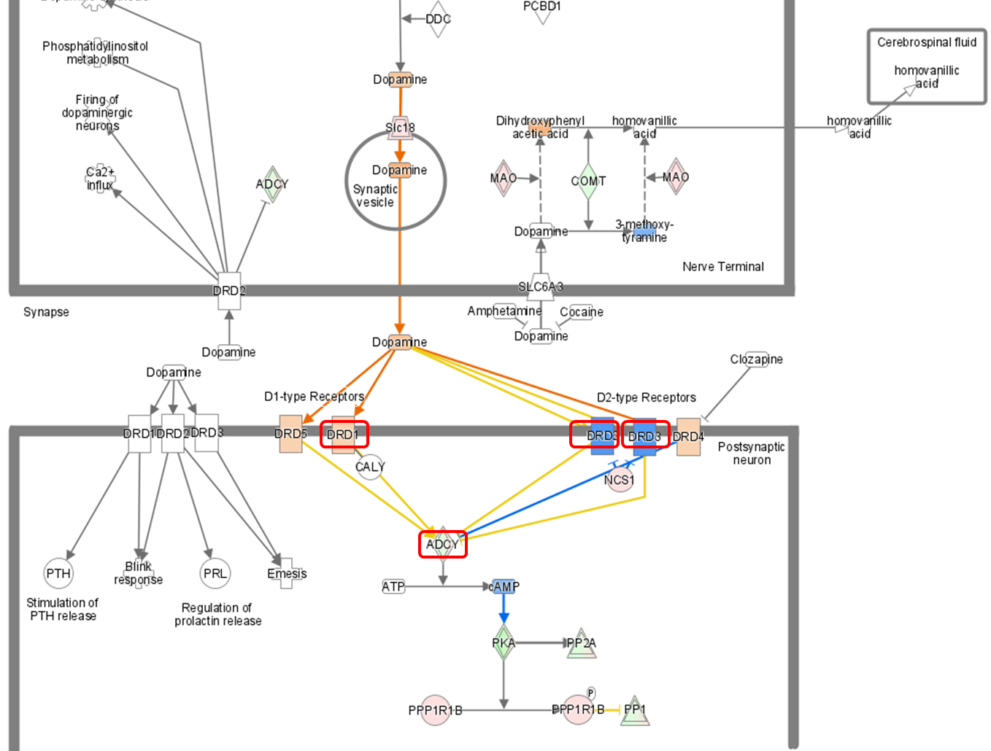
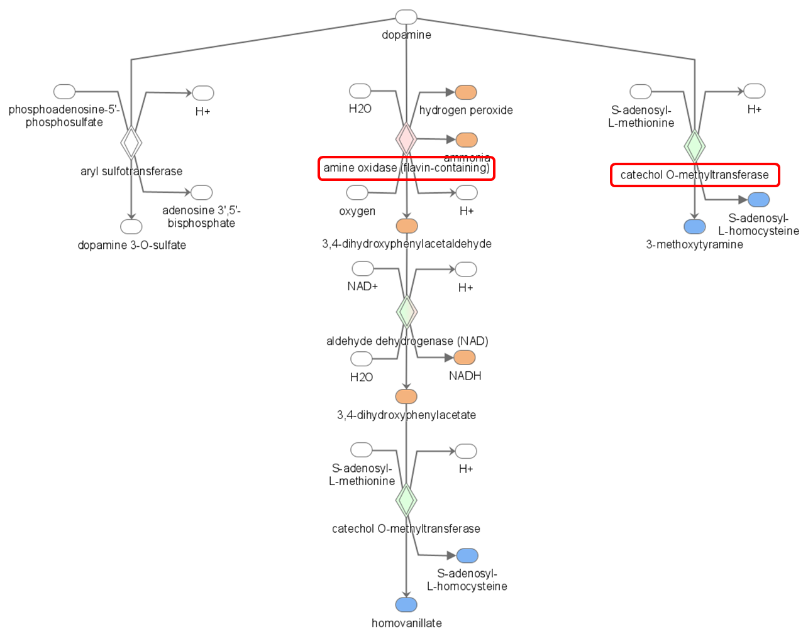
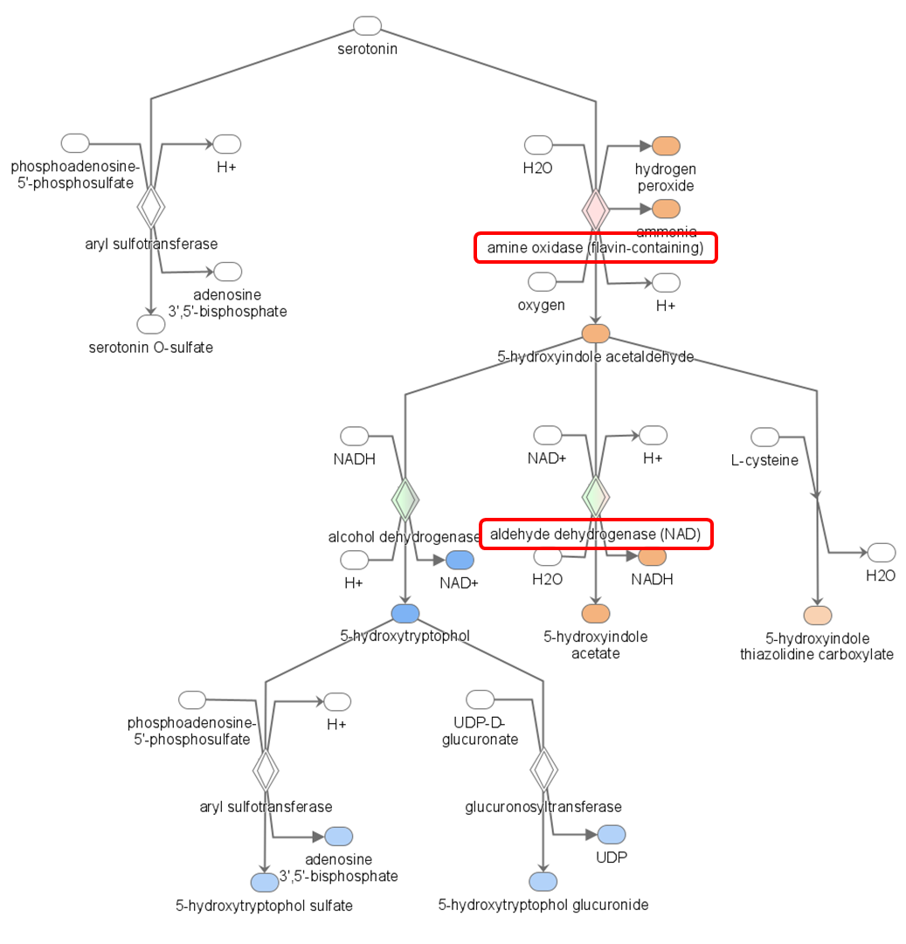
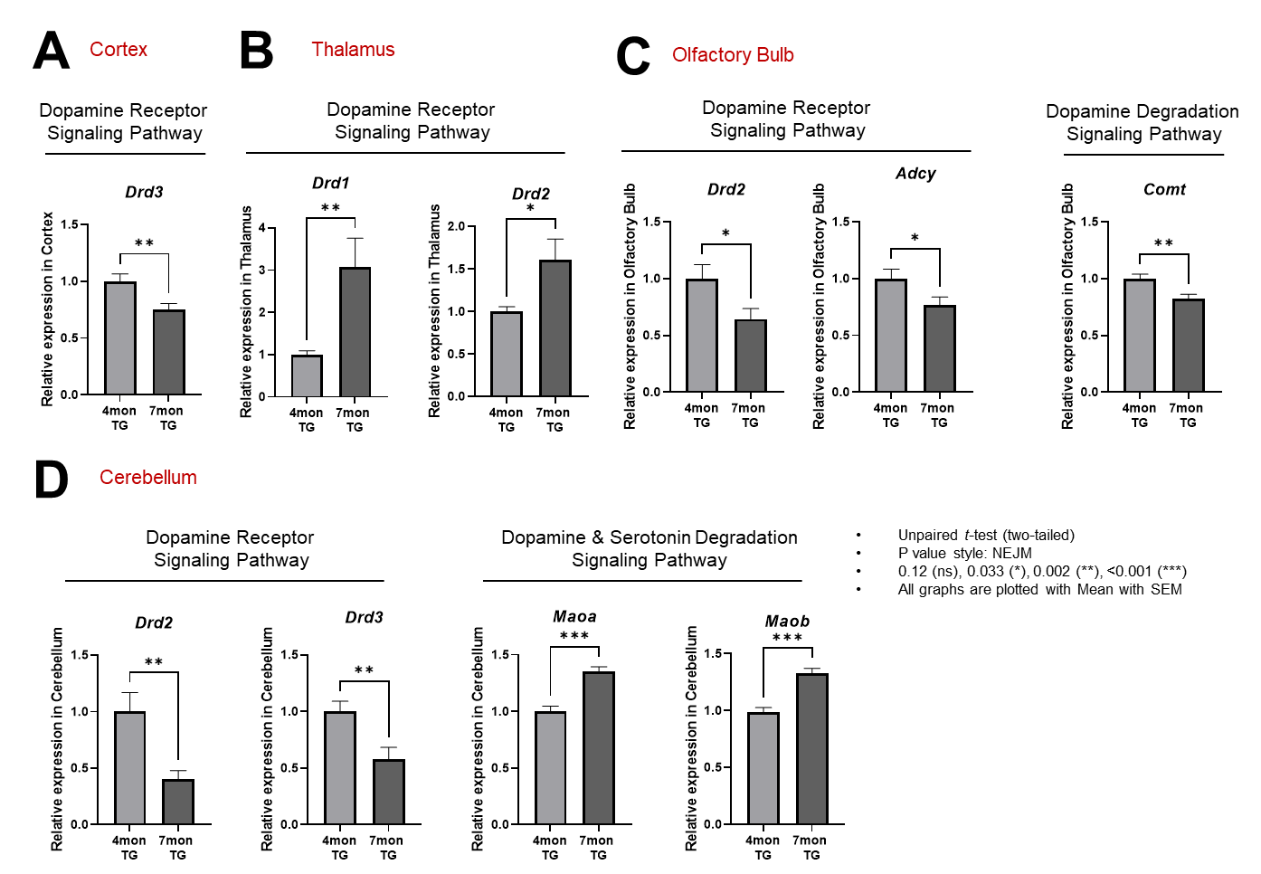
Integrative proteomics approach for AD progression in PS19 model mice reveals new signaling modules
Hagyeong Lee¹, Eunji Cho¹, Seulah Lee¹, Yang Woo Kwon², Dayea Kim² and Jong Hyuk Yoon^{1,★}
¹ Neurodegenerative Diseases Research Group, Korea Brain Research Institute, Daegu, 41062, Republic of Korea
² New Drug Development Center, Daegu-Gyeongbuk Medical Innovation Foundation(K-MEDI hub), Daegu, 41061, Republic of Korea
HPLC-MS :
Abstract
Introduction
Materials & Methods
Alzheimer's disease (AD) is a progressive neurodegenerative disease associated with cognitive, functional, and behavioral impairments. It is characterized by the accumulation of extracellular amyloid-β plaques, and formation of intracellular neurofibrillary tangles by accumulating hyperphosphorylated-tau protein. Changes in neurotransmitter function, such as dopamine, are also significant in AD, leading to impaired neurotransmission. While the association between neurotransmitter alteration and AD pathology is recognized, in-depth profiling about neurotransmitters and their related proteomic changes still needs to be studied. Thus, we conducted a study to profile and integrate proteomes and neurotransmitters using seven brain regions of PS19 (Tau P301S) mice according to AD progression. We found notable changes in canonical pathways, including metabolic abnormalities, depending on the brain regions though proteomic analysis. Additionally, alteration of six neurotransmitters were identified under AD progression via profiling neurotransmitters. By integrating the proteomic and neurotransmitters profiles, we found that several specific neurotransmitter-related signaling modules are AD progression-dependently associated to the neurotransmitter changes, especially in the hippocampus and cerebellum. This integrative approach could offer new signaling modules to help understand AD progression.
Quantitative profiling of Neurotransmitters
12 Neurotransmitter standards: VMA, TYR, NE, EPI, DOPAC, DA, 5HIAA, HVA, 3MT, 5HT, TRP
Standard curve- based quantitation
PS19 mouse : 4month/ 7month - wild type, Hetero type (Tg)
Process : Tissue lysis → Protein assay → Centrifuge & Take sup. → HPLC-ECD analysis
HPLC-ECD
Running condition
System | UltiMate™ 3000 ECD-3000RS (Thermo Scientific)
Column dimension | Hypersil™ BDS C18 column (3 μm, 3 × 150 mm)
Flow rate | 0.5 mL/ min
Eluent composition | Test mobile phase 100%
Injection volume | 10uL
LC runtime | 15min, isocratic
ECD channel | 250mV, 400mV
Proteomics
PS19 mouse : 4month/ 7month - wild type, Hetero type
Process : Tissue → Single tube-based peptide preparation → HPLC-MS analysis
HPLC-MS
Running condition
System | UltiMate™ 3000 Q-exactive plus (Thermo Scientific)
Column dimension | PepMap™ RSLC C18 column (2 μm, 75um × 50 cm)
Flow rate | 0.3 uL/ min
Eluent composition | A: 0.1% Formic acid in water B: 0.1% Formic acid in ACN
Injection volume | 10uL (+)
LC runtime | 135min, gradient
MS condition | MS/MS
Results
1. Research Scheme & experimental condition
2. Multi-proteomics by regions of PS19 brain according to AD progression
A
B
C
D
3. Quantitative profiling of neurotransmitters by region of PS19 brain according to AD progression
4. Integrative proteomics analysis identifying new signaling modules of AD progression
Wild type
PS19
5. Validation of the discovered signaling modules using Q-PCR
Conclusions
We performed new integrative approach for multi-proteomics and quantitative profile of neurotransmitters according to seven brain regions of PS19 mice.
We found significantly altered canonical pathways in the brain regions in proteomic analysis, including metabolic abnormalities.
We found that six neurotransmitters, including dopamine, serotonin, homovanillic acid, norepinephrine,
3-methoxytyramine, and 3,4-dihydroxyphenylacetic acid, were significantly changed under AD progression.
By integrative approach, we found that AD progression-dependent dopamine- and serotonin-related signaling modules are closely related to the neurotransmitter changes, especially in the hippocampus and cerebellum.
This approach could provide new signaling modules to help understand AD progression.
Reference
Ano, Y., Takaichi, Y., Ohya, R., Uchida, K., Nakayama, H., & Takashima, A. (2023). Tryptophan-tyrosine dipeptide improves tau-related symptoms in tauopathy mice. Nutritional Neuroscience, 26(8), 766-777.
Helmschrodt, C., Becker, S., Perl, S., Schulz, A., & Richter, A. (2020). Development of a fast liquid chromatography-tandem mass spectrometry method for simultaneous quantification of neurotransmitters in murine microdialysate. Analytical and bioanalytical chemistry, 412, 7777-7787.
Acknowledgement
This research was supported by KBRI basic research program through Korea Brain Research Institute funded by Ministry of Science and ICT(24-BR-02-03, 24-BR-04-02, 24-BR-03-12).

