Slide 1



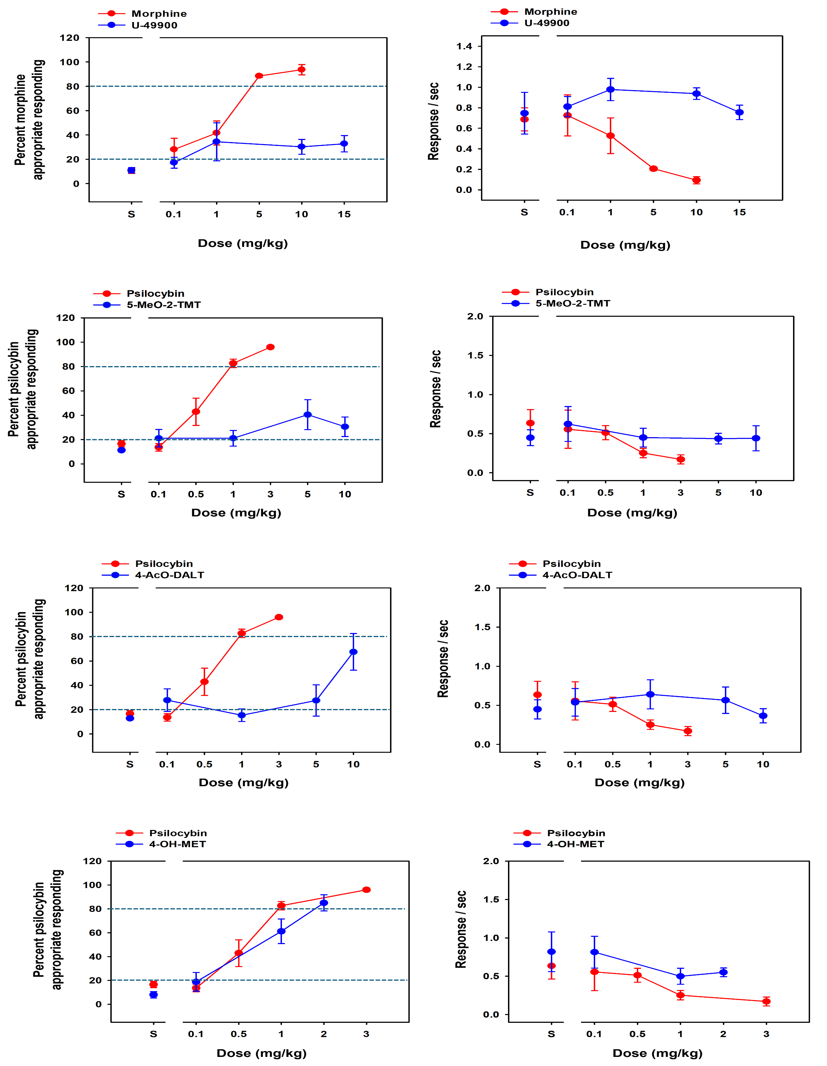
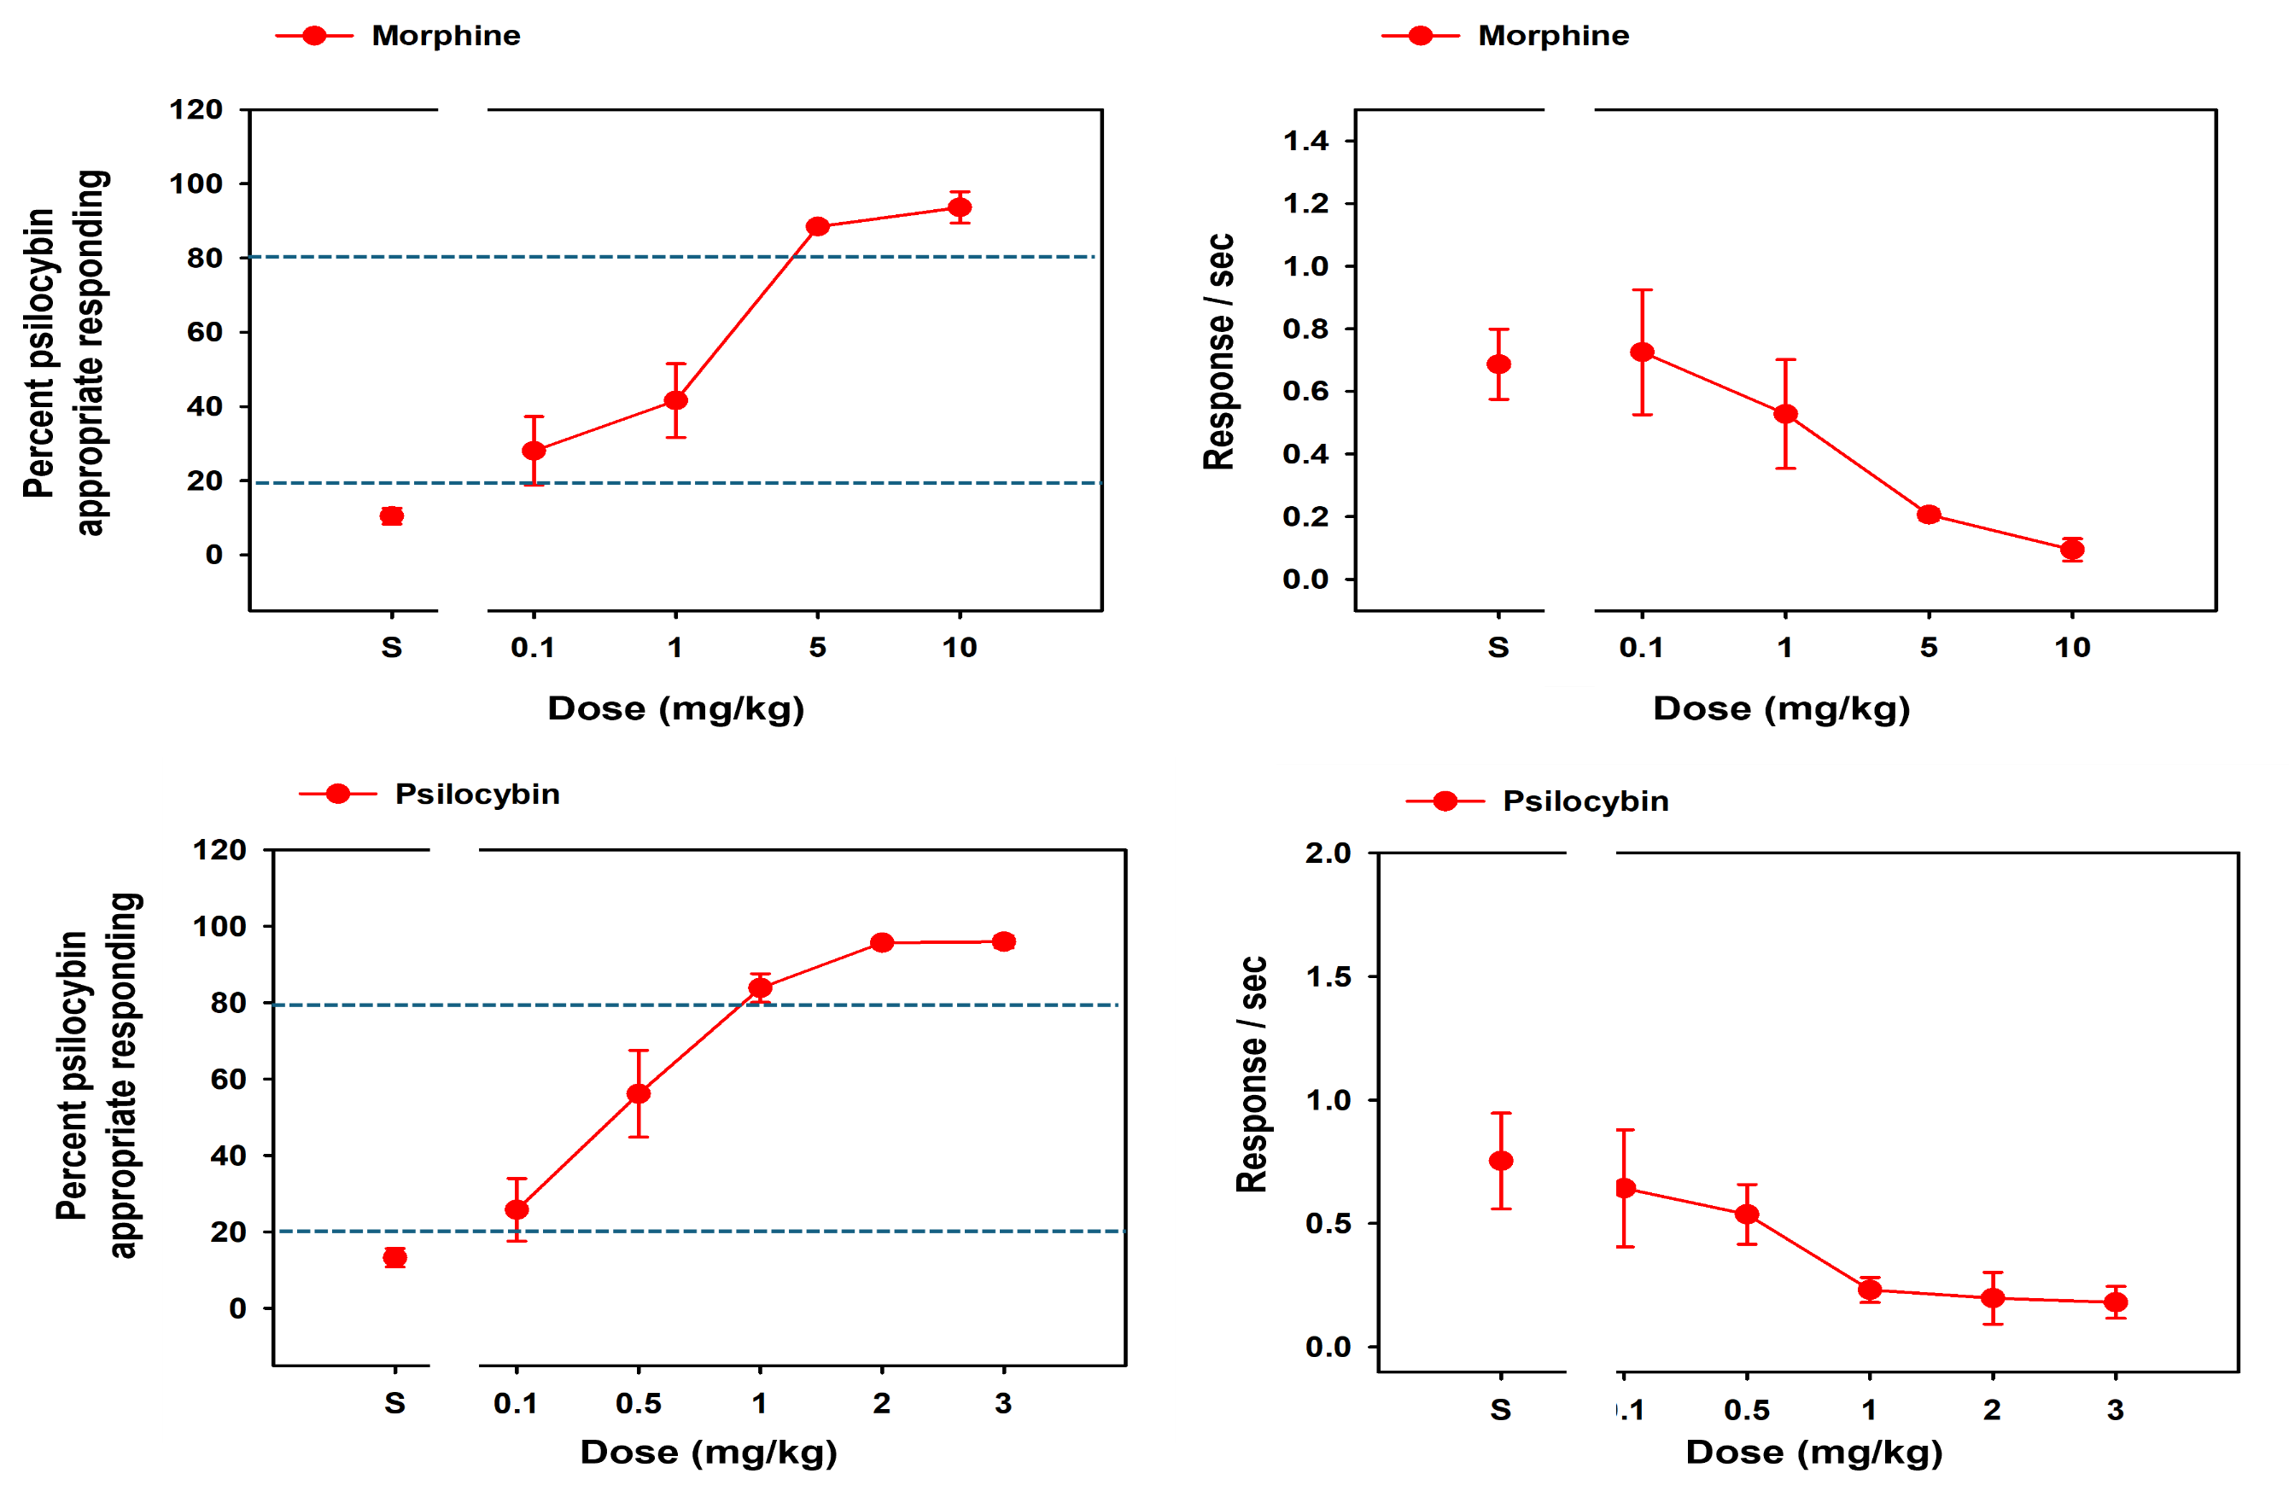


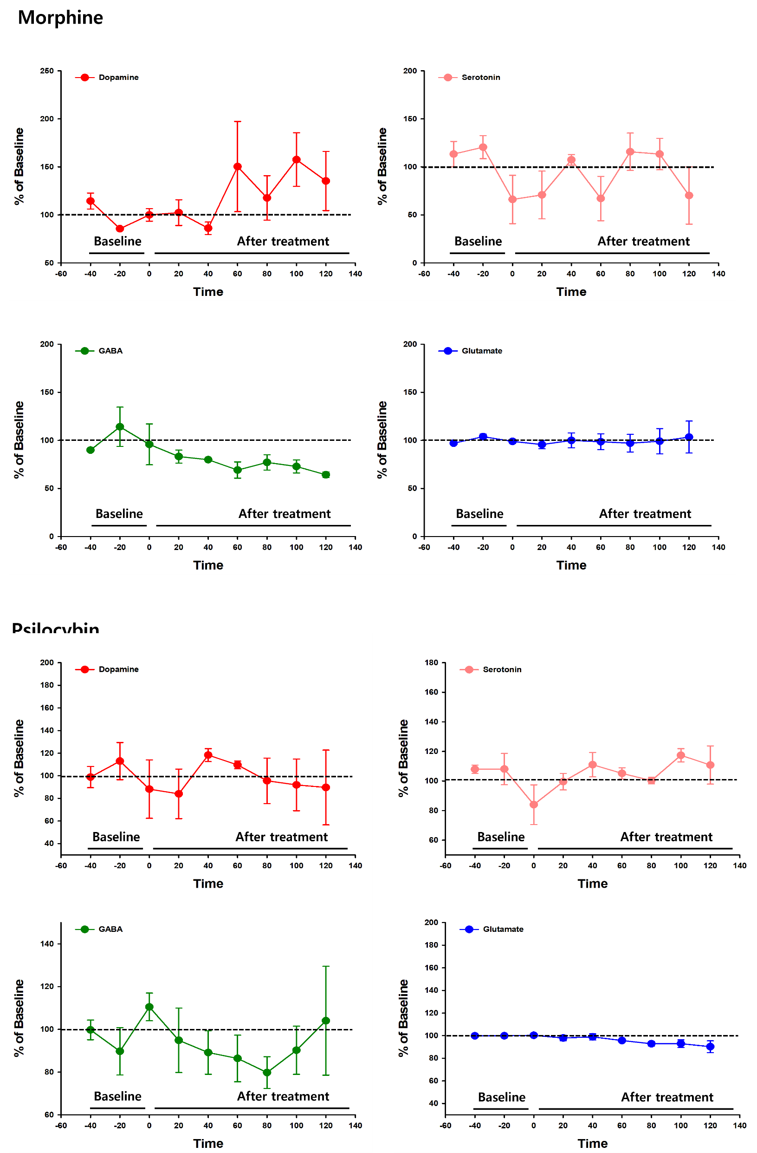
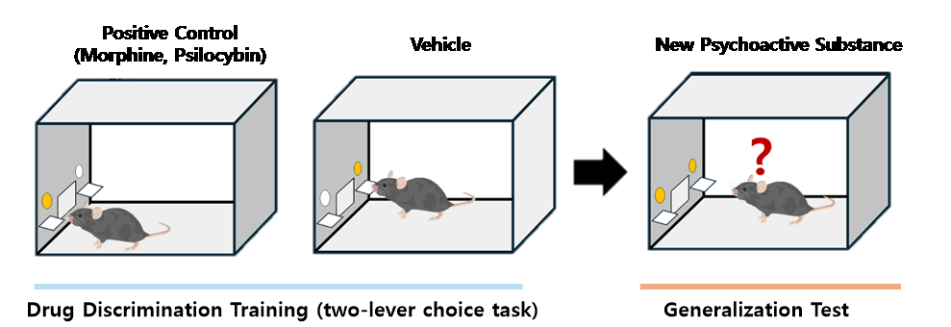
Discriminative Stimulus Properties of New psychoactive substances in Mice
Su min Kang^{1,2,#}, Min Jin Oh^{1,3}, Sejin Jeong^{1,4}, Suchan Chang¹, Ja Wook Koo^{1,3,*}
¹Emotion, Cognition and Behavior Research Group, Korea Brain Research Institute, Daegu 41062, South Korea
^{2.} KNU Alzheimer’s Disease Research Institute, Department of Physiology, School of Medicine, Kyungpook National University, Daegu, South Korea
^{3.} Department of Brain and Cognitive Sciences, Daegu-Gyeongbuk Institute of Science and Technology (DGIST), Daegu, 42988, Republic of Korea
4. Departemet of Life Science, Yeungnam University, Gyeongsan 38541, Republic of Korea
* Corresponding Author: jawook.koo@kbri.re.kr
Introduction
Results
Discriminative stimulus effects of NPS
New psychoactive substances (NPS), also referred to as designer or synthetic drugs, pose significant challenges to drug consumers, clinicians, researchers, and policymakers globally. The rapid emergence of NPS on the global drugs market highlights concerns regarding their chemical composition, metabolic profile, and associated health risks. It is increasingly important to assess the addictiveness of NPS and analyze their properties. Drug discrimination studies can offer valuable insights into the subjective effects and abuse potential of NPS by training animals to discriminate between NPS and control substances. Additionally, the microdialysis technique enables the sampling and collecting of small-molecular-weight substances from the targeted brain region. Through this method, researchers can evaluate whether NPS produces subjective effects similar to those of known addictive drugs.
Discriminative stimulus effects of Positive control substance
A
A
B
Material & Method
B
Morphine is a potent opiate that is naturally derived from the opium poppy. It plays an important role in modern medicine, particularly in the management of acute and chronic severe pain. It is commonly used after surgery, in cancer treatment, and for trauma patients.
Psilocybin is a psychedelic compound found in certain mushrooms. It plays a significant role in the treatment of mental health conditions such as addiction, depression, and mood disorders, particularly in terminally ill patients. It is commonly used to alter perception and cognition, providing transformative psychological benefits by potentially reducing anxiety and fear.
C
Figure 1. Results of generalization tests with Positive control substances Morphine and Psilocybin
A: Generalization tests (left) and rate of responding in responses (right) with Morphine
B: Generalization tests (left) and rate of responding in responses (right) with Psilocybin
Analysis of Neurotransmitter release in NAc
Morphine
D
A
Animal : Male C57BL/6 mice (weighing 20-25g)
Figure 3. Results of generalization tests with Positive control substances and NPS
A: Generalization tests with U-49900 for discriminative stimulus effects of morphine.
B: Generalization tests with 5-MeO-2-TMT for discriminative stimulus effects of psilocybin.
C: Generalization tests with 4-AcO-DART for discriminative stimulus effects of psilocybin.
D: Generalization tests with 4-OH-MET for discriminative stimulus effects of psilocybin.
Drug-discrimination
· Food training: Time reduction training, lever adaptation training through fixed ratio training (FR10).
· Drug discrimination training: Training to discriminate between a positive control substance (training substance) and a negative control substance.
· Test session: Assessment of the generalization extent of new psychoactive substances in relation to the positive control substance.
Psilocybin
Discussion
B
In this study, mice reliably discriminated between NPS (New Psychoactive Substances) and vehicle during training and test sessions. Our results show that the NPS-associated lever response rate (%) increased dose-dependently, with morphine eliciting a lever response rate of more than 80% at a concentration of 5 mg/kg, and psilocybin at 1 mg/kg. Four types of temporary NPS showed partially generalized responses at different concentrations. This suggests that these compounds may have subjective effects similar to addictive psychoactive. Microdialysis was conducted to monitor the neurochemical changes in the brain during initial and repeated exposure to the drug. Our present study showed that glutamate, GABA, dopamine, and serotonin are altered following exposure to positive control substances. To confirm the significant difference in neurotransmitter release via drug injection, additional microdialysis experiments will be conducted for the NPS afterward.
Microdialysis is a technique used to sample extracellular fluid in living tissue, allowing the measurement of neurochemicals in real-time. A small probe is implanted into the target brain area, and perfusion fluid is introduced to collect substances from the surrounding space. The collected samples can then be analyzed to assess changes in neurotransmitter levels.
Liquid chromatography-Mass Spectrometry(LC-MS)
- Analysis substance: Dopamine, Serotonin, GABA, Glutamate
- Internal standard: Dopamine-d4, Serotonin-d4, Glutamic acid-d5, γ-Amino butyric Acid-d6
- LC: Waters Acquity UPLC I-class (Waters, USA), Column (Kinetex 1.7μm F5; 100Å, 100 x 2.1 mm, Phenomenex)
- Mass Spectrometer: Xevo TQ-S triple quadrupole MS/MS
Figure 2. Results of microdialysis analysis with Positive control substances Morphine and Psilocybin
A: Analysis of neurotransmitter concentration (Dopamine, Serotonin, GABA, Glutamate) with Morphine
B: Analysis of neurotransmitter concentration (Dopamine, Serotonin, GABA, Glutamate) with Psilocybin
Acknowledgement
This research was supported by a grant from Ministry of Food and Drug Safety (MFSD) (24212MFDS223).

