Slide 1


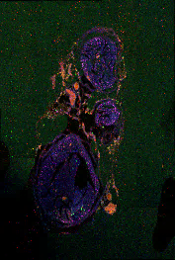
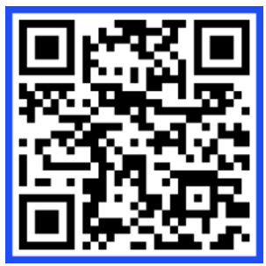
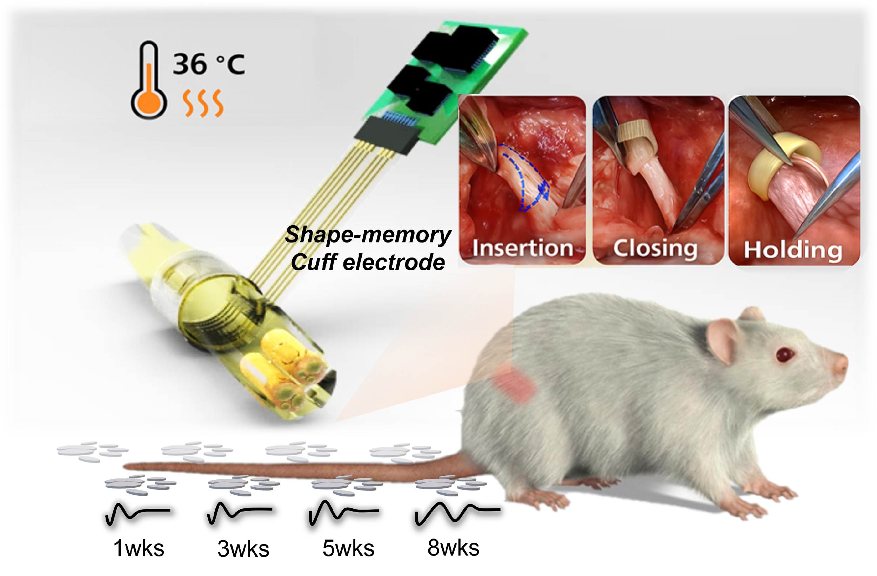
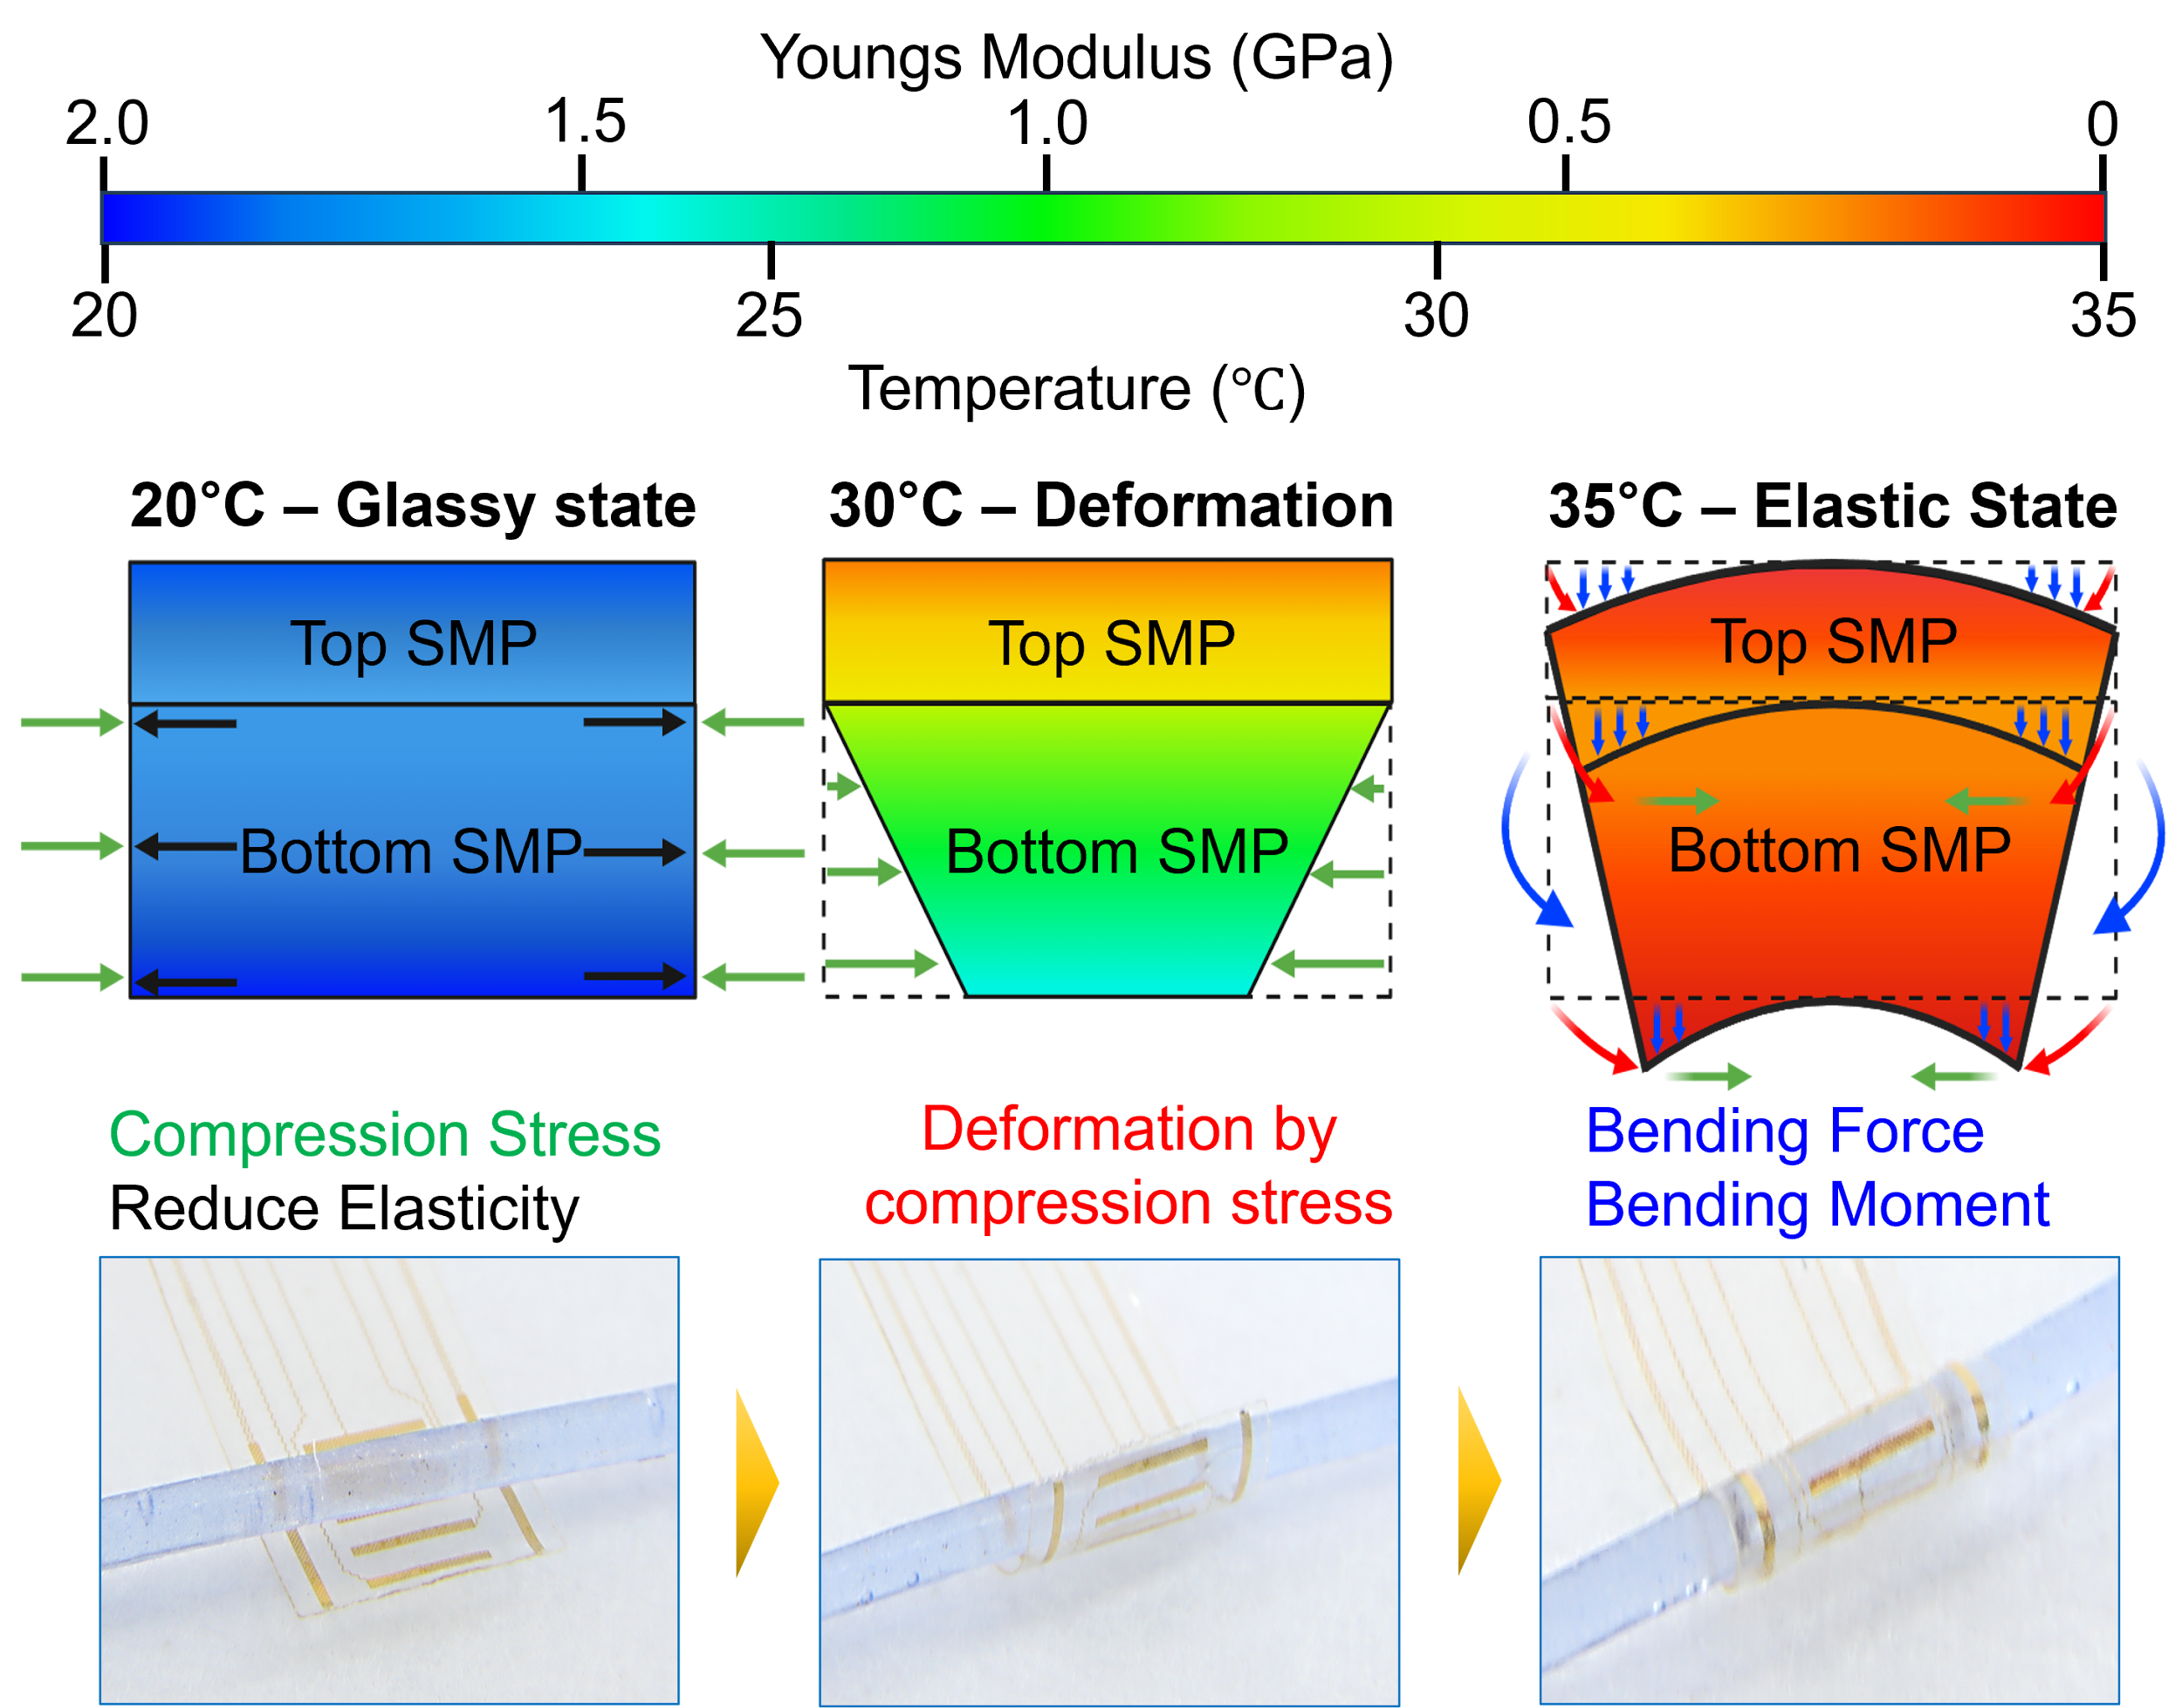
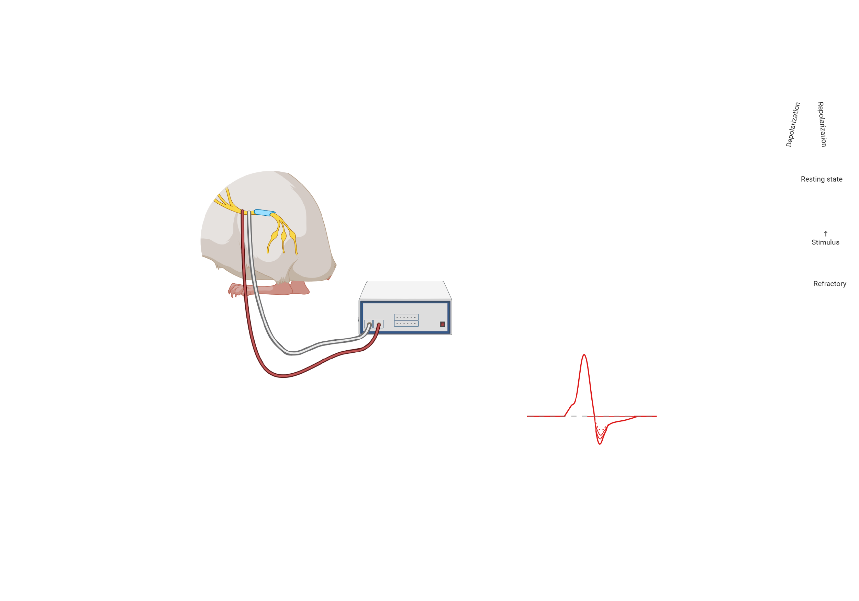
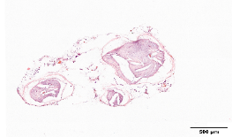
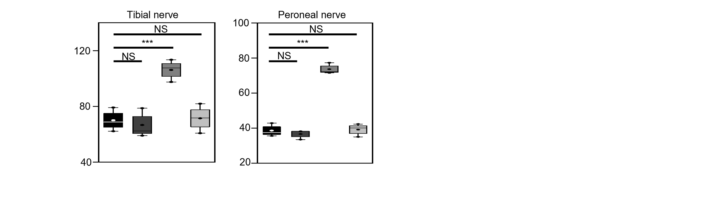
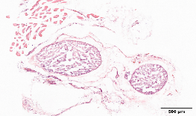
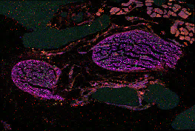
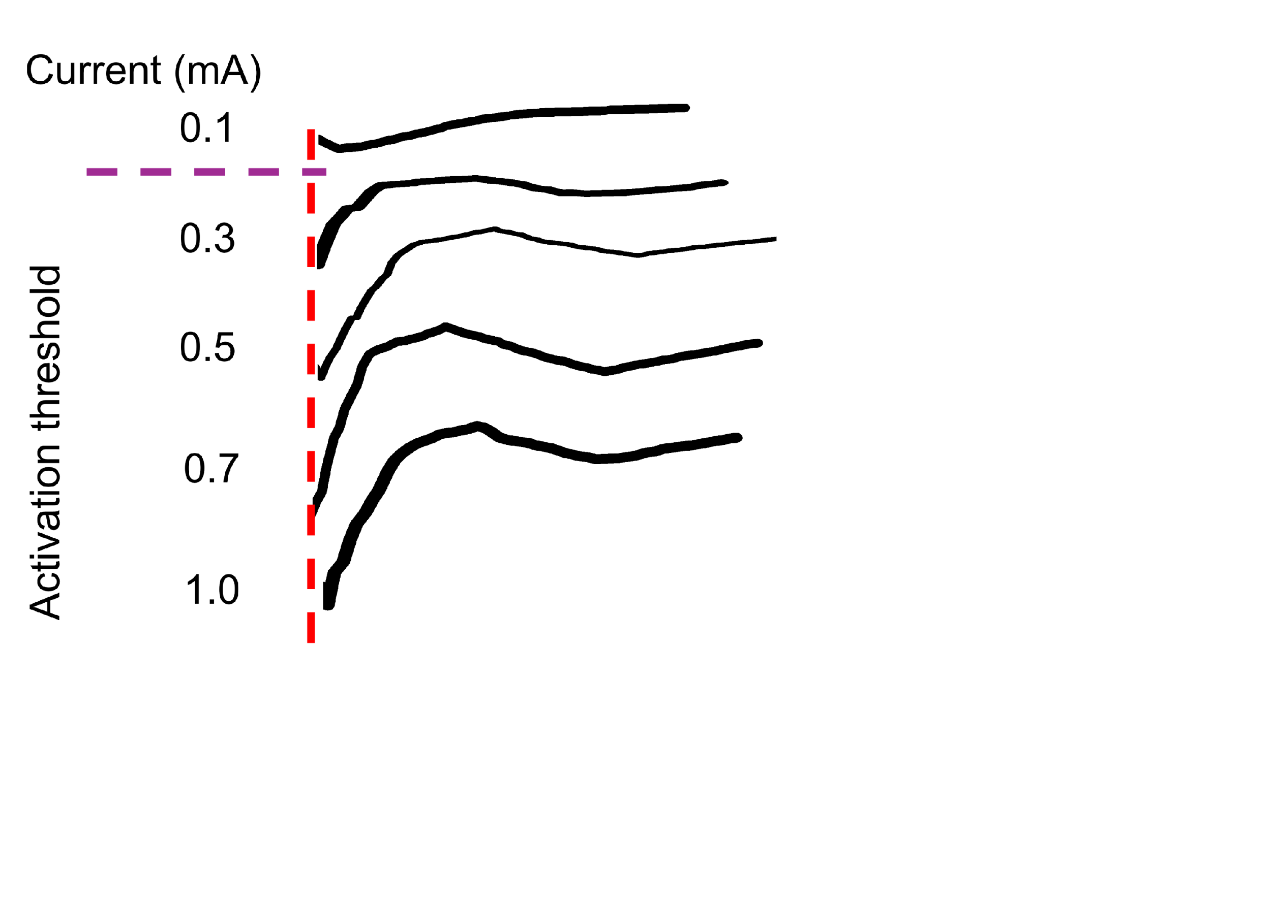
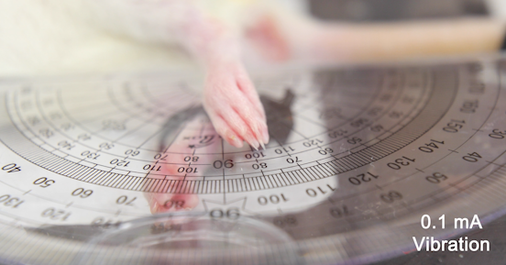
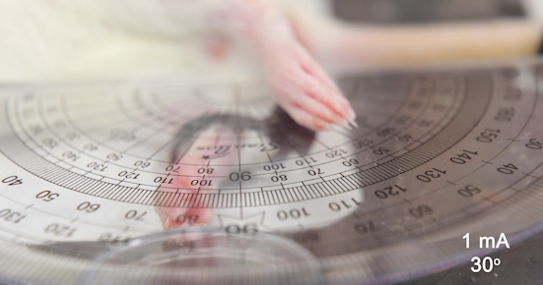
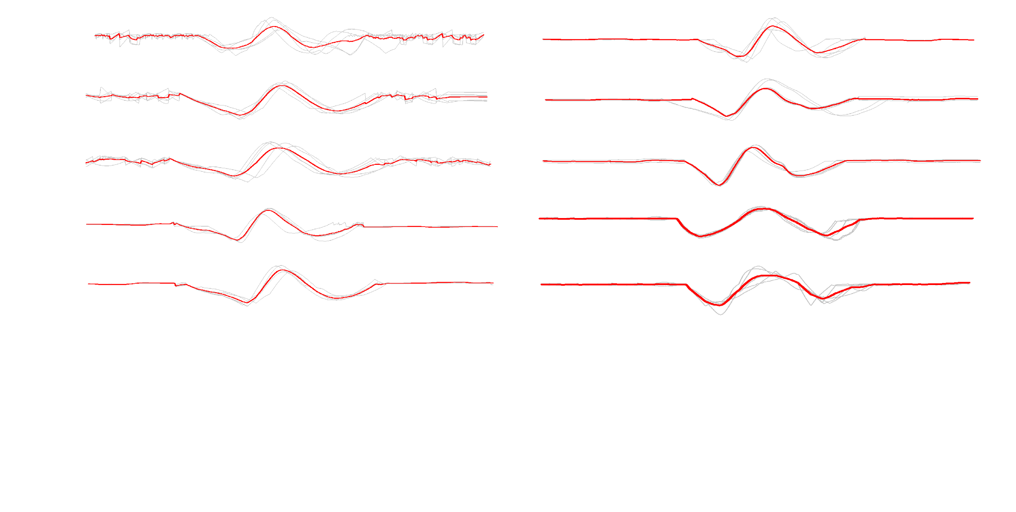
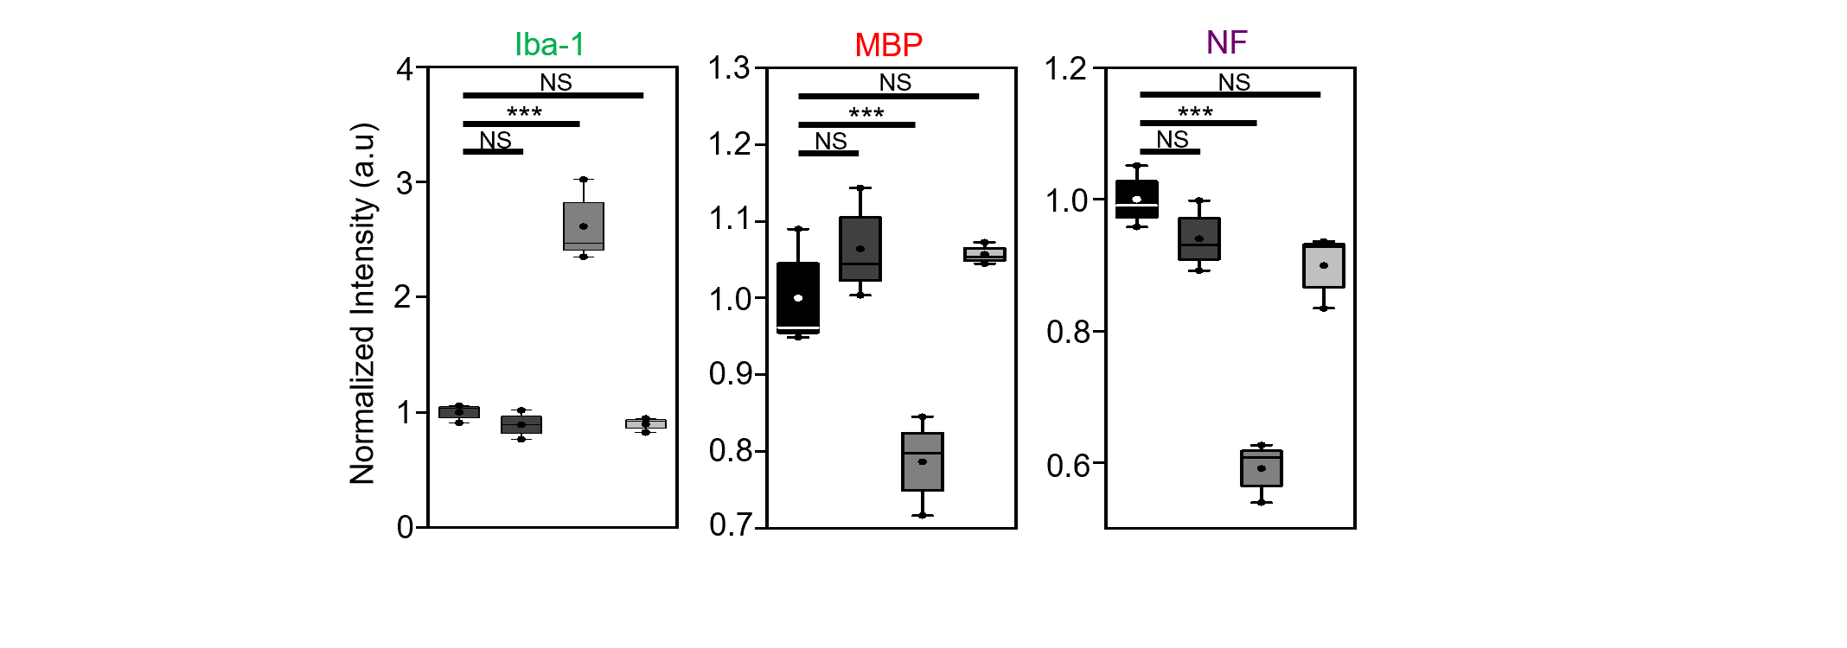
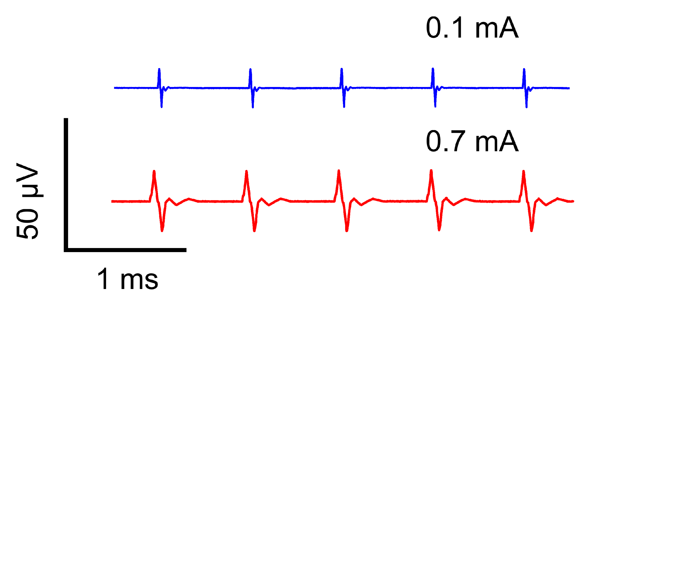
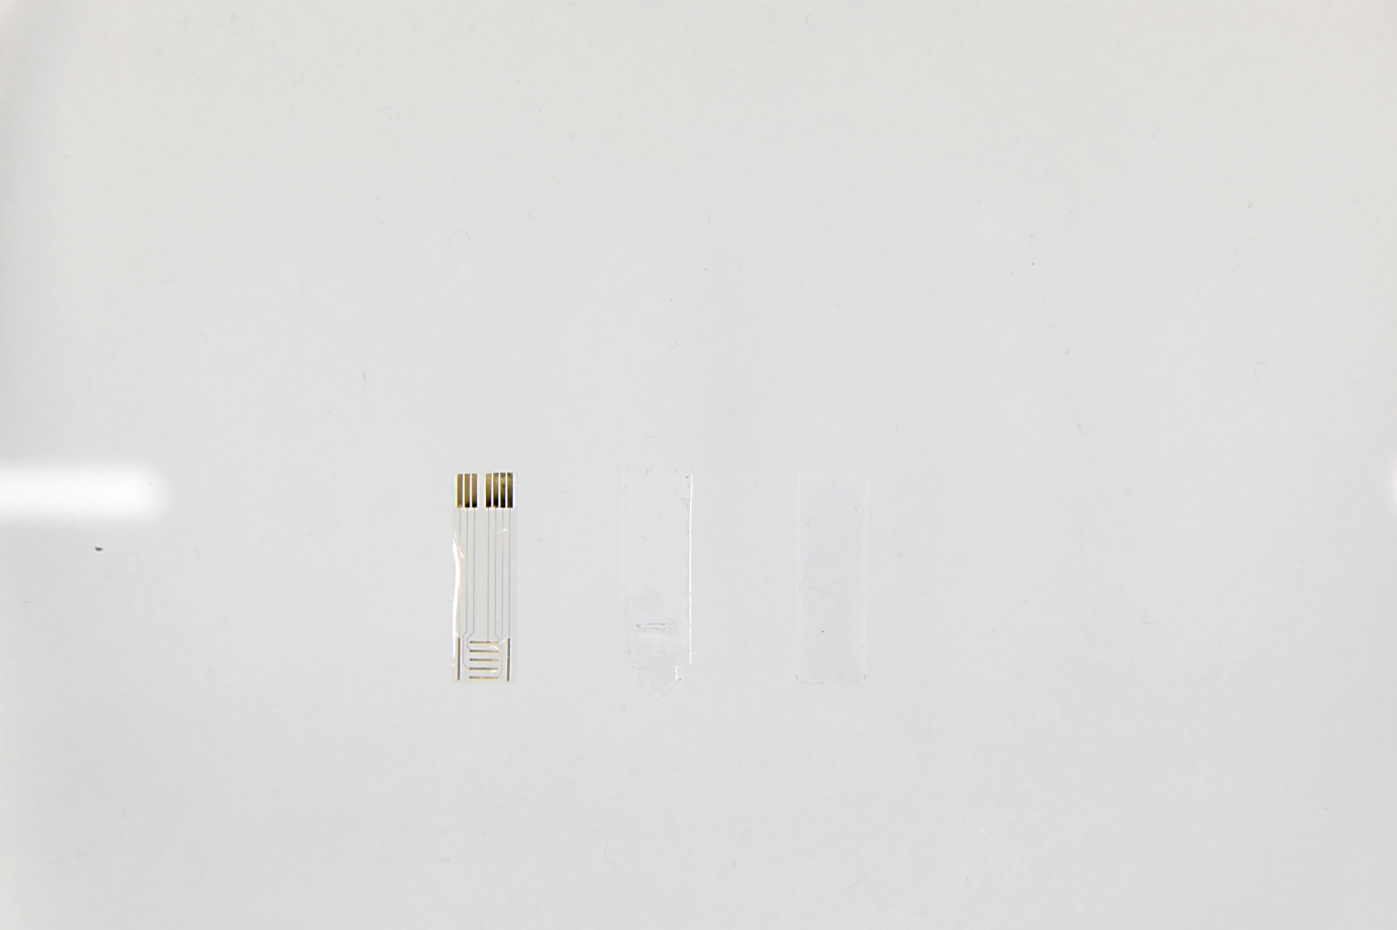
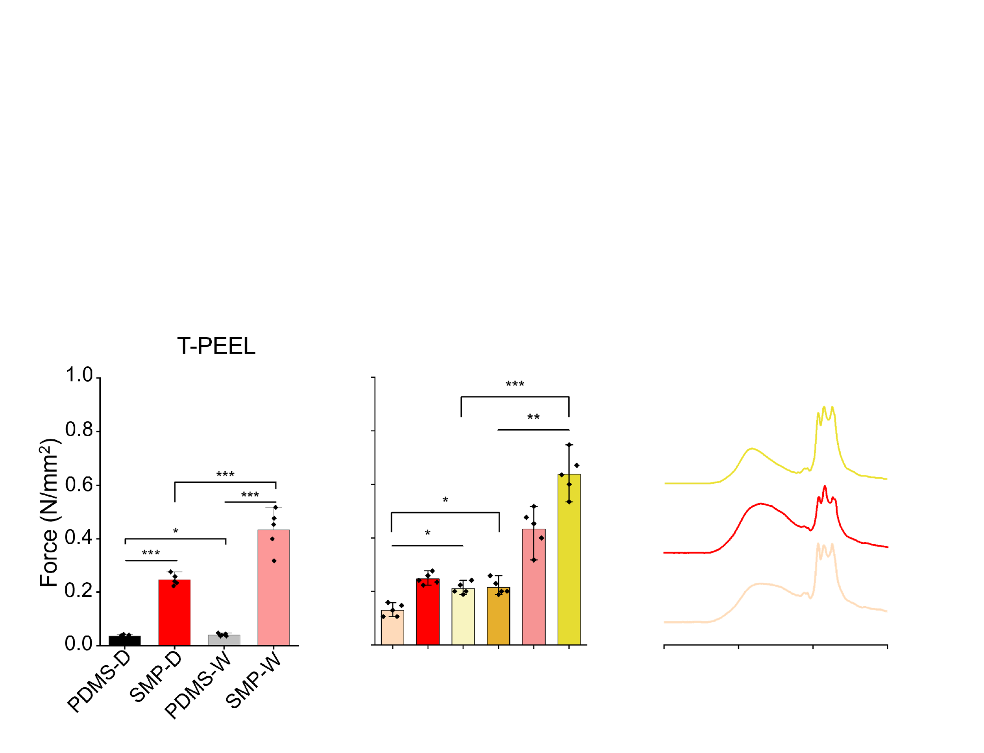
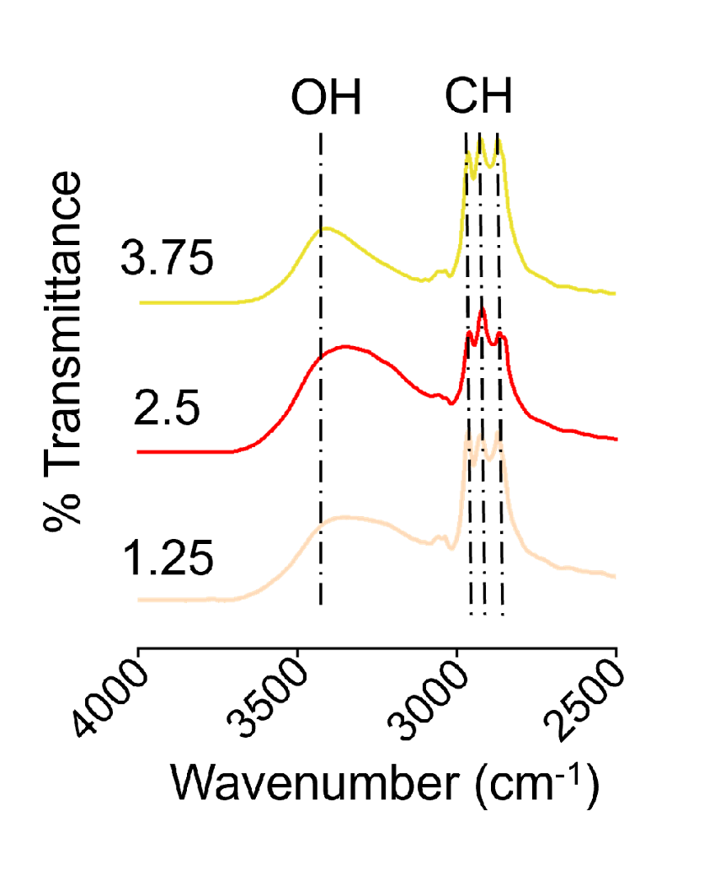
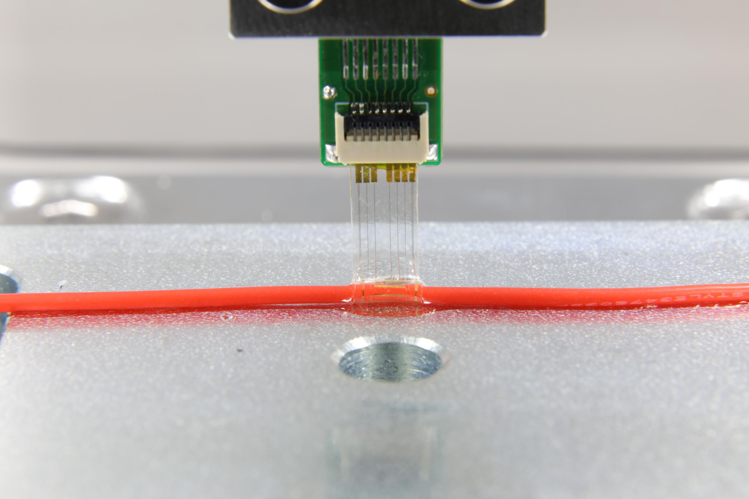
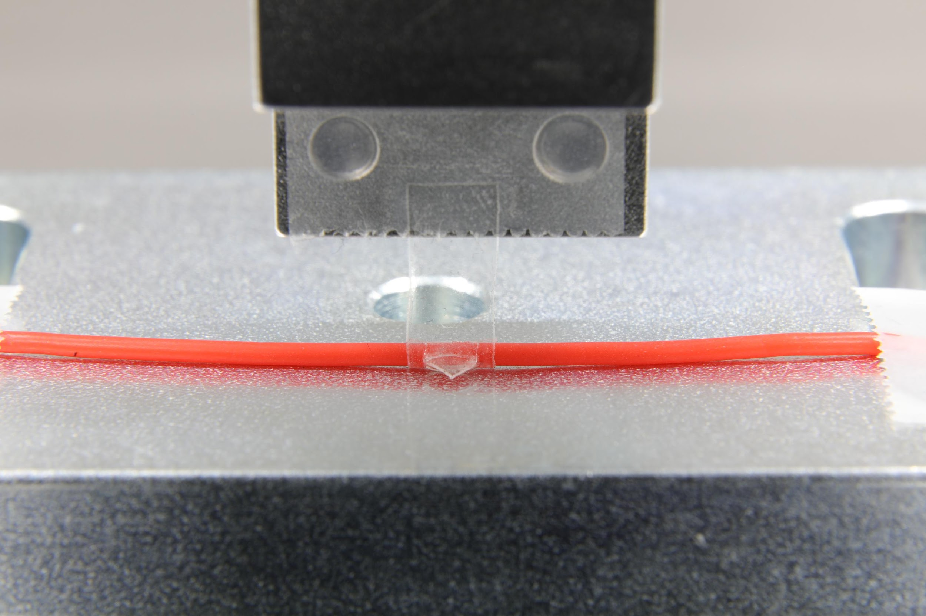
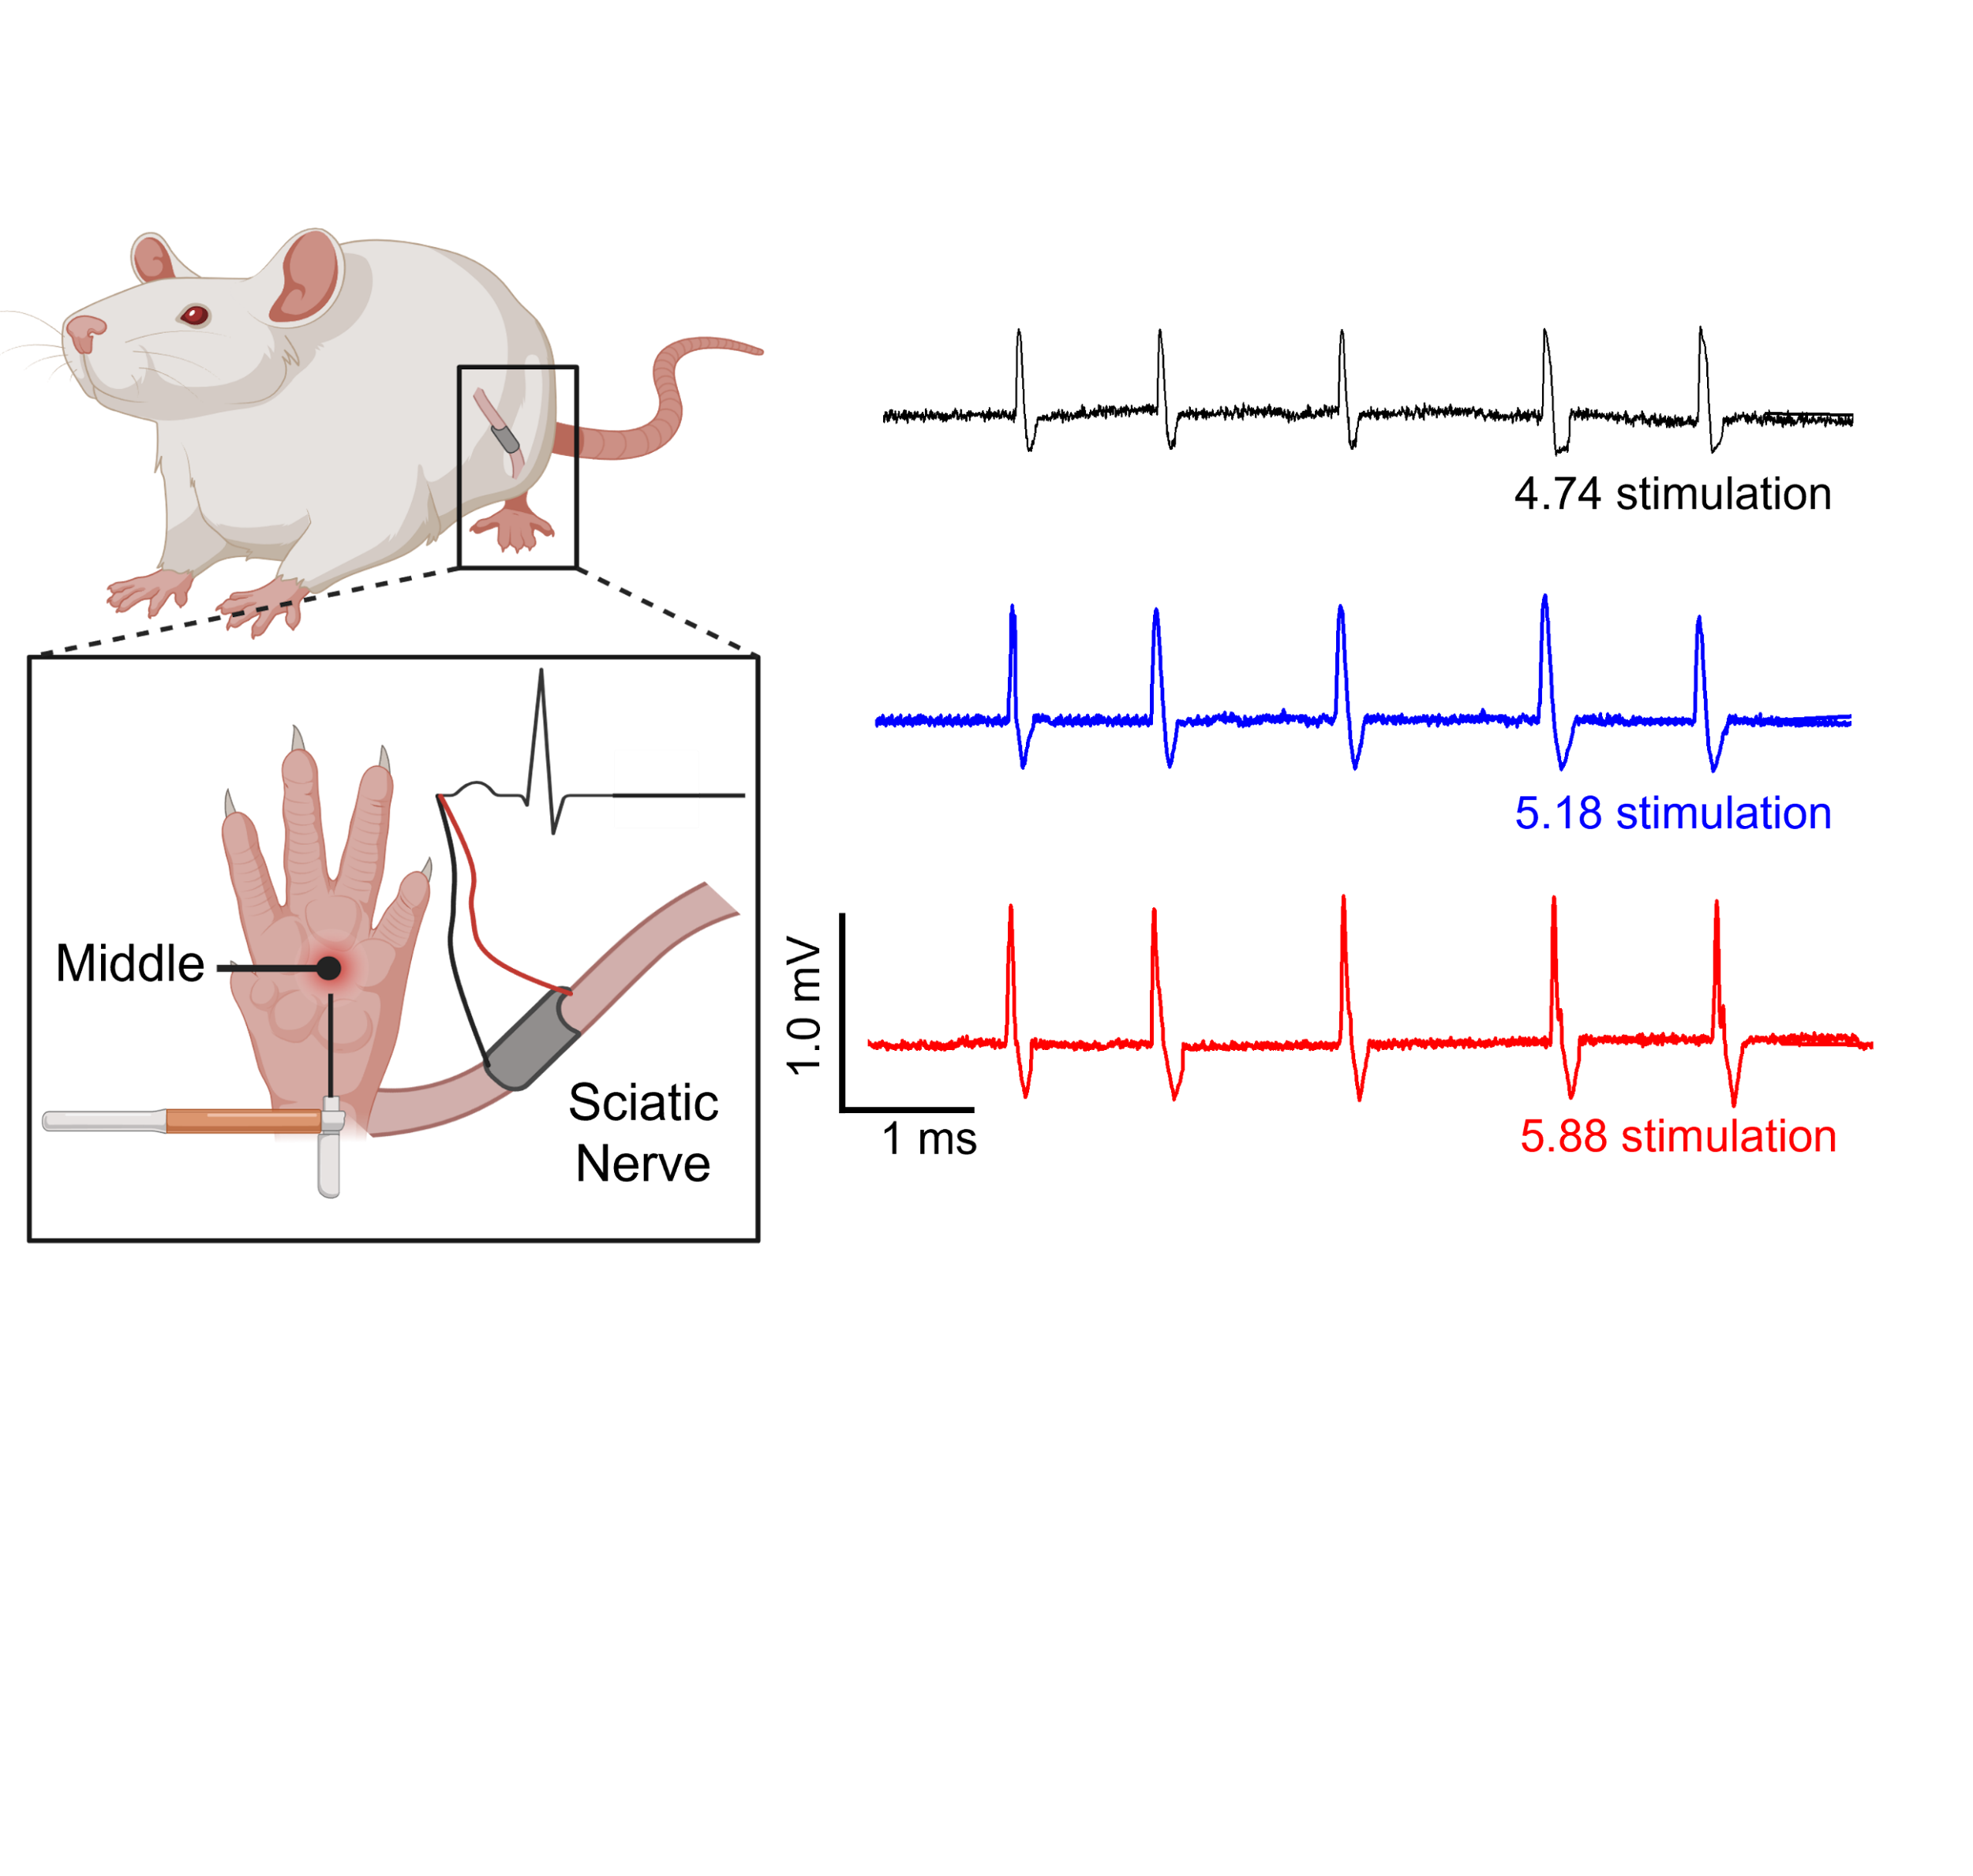
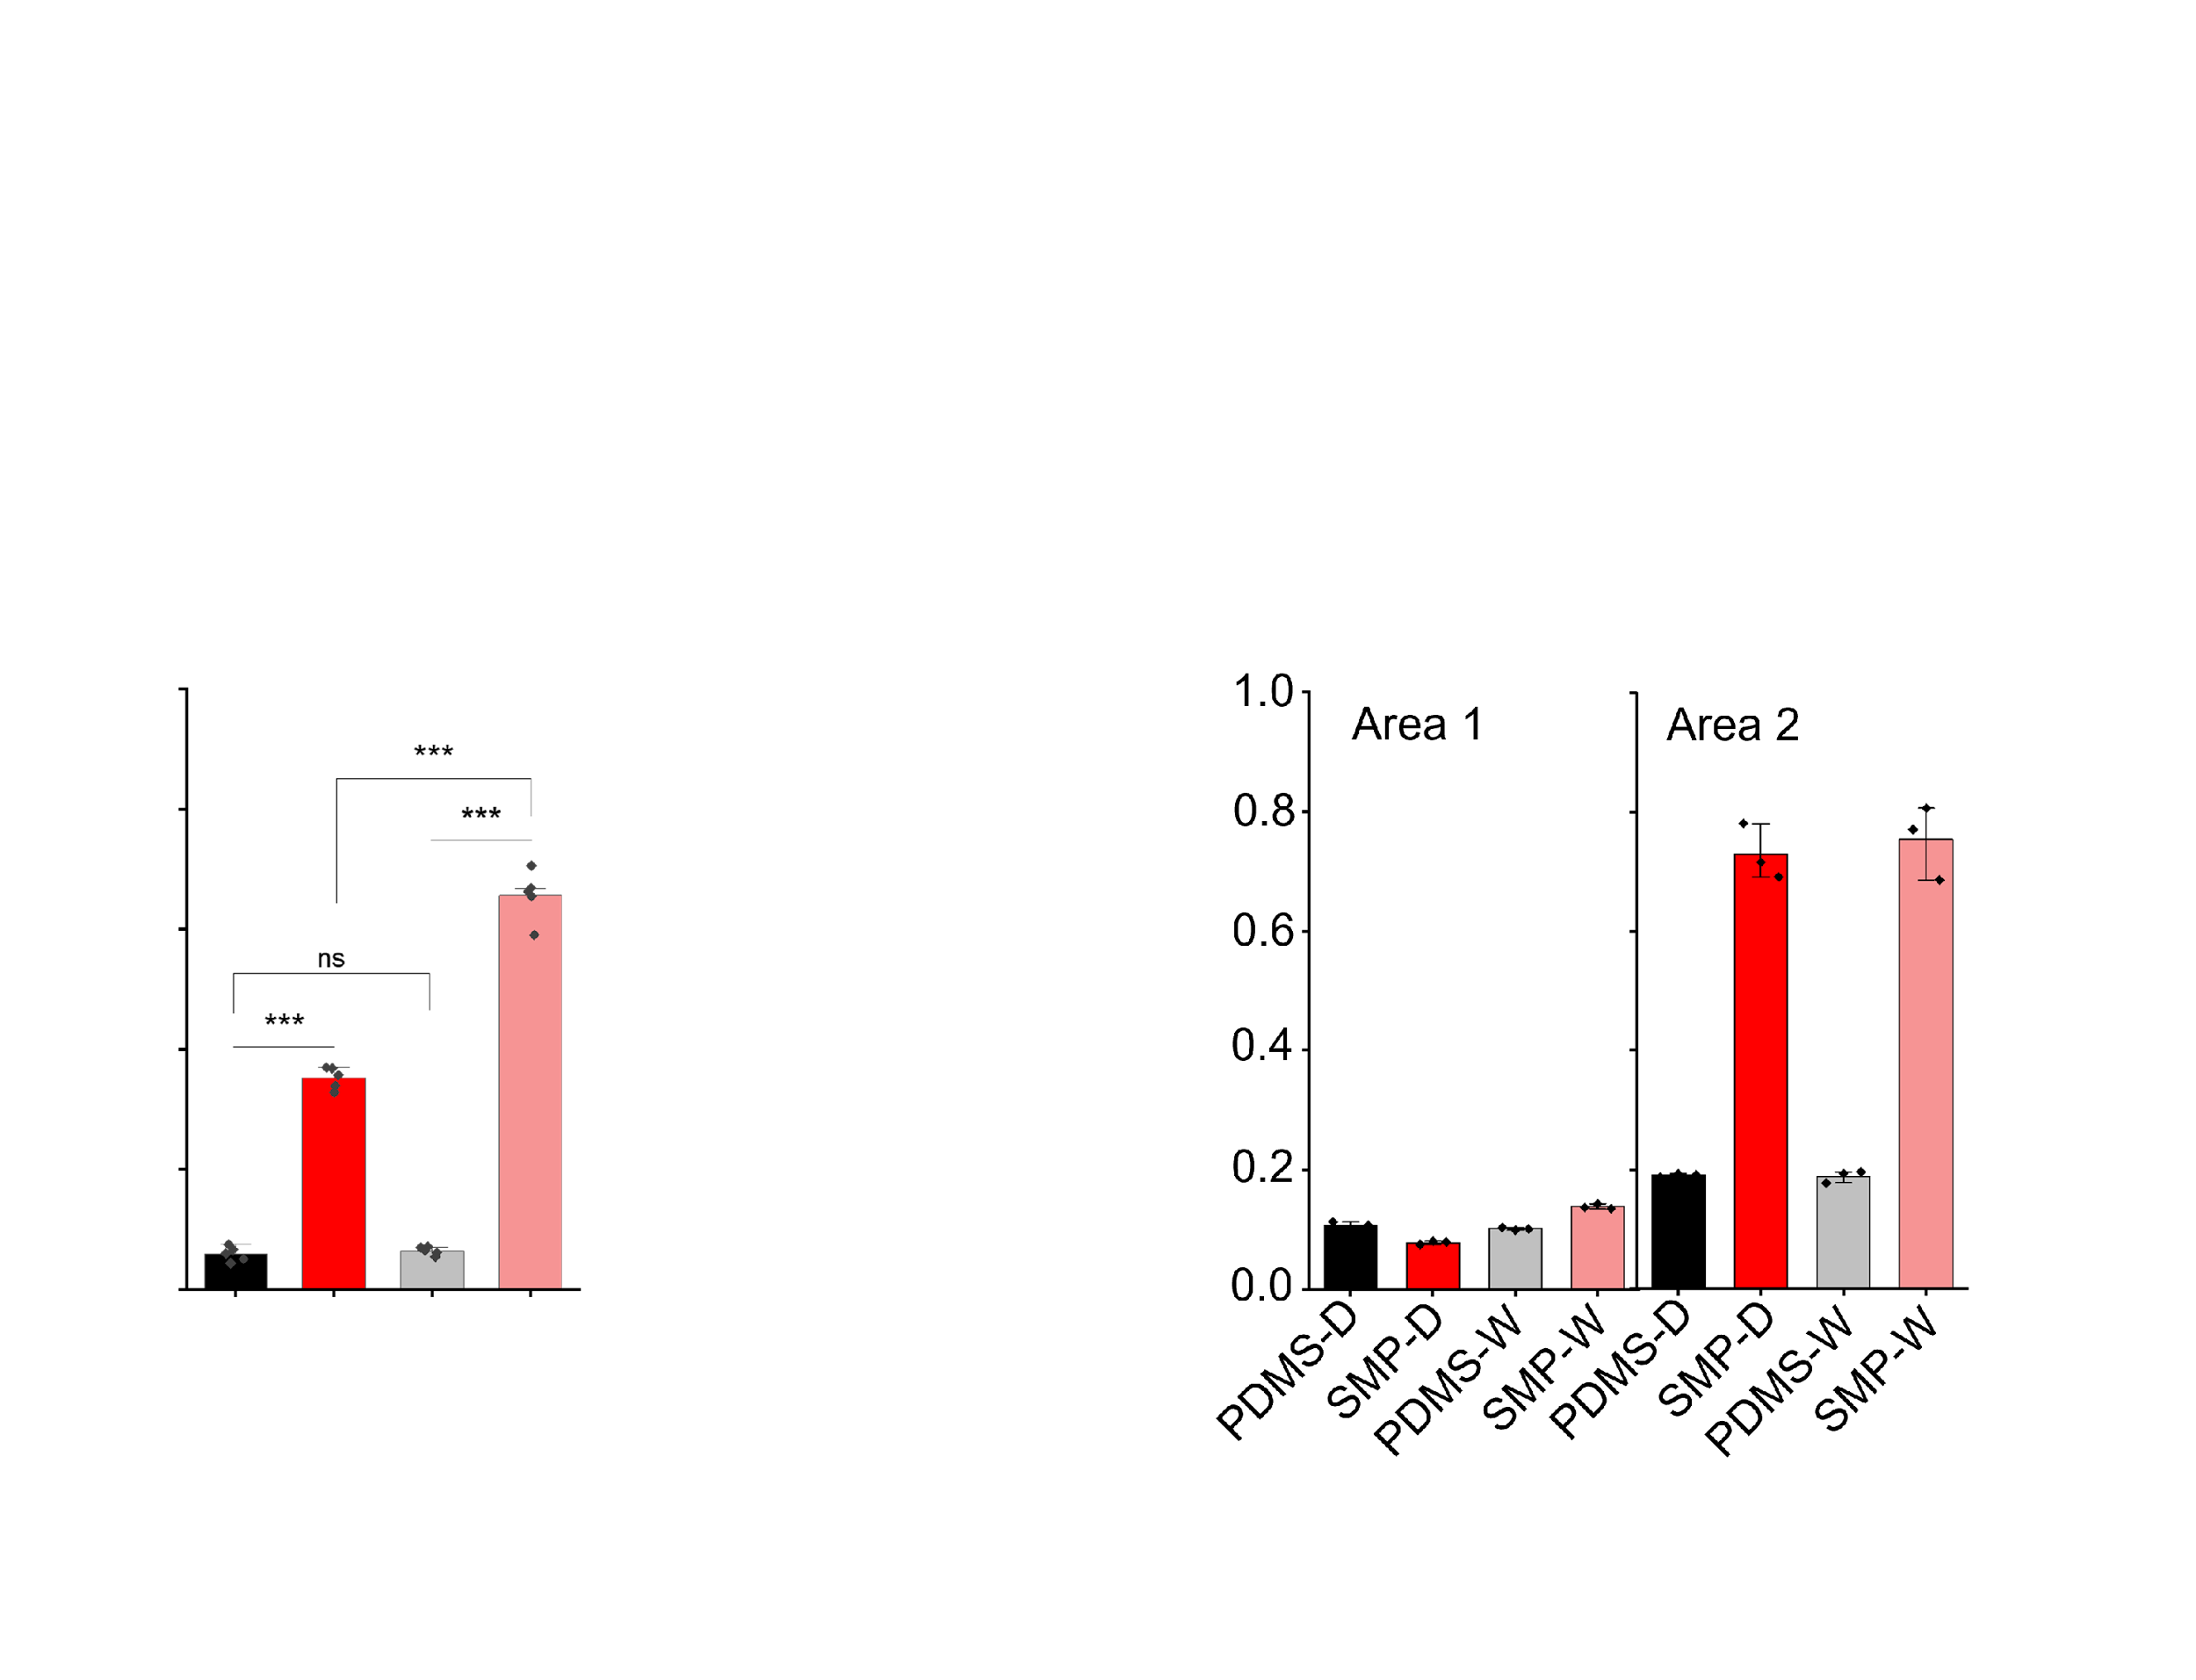
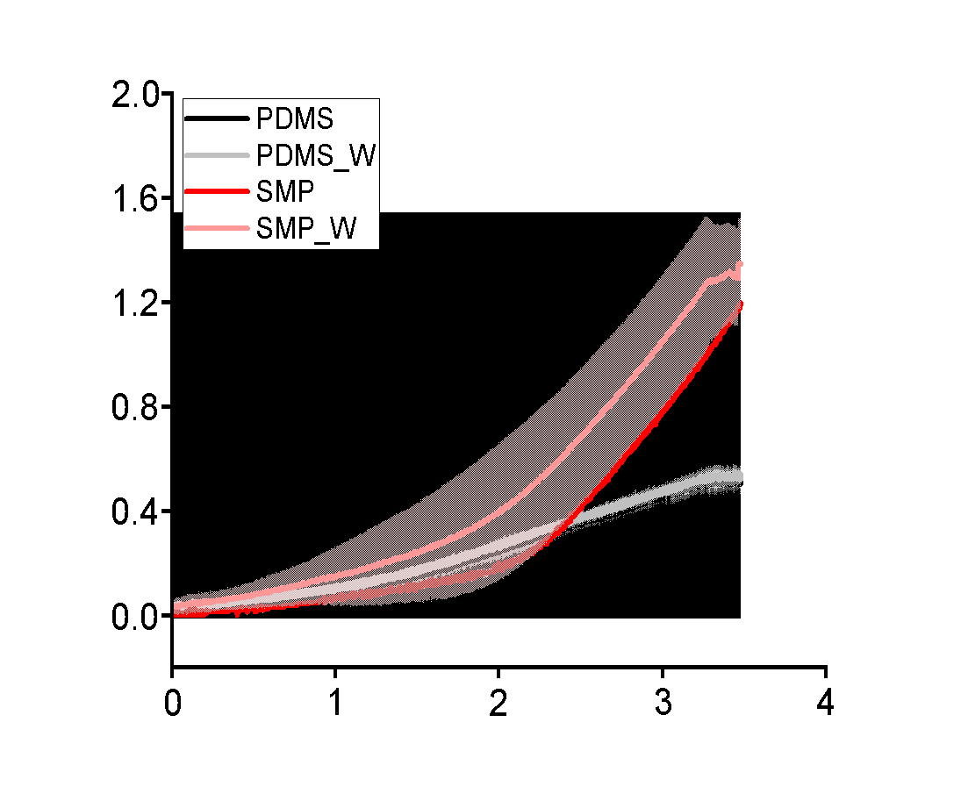
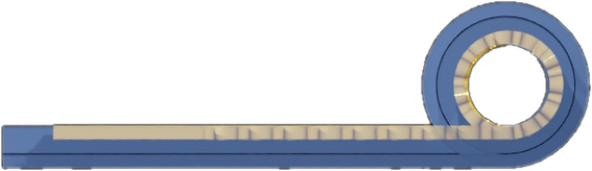
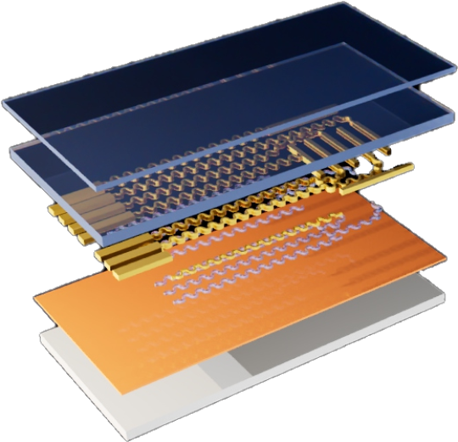
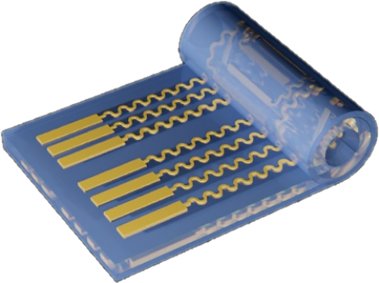
Thermal Strain-Induced Autonomous Cuff Electrode for Peripheral Nerve Interfaces
Seungjun Lee¹, Jonghee Eun¹, Jimin Lee^{1,2}, Namsun Chou^{1,3} *
¹Emotion, Cognition & Behavior Research Group, Korea Brain Research Institute (KBRI), Daegu 41062, Korea
²Department of Robotics and Mechatronics Engineering, Daegu Gyeongbuk Institute of Science and Technology (DGIST), Daegu, 42988, Republic of Korea
³Graduate School, Daegu Gyeongbuk Institute of Science & Technology (DGIST), Daegu, 42988 Republic of Korea
* Corresponding Email : nschou@kbri.re.kr
Advanced NeuroTechnology Lab.
: https://sites.google.com/view/adv-neurotech-lab
INTRODUCTION
‘AUTO-CUFF’ MECHANISM
IN VIVO-ELECTRICAL STIMULATION
CHRONIC USE & BIOCOMPATABILITY
Peripheral nerve interfaces (PNIs) establish bidirectional communication between the nervous system and external devices, enabling applications in neuroprosthetics, neuromodulation, and sensory feedback.
Conventional cuff electrodes require suturing or mechanical fixation to secure around the nerve, often resulting in nerve compression, ischemia, and inflammatory reactions during chronic implantation.
Mechanical mismatch between the rigid electrode and the soft nerve tissue leads to micromotion-induced damage and signal instability over time.
To overcome these limitations, a thermo-responsive “Auto-Cuff” based on shape memory polymer (SMP) was developed, capable of autonomously conforming to the nerve upon exposure to body temperature (36–37 °C).
The self-wrapping mechanism eliminates the need for sutures or external tools, achieving suture-free, minimally invasive implantation and uniform contact with the epineurium.
A bilayer SMP design was engineered to provide programmable deformation and mechanical tuning of stiffness, enabling precise control over the wrapping force and flexibility to match the soft mechanical properties of peripheral nerves.
Stimulation artifact
Sham
TN
PN
Amplitude
8 weeks implantation
TN
PN
0.1 mA
Neuroinflammatory responses, showing no significant difference compared with the control group.
No remarkable histological differences were observed between the sham and 8-week groups.
SMP deformation – young’s modulus change by temperature.
Double layer structure of SMP bending direction modification.
Week 1
SNR : 4.9
FABRICATION PROCESS
BENDING & CLOSING PROPERTIES
1.0 mA
Week 2
SNR : 9.4
Si wafer
Si wafer
Si wafer
Week 3
SNR : 11.6
Sacrificial Layer
SMP Insulation Layer
Metal Patterning
SMP
Week 4
SNR : 15.9
Si wafer
Si wafer
Si wafer
PDMS tie
Week 5
SNR : 15.3
1st SMP Layer
2nd SMP Layer
Sacrificial Layer Remove
1.2mm
Low and high electrical stimulation
Foot moving angle differences.
High CNAP recorded in high electrical stimulation.
The SNR gradually improved up to week 5.
Stable, reliable neural signal recordings were maintained during this period.
Cu
Cr/Au
Insulation SMP
1st SMP
2nd SMP
SMP
SMP fabrication
Particular condition of SMP used for flexibility secured.
Semiconductor fabrication process possibility.
Electrode line structure improvement
Electrode bending properties consider to maintain conductivity.
Double layer SMP lead bending and closing activation.
PDMS tie
1.2mm
IN VIVO-VON-FREY STIMULATION
CONCLUSION
Bending deformation identified by t-peel analysis
Strain increased in PDMS gradually increased pressure.
Roll line appeared in SMP electrode while strain increased.
A thermo-responsive Auto-Cuff made of shape memory polymer enabled suture-free and minimally invasive peripheral nerve interfacing.
The bilayer SMP design provided stable self-wrapping and mechanical durability under physiological conditions.
In vivo studies demonstrated improved SNR and stable neural recordings with minimal neuroinflammatory response.
Histological analyses revealed no significant tissue damage, confirming excellent biocompatibility and long-term stability.
‘AUTO-CUFF’ STRUCTURE
Top SMP
4um
SMP Closing
Double Layer SMP
Bottom SMP
30um
Pressure (MPa)
A’
A
SMP Bending
Metal pattern
Electrode pad
Insulation SMP
A’
Foot stimulation recording
Von-Frey stimulation on middle of rat foot with different stimuli weight.
Sciatic nerve stimulation differently by weight.
Various type of stimulation could be recorded through nerve
ACKNOWLEDGMENT
SMP
Strain (10mm/s)
This work was supported by grants of the National Research Foundation (grant no.: NRF-2021R1C1C 2011489) and Korea Brain Research Institute (grant no.: 25-BR-02-02) funded by the Ministry of Science and ICT of Korea.
A
Ti/Au
SMP bending and closing confirmation
PDMS compared with SMP bending and closing properties.
Pulling test for verifying SMP’s nerve holding force.
Cu
Wafer

