Slide 1

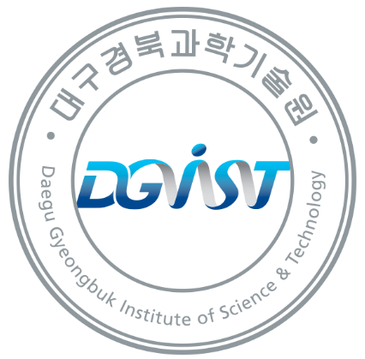
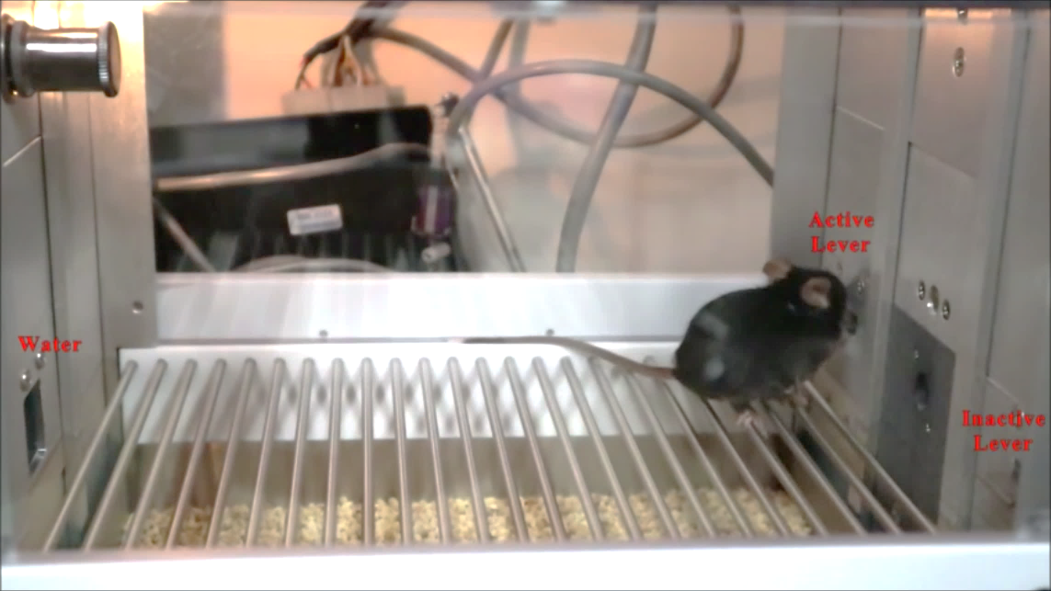

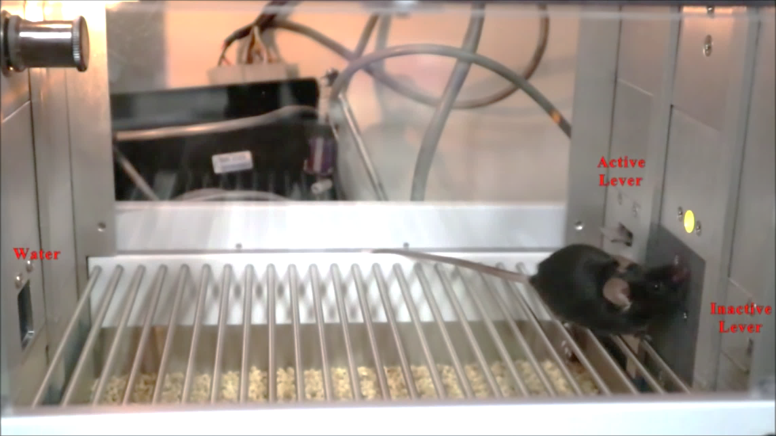
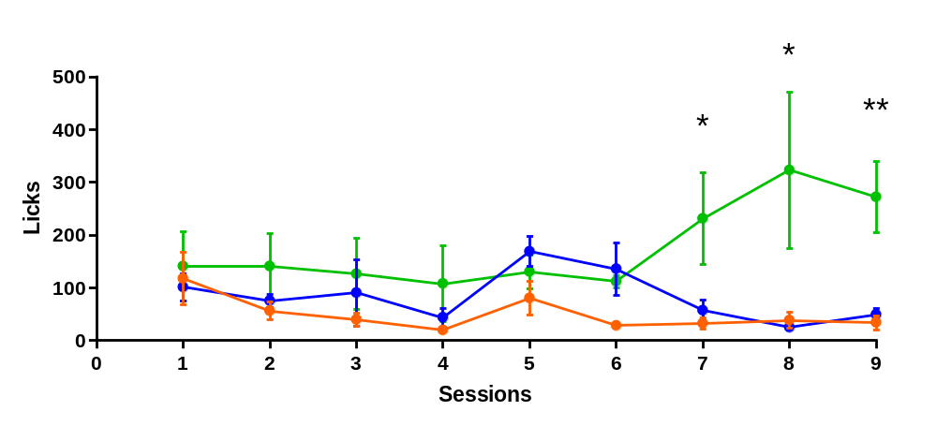


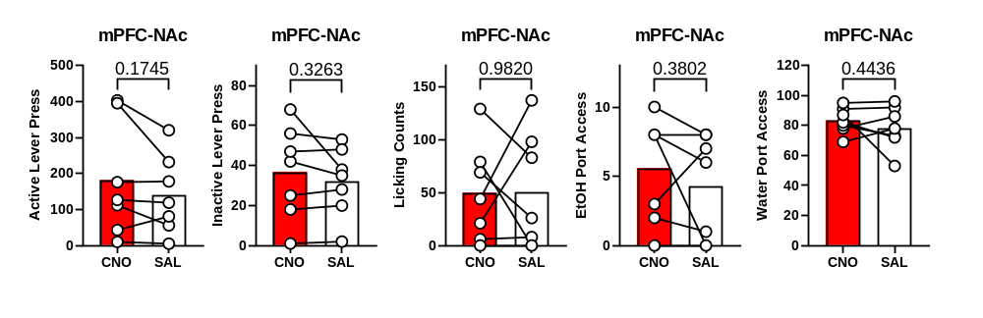

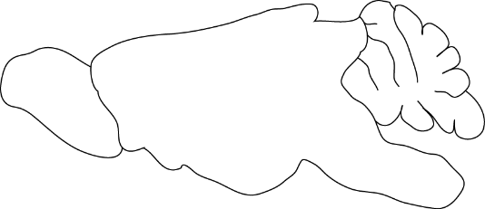
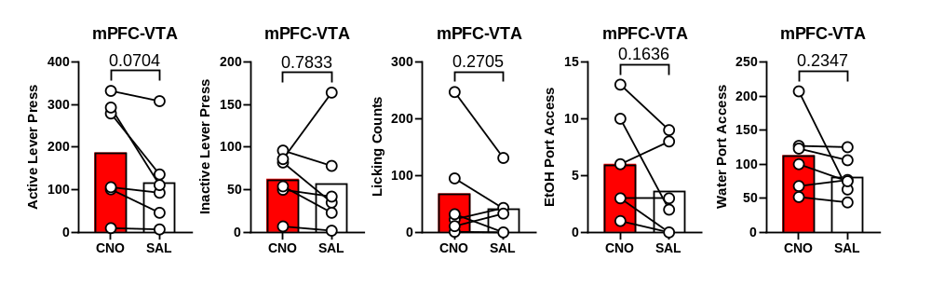
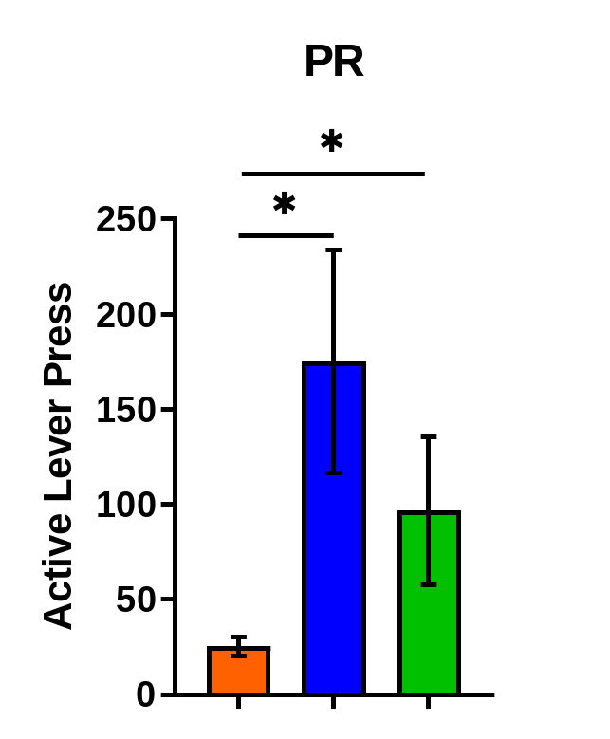
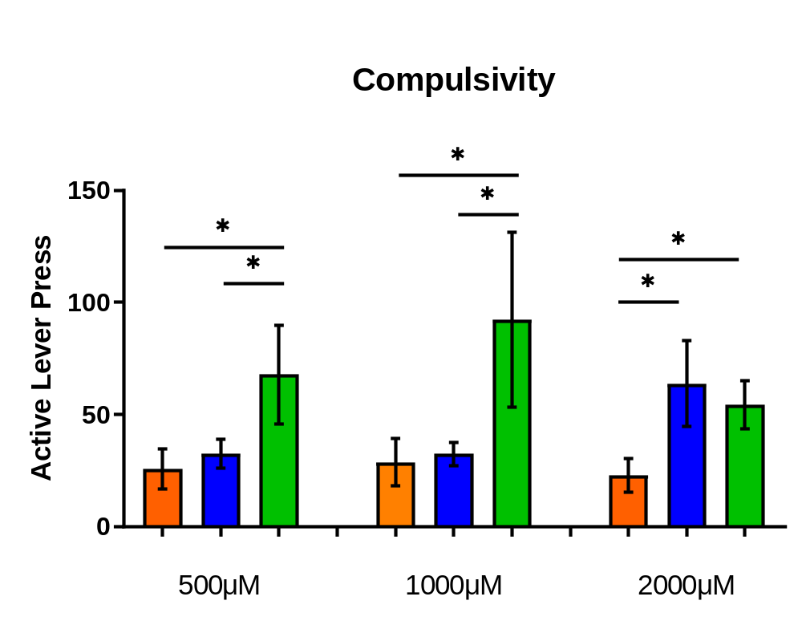
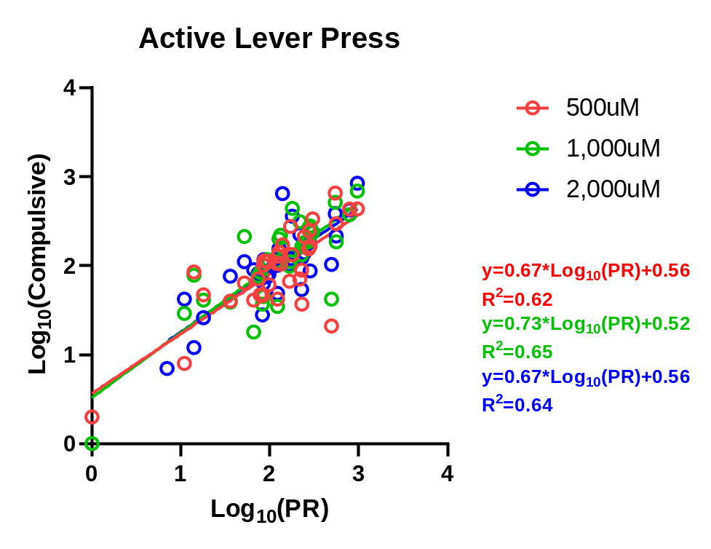
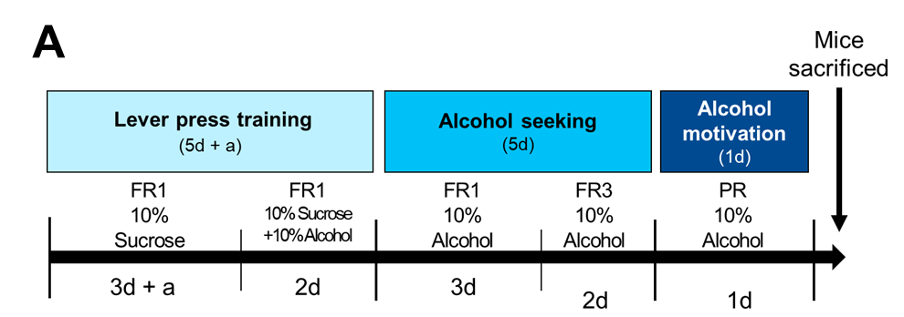
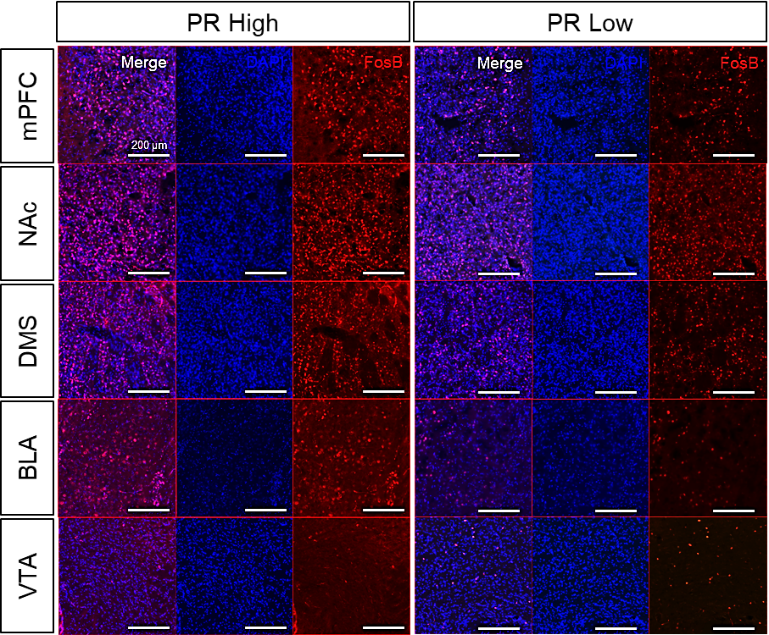
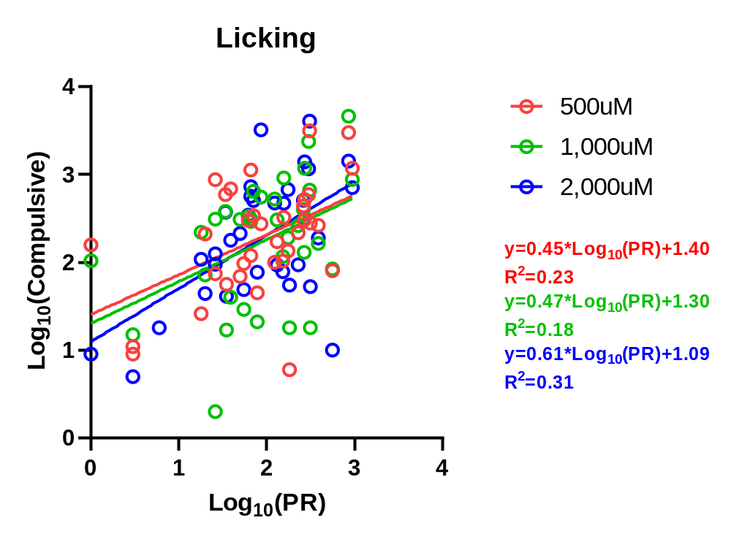
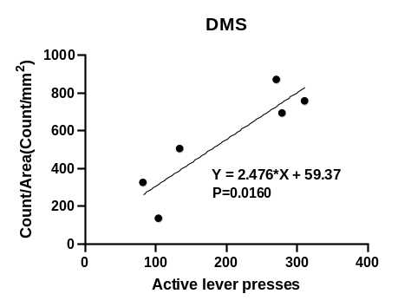
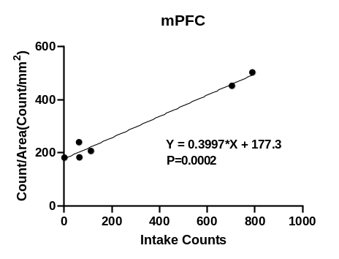
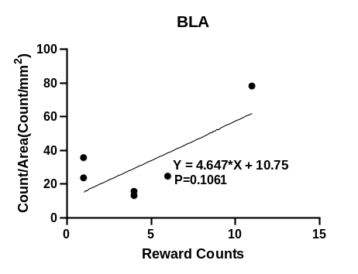
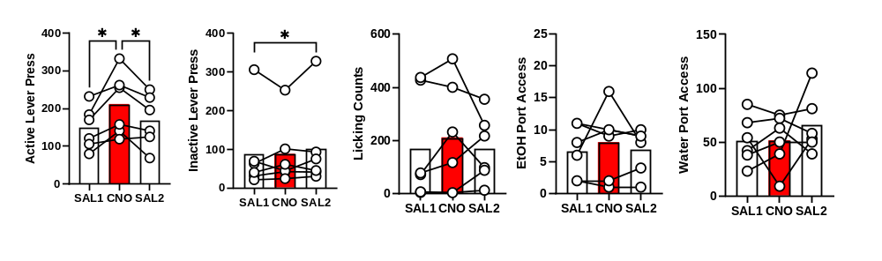
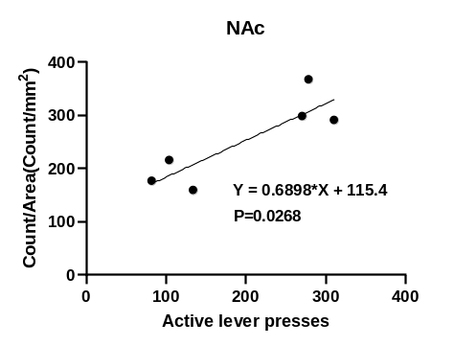
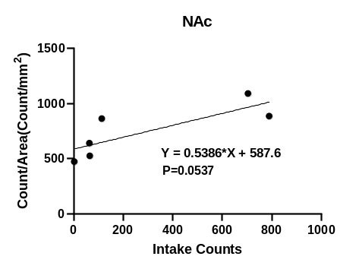
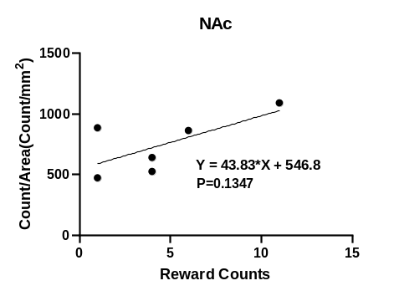
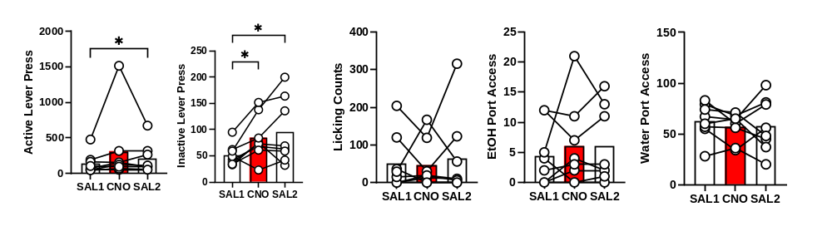

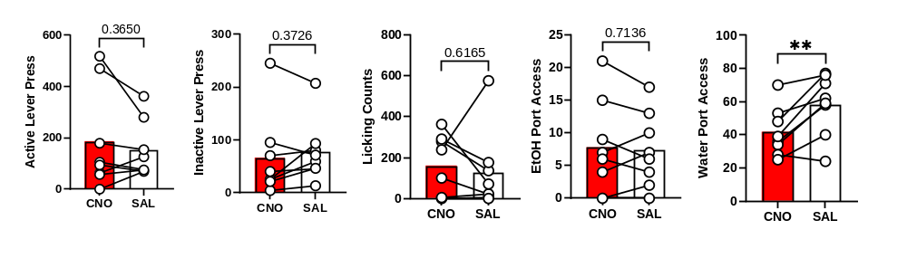
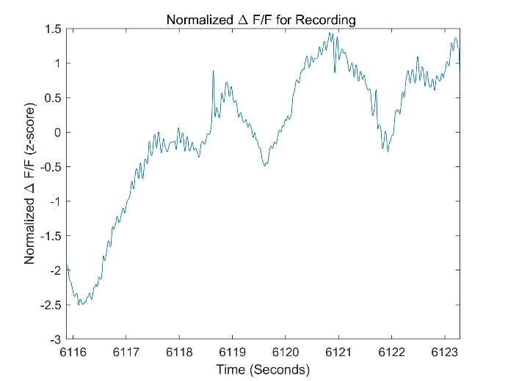
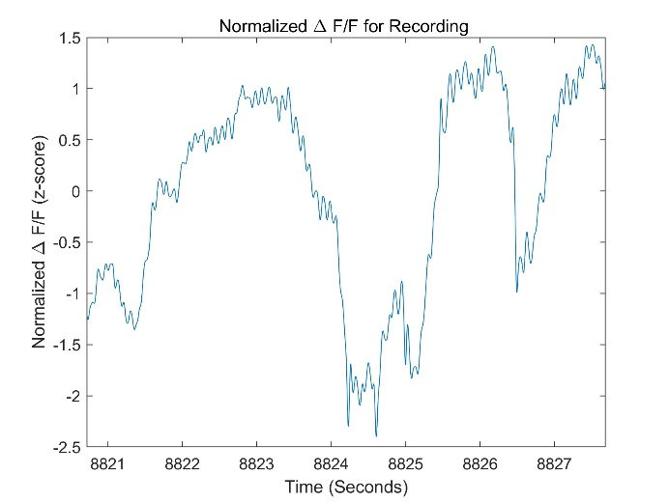
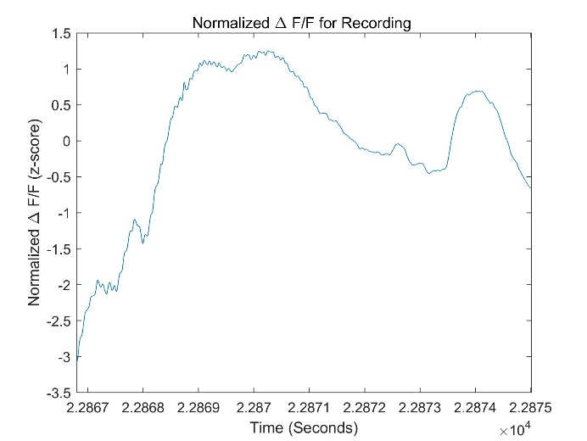
P-040 Mechanisms of Brain Disorders
Alcohol Addiction-like Behaviors in Operant Ethanol Self-Administration Mediated by the mPFC Reward Circuit
Jiyun Lee^{1,2}, Sumin Kang^{1,3}, Eum-Ji Kim¹, Shijie Xu⁴, Ja Wook Koo^{1,2,*}
¹Emotion, Cognition & Behavior Research Group, Korea Brain Research Institute (KBRI), Daegu, Republic of Korea
²Department of Brain Sciences, Daegu Gyeongbuk Institute of Science and Technology (DGIST), Daegu, Republic of Korea
³KNU Alzheimer’s Disease Research Institute, Department of Physiology, School of Medicine, Kyungpook National University, Daegu, South Korea
⁴Medical Research Center, Affiliated Cancer Hospital of Hainan Medical University, Haikou, China
*Corresponding author: jawook.koo@kbri.re.kr
Abstract
Ethanol is readily accessible and is one of the representative substances in substance use disorders. Despite the ease of access to ethanol, only a small number of individuals experience alcohol use disorder. Differentiation in behavior in response to ethanol exposure, ranging from avoidance to compulsive intake, suggests the complexity of the neurobiological mechanism underlying alcohol addiction. Addiction is a brain dysfunction that causes people to persistently or compulsively seek out or take addictive drugs despite the negative psychological and physical effects. In most drug addictions, the same or different neural circuits mediate characteristic addictive behaviors according to the development and differentiation of addictive behaviors.
Therefore, we developed alcohol addictive-like behavior models in operant ethanol oral self-administration to identify addictive-like behavioral differentiation. We clustered the behavioral phenotypes using the three factors – fixed ratio (FR), progressive ratio (PR), and aversive-tasting ethanol solution – to establish the point of reference for alcohol addictive-like behaviors. Then, we discovered that operant interaction patterns in the PRs are the most highly associated with the alcohol-drinking phenotype. We hypothesize that reward circuits involved with the medial prefrontal cortex (mPFC) intricately regulate complex behaviors in ethanol self-administration. Accordingly, we identified changes in operant behaviors in PR using the DREADD system, targeting four reward circuits associated with the mPFC (mPFC-NAc, mPFC-VTA, mPFC-DMS, and mPFC-BLA). This suggested that each of the four mPFC circuits plays a distinct role in alcohol-addictive-like behaviors. Also, this multi-circuit relation may mediate individual alcohol addictive-like behavioral differentiation. Further research is required to investigate individual differences in the distinct behaviors of alcohol addiction in the operant ethanol oral self-administration.
Experimental Settings
Addictive behavioral phenotyping in EtOH SA using parameters: PR and Compulsivity
Behavioral changes of EtOH SA using Gi DREADD inhibition in the mPFC-output circuits (1)
Operant/Experimental Condition
Example Figures
A
Room
Light
20:00 ~ 08:00
Per Session
Active Lever
Lever press training
(5d + a)
Alcohol seeking
(5d)
Alcohol
motivation
(1d)
Alcohol compulsivity
(500uM, 1000uM, 2000uM, 3d)
A
Lever press training
(5d + α)
Alcohol seeking
(5d)
Alcohol
motivation
(1d)
CNO
(2 mg/kg)
(1d)
Alcohol
motivation
(1d)
SALINE
(1d)
Active Lever Light
Virus injection
FR1
10% Sucrose
FR1
10% Sucrose
+10% Alcohol
FR1
10% EtOH
FR3
10% EtOH
PR
10% EtOH
PR
10% EtOH
PR
10% EtOH
PR
10% EtOH
FR1
10% Sucrose
FR1
10% Sucrose
+10% Alcohol
FR1
10%
Alcohol
FR3
10%
Alcohol
PR
10%
Alcohol
FR1
10% Alcohol
+500uM quinine
FR1
10% Alcohol
+1,000uM quinine
FR1
10% Alcohol
+2,000uM quinine
2 wks
3 d+α
2 d
3 d
2 d
1 d
1 d
1 d
1 d
EtOH Port
Active Lever Press
3d + a
2d
3d
2d
1d
1d
1d
1d
B
C
Water
Port
B
C
High
Compulsivity
AAV5-DIO-hM4D(Gi)-mCherry
AAVrg-CAG-Cre
Free chow
Inactive
Lever
mPFC
NAc
EtOH Port Access & Licking
Compulsive parameters
mPFC-NAc
Operating Steps
Low
Motivation
High
Motivation
D
E
Mouse
Active lever press
10 Sec Active lever light ON
10 sec Able to access EtOH port
Access water port
3 sec Water filled into Water port
Licking ++
Reward +1
Water +1
Inactive lever press
Active lever press ++
Inactive Lever Press ++
AAV5-DIO-hM4D(Gi)-mCherry
AAVrg-CAG-Cre
D
FR1
FR3
PR
Compulsivity
Motivation parameters (PR)
mPFC
VTA
E
F
mPFC-VTA
FosB expression patterns in brain regions are associated with behaviors in EtOH SA
(A) Experimental scheme of Gi DREADD inhibition of mPFC, mPFC-to-NAc and mPFC-to-VTA (B) Schematic illustration of viral injection: mPFC-to-NAc. (C) Counts changes during the mPFC-to-NAc chemogenetic inhibition: active lever press, inactive lever press, licking counts, EtOH port access counts, water port access counts (Left to right panel, n=7). (D) Schematic illustration of viral injection: mPFC-to-VTA. (E) Counts changes during the mPFC-to-VTA chemogenetic inhibition: active lever press, inactive lever press, licking counts, EtOH port access counts, water port access counts (Left to right panel, n=6). (paired T-test, post hoc test: Fisher’s LSD).
A
B
Behavioral changes of EtOH SA using Gi DREADD inhibition in the mPFC-output circuits (2)
G
(A) Experimental scheme of the behavioral phenotype clustering in EtOH oral self-administration. (B) – (E) showed preliminary addictive behavioral phenotype clustering using parameter as active lever press (n=16). We clustered phenotypes in low motivation group, high motivation group, and high compulsivity group. Motivation parameter was selected as progressive ratio session. And the compulsive parameter was selected as escalated concentration of quinine + EtOH session. The clustering was performed by the experimenter, who arbitrarily defined the quadrants. (B) Licking counts during the lever press training session. (C) Diagram illustrating the clustering of three types of addictive behaviors with defined quadrants. (D) Active lever press in the PR session. (E) Active lever press in the compulsive licking session. (F) Log-scaled correlation of active lever press. (F) – (G) showed addictive behavioral phenotype clustering of large number of experimental group (n=38). We implemented more logical phenotype clustering by incorporating advanced mathematical and statistical methods, improving upon previous approaches. (G) Log-scaled correlation of licking counts.
A
Lever press training
(5d + α)
Alcohol seeking
(5d)
Alcohol
motivation
(1d)
SALINE
(1d)
CNO
(2 mg/kg)
(1d)
SALINE
(1d)
Virus injection
FR1
10% Sucrose
FR1
10% Sucrose
+10% Alcohol
FR1
10% EtOH
FR3
10% EtOH
PR
10% EtOH
PR
10% EtOH
PR
10% EtOH
PR
10% EtOH
C
Active Lever
Licking
Reward
2 wks
3 d+α
2 d
3 d
2 d
1 d
1 d
1 d
1 d
B
AAV5-DIO-hM4D(Gi)-mCherry
AAVrg-CAG-Cre
C
Active Lever
Inactive Lever
Licking
Reward
Water
Behavioral changes of EtOH SA using Gi DREADD inhibition in the mPFC
mPFC
DMS
(A) Experimental scheme of FosB expression profiling after the PR session. (B) Representative images for licking counts of PR high and PR low in brain regions. (C) Simple linear regression of each behaviors; Active lever press, licking counts, reward counts. Representative graphs of the two brain regions with the lowest p-values out of five tested. (each n=6)
A
Lever press training
(5d + α)
Alcohol seeking
(5d)
Alcohol
motivation
(1d)
CNO
(2 mg/kg)
(1d)
Alcohol
motivation
(1d)
SALINE
(1d)
D
mPFC-DMS
E
Fiber photometry of the mPFC during the EtOH SA FR1
Virus injection
FR1
10% Sucrose
FR1
10% Sucrose
+10% Alcohol
FR1
10% EtOH
FR3
10% EtOH
PR
10% EtOH
PR
10% EtOH
PR
10% EtOH
PR
10% EtOH
AAV5-DIO-hM4D(Gi)-mCherry
AAVrg-CAG-Cre
A
Lever press training
(5d + α)
Alcohol seeking
B
mPFC
Virus injection
Optic fiber implant
FR1
10%
Sucrose
FR1
10% Sucrose
+10% Alcohol
FR1
10%
EtOH
Fiber Photometry with TTL output
AAVdj-CaMKIIa-GCaMP6s
Optic fiber
2 wks
3 d+α
2 d
3 d
2 d
1 d
1 d
1 d
1 d
BLA
mPFC
B
C
Active Lever
Inactive Lever
Licking
Reward
Water
mPFC-BLA
C
2 wks
1 wk
3 d+α
2 d
1 d
AAV-hM4D(Gi)-mCherry
(A) Experimental scheme of Gi DREADD inhibition of mPFC-to-DMS and mPFC-to-BLA. (B) Schematic illustration of viral injection: mPFC-to-DMS. (C) Counts changes during the mPFC-to-DMS chemogenetic inhibition: active lever press, inactive lever press, licking counts, EtOH port access counts, water port access counts (Left to right panel, n=7). (D) Schematic illustration of viral injection: mPFC-to-BLA. (E) Counts changes during the mPFC-to-VTA chemogenetic inhibition: active lever press, inactive lever press, licking counts, EtOH port access counts, water port access counts (Left to right panel, n=6). (repeated measures ANOVA, post hoc test: Fisher’s LSD, P*<.05).
(A) Experimental scheme of the mPFC fiber photometry during the EtOH oral self-administration FR1 session. (B) schematic illustration of viral injection and optic fiber implant in the mPFC. (C) representative images of mPFC fiber photometry during the FR1 session. Laser irradiation was controlled TTL by signals. TTL signal was generated for 10 seconds by pressing an active lever and outputting an EtOH port.
mPFC
Acknowledgements
mPFC
This research was supported by the KBRI basic research program through Korea Brain Research Institute (25-BR-07-01; JWK) and by the National Research Foundation grant (NRF-2021R1A2C2094627, RS-2024-00508718; JWK) funded by the Korea government (Ministry of Science and ICT).
Active lever press
/Alcohol out
Active lever press
/Alcohol out
Active lever press
/Alcohol out
(A) Experimental scheme of Gi DREADD inhibition of mPFC. (B) Schematic illustration of viral injection: mPFC. (C) Counts changes during the mPFC chemogenetic inhibition: active lever press, inactive lever press, licking counts, EtOH port access counts, water port access counts (Left to right panel, n=8).

