Slide 1
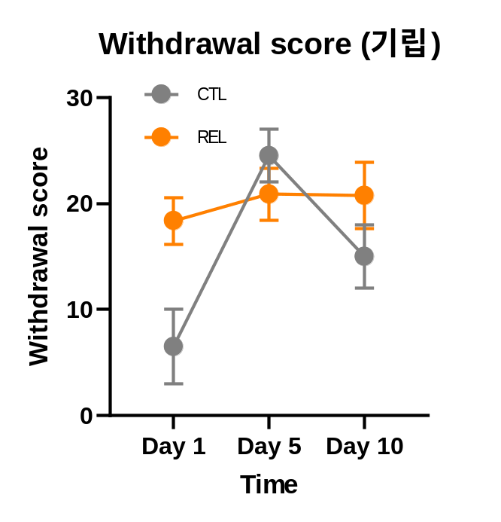
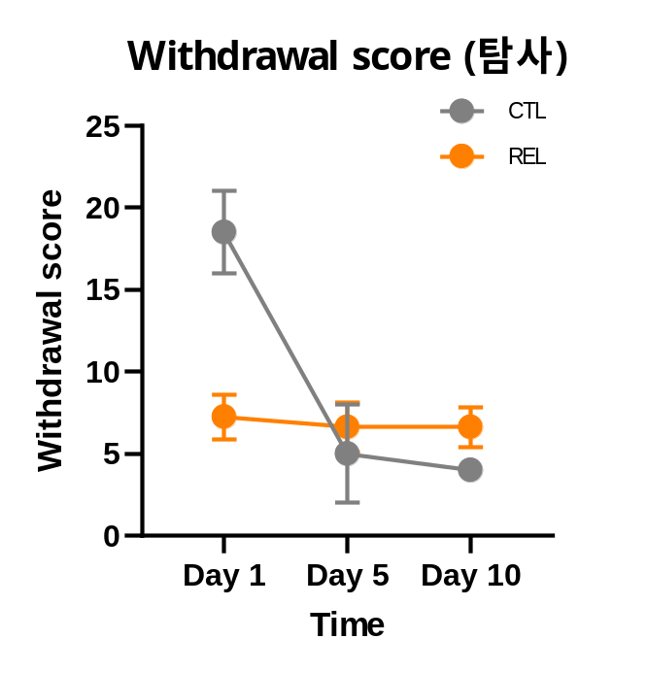
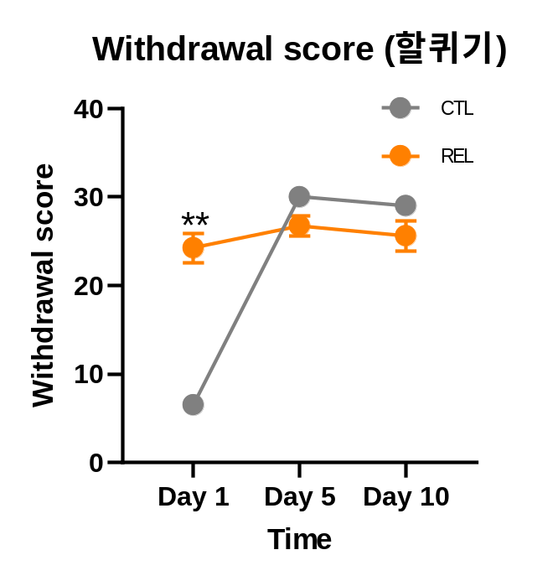
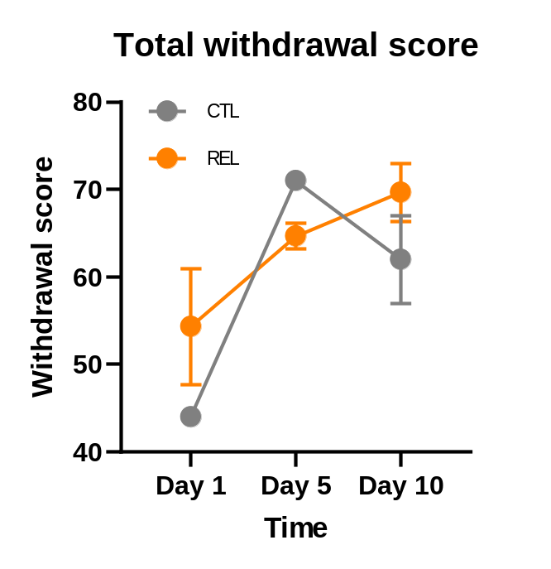
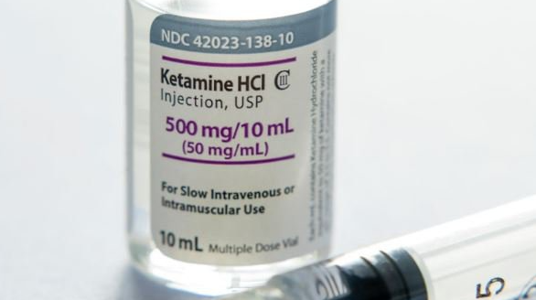
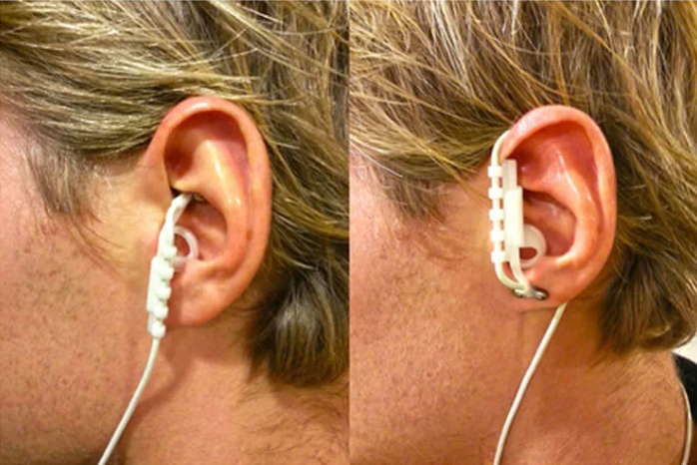
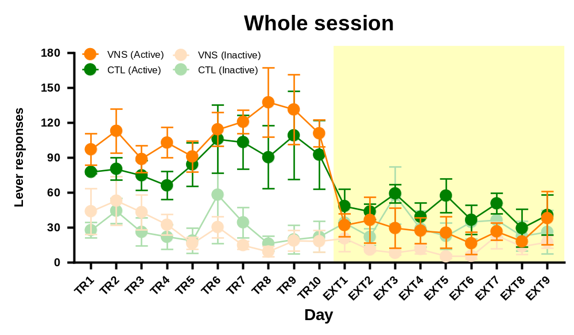
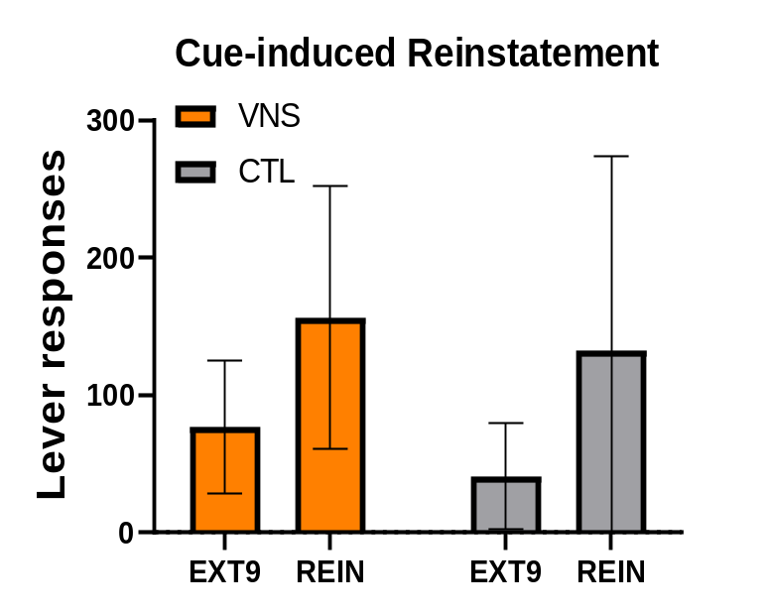
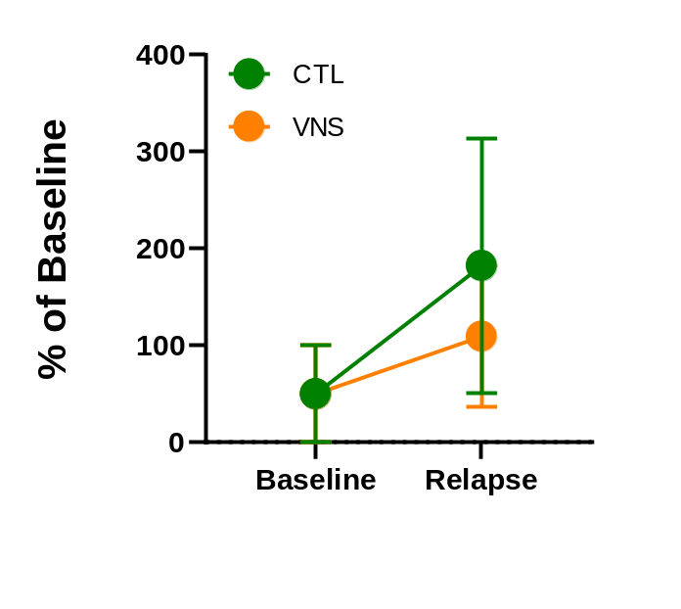
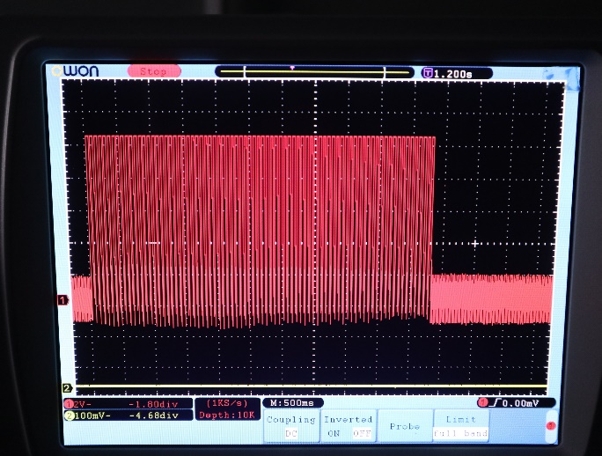
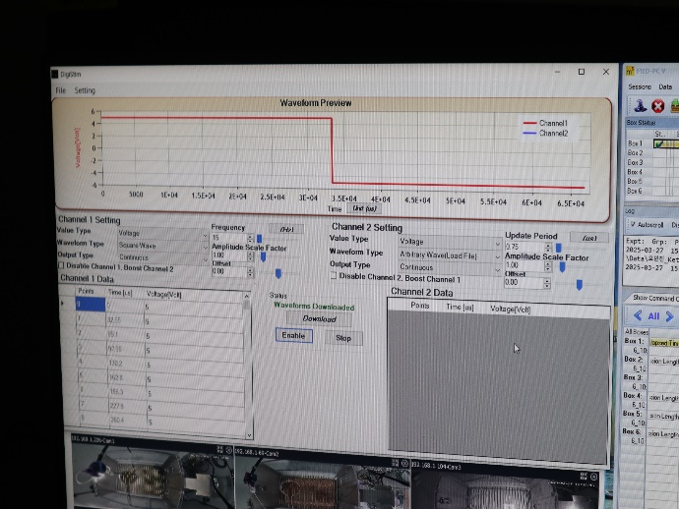
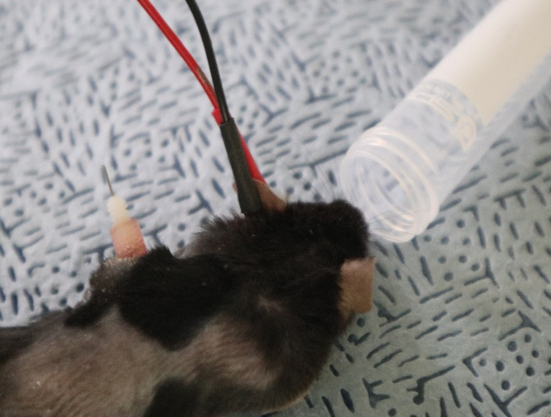
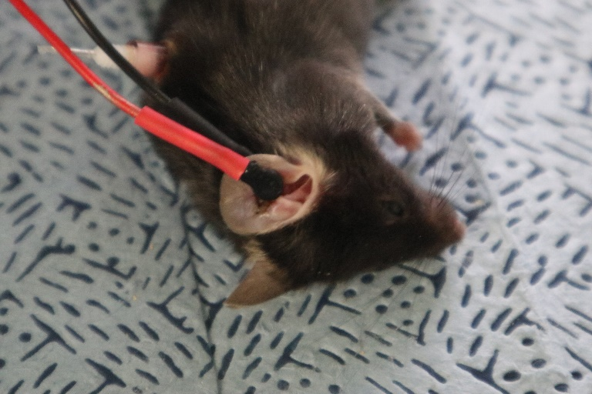
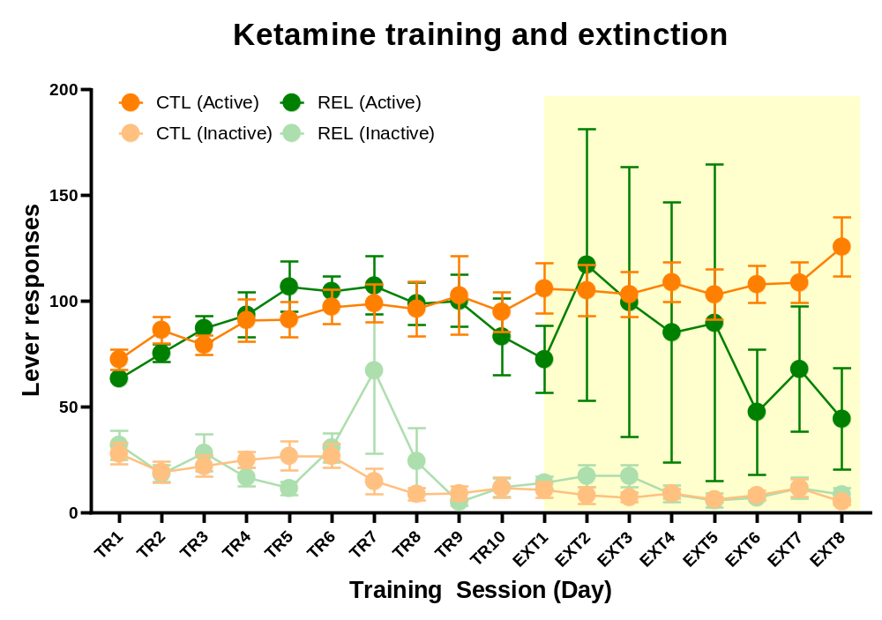
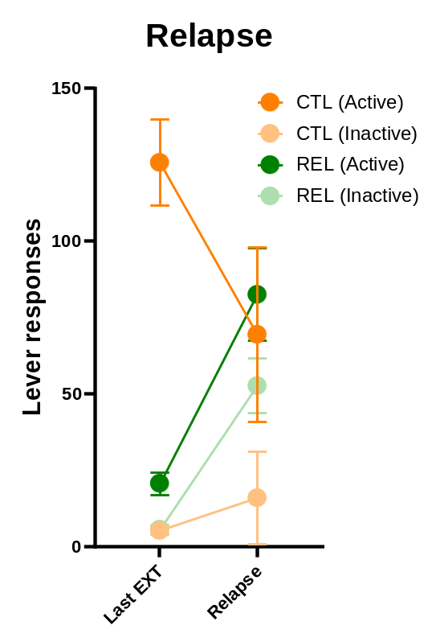
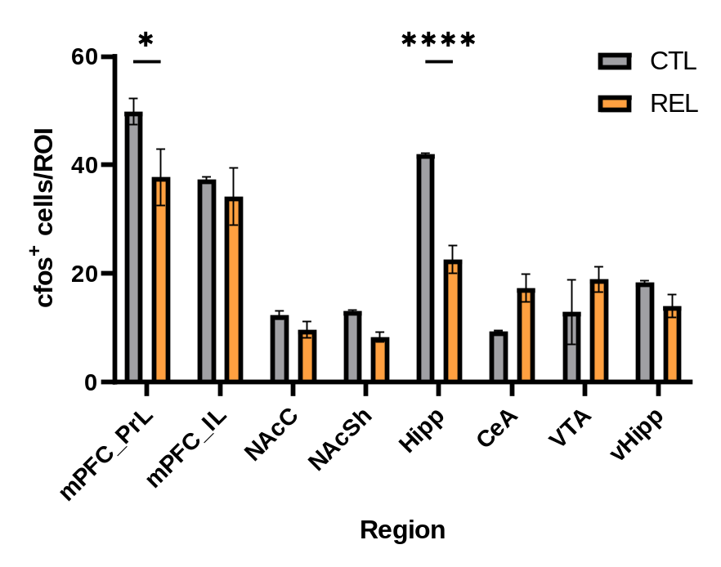
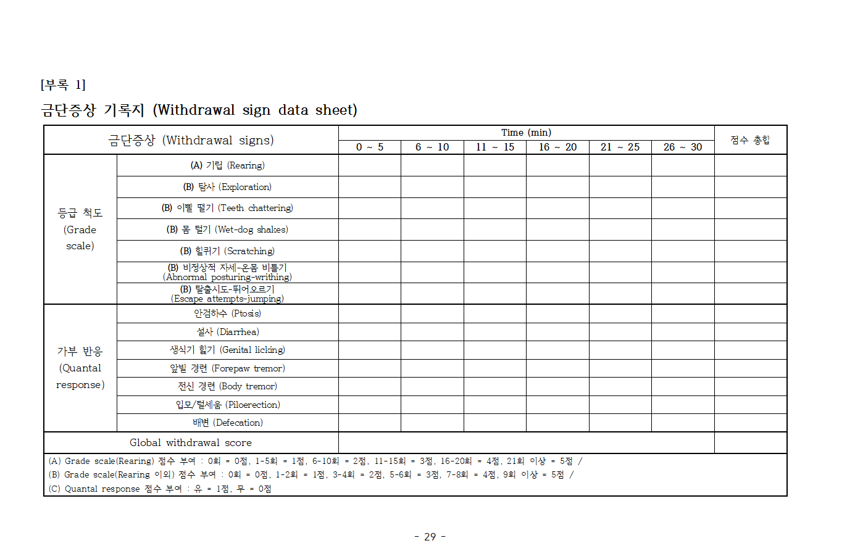
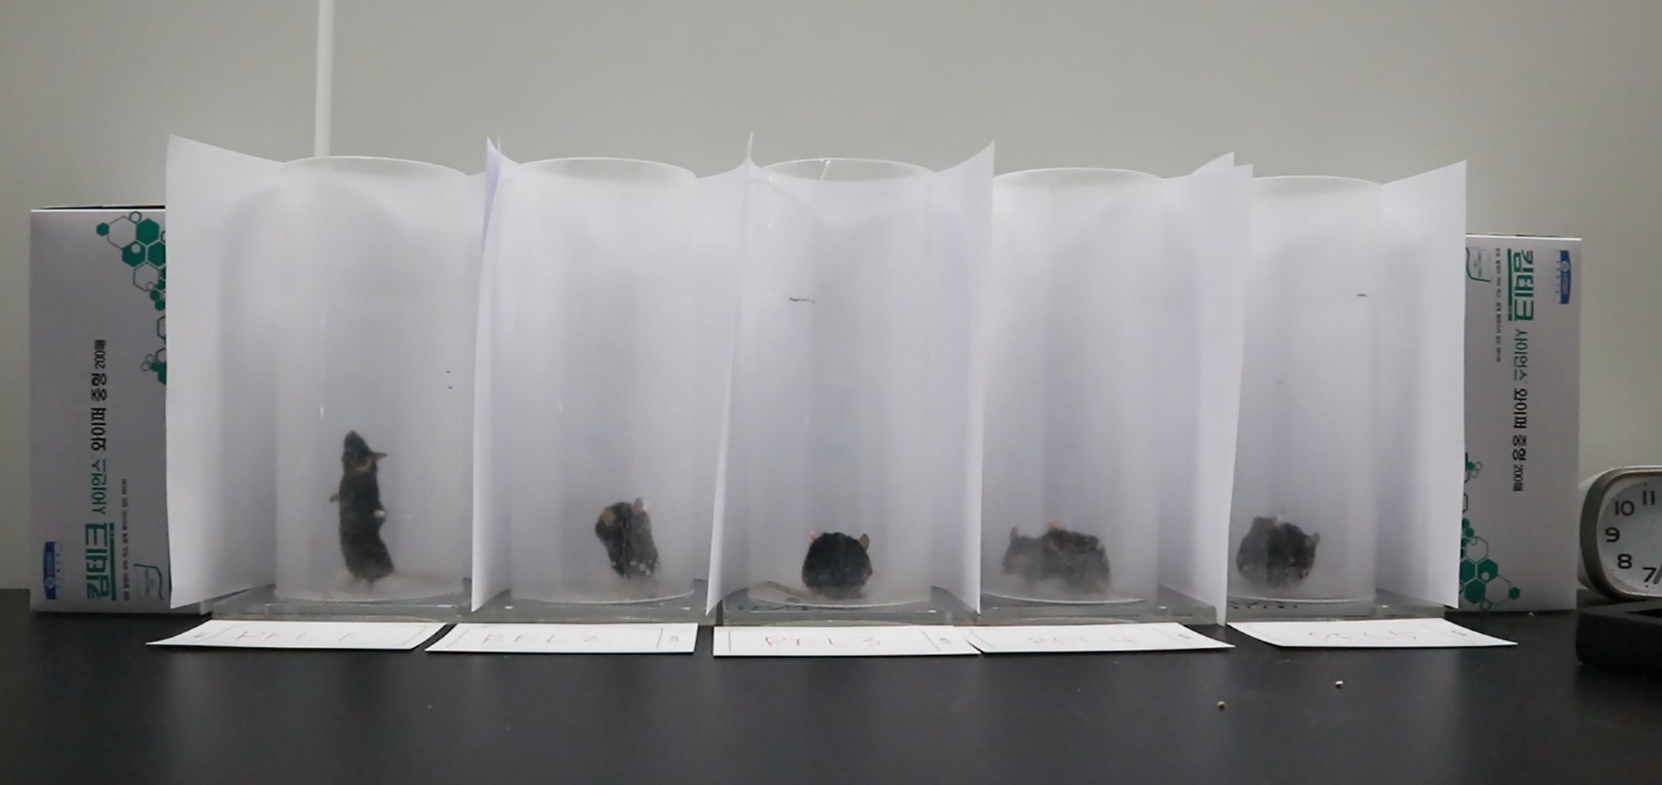
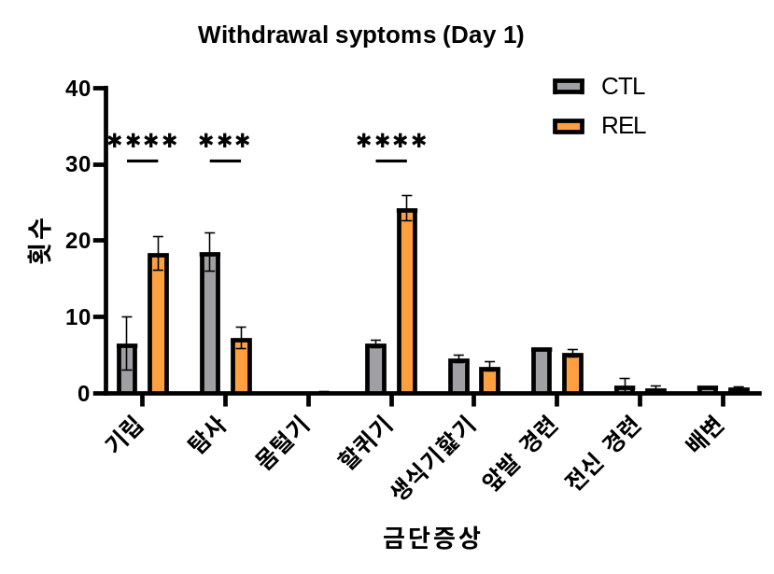
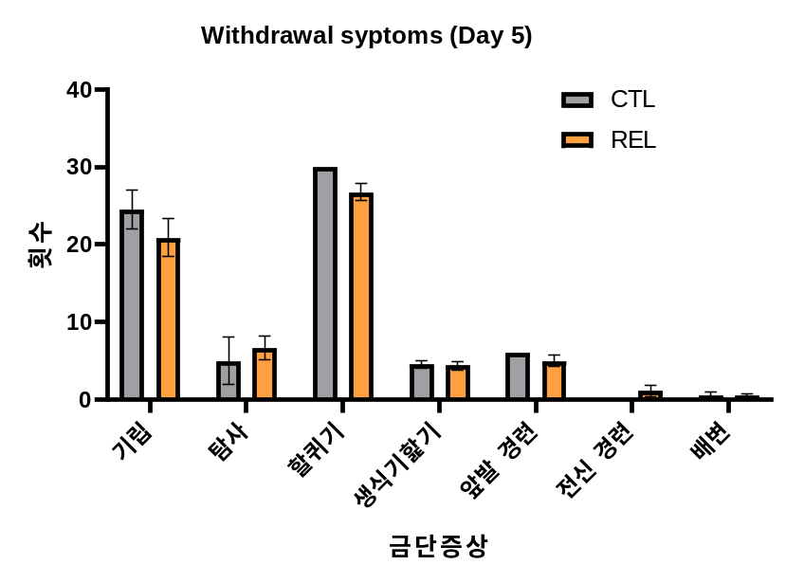
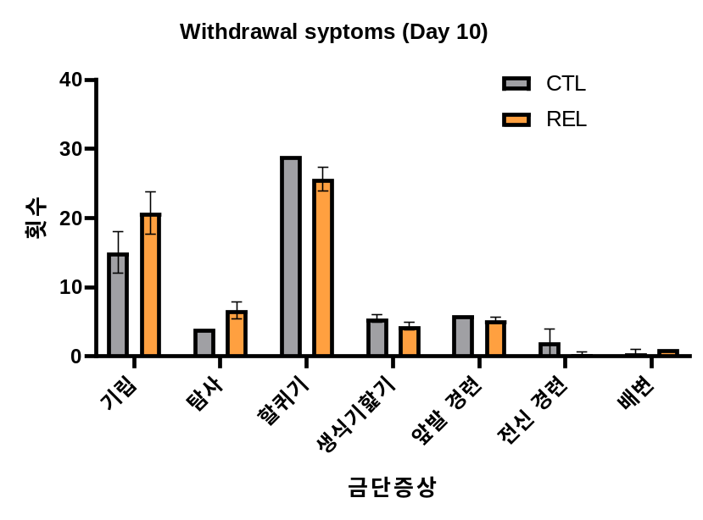


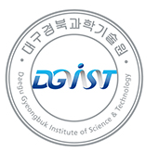
Effect of Transcutaneous Vagus Nerve Stimulation
on Ketamine Reinstatement
Minjin Oh^{1,2}, Sejin Jeong^{2,3}, Suchan Chang², Ja Wook Koo^{1,2}
¹Brain Sciences, DGIST, Daegu, Republic of Korea
²1Emotion, Cognition and Behavior Research Group, KBRI, Daegu, Republic of Korea
³Life Science, Yeungnam University, Gyeongsan, Republic of Korea
Background
CTL
Only Extinction
E
Ketamine, a potent NMDA receptor antagonist, has shown rapid and robust antidepressant effects in patients with treatment-resistant depression (TRD). However, repeated administration is required to sustain these effects, which raises concerns about drug dependence and relapse risk. While the neural mechanisms underlying relapse have been extensively studied in opioid and psychostimulant addiction, ketamine relapse remains poorly understood.
Food Training
(3 days)
Recovery
(4 days)
Ketamine Training
(10 days, 2 hours)
VNS
Extinction
+ Vagus Nerve Stimulation
Catheter implantation
Cue-induced
reinstatement
We sought to confirm the efficacy of Vagus Nerve Stimulation (VNS) for treating ketamine addiction. We created a subsequent model in which one group underwent an extinction period following self-administration, while the other group was stimulated for 5 minutes at 5V, 15Hz before entering extinction.
Prior to stimulation, we administered a low dose of inhalational anesthesia, and self-administration was conducted after the subjects had fully recovered from anesthesia.
F
Previous studies have demonstrated that vagus nerve stimulation (VNS) attenuates relapse-like behaviors in cocaine and heroin addiction models, and VNS is already used clinically to treat depression. These findings raise the possibility that transcutaneous VNS (tVNS) may serve as a novel therapeutic strategy for ketamine relapse.
In this study, we investigated whether tVNS can reduce ketamine relapse and identified the neural circuits involved.
(A) Graph of mouse lever responses during the ketamine self-administration (1mg/kg, 10ul per infusion) process for establishing a ketamine addiction model. (B) Changes in the activation of related brain regions after establishing the ketamine addiction model (confirmed via c-fos staining). (C) Microscope images of brain regions with c-fos staining. Captured using a (Nikon ECLIPSE Ni series) at 10x magnification under TRITC conditions. (D) Graph showing the change in withdrawal symptoms by date. (E) Trends of behaviors that showed significant changes during withdrawal. (F) Results of ketamine self-administration (1mg/kg, 10ul per infusion) conducted to confirm the efficacy of VNS.
Methods
Results
CTL
Ketamine Training
+ Withdrawal behavior recording
(8 days, 2 hours)
A
B
Discussion
Food Training
(3 days)
Recovery
(4 days)
Ketamine Training
(10 days, 2 hours)
Rein
Extinction
+ Withdrawal behavior recording
(7 days, 2 hours)
Based on the research findings, our study successfully established a robust animal model of ketamine addiction and relapse. The significant increase in rearing and scratching behaviors observed on the first day of extinction (the first day of withdrawal), along with the consistently elevated or maintained withdrawal scores in the experimental group, validates the severity of dependence induced through the self-administration protocol.
Our results demonstrate the therapeutic efficacy of Vagus Nerve Stimulation (VNS) as a potential intervention for ketamine addiction. In the cue-induced reinstatement experiment, the VNS group showed a smaller increase in lever responses compared to the control group, suggesting that VNS successfully modulated and reduced addiction relapse behavior.
Furthermore, our investigation into the neural mechanisms revealed differential activity in key brain regions associated with relapse. We conducted additional analysis on four areas that showed relatively high changes in activity during relapse: the prefrontal cortex prelimbic area (PrL), nucleus accumbens shell (NAcSh), dorsal hippocampus (dHipp), and central amygdala (CeA). The experimental group (reinstatement group) exhibited lower cellular activity in the PrL, NAcSh, and dHipp, while the CeA showed a trend of increased neural activity. This suggests that a GABAergic signal from the CeA to the dHipp may be involved in a relapse-specific neural circuit, and further experiments are planned to confirm this.
Catheter implantation
Cue-induced
reinstatement
To establish the ketamine addiction model, we first conducted self-administration. A total of 10 days of two-hour ketamine training sessions were performed. Following this, subjects were randomly assigned to two groups: a control group and a reinstatement group.
After the ketamine training, the reinstatement group underwent a 7-day extinction period, followed by cue-induced reinstatement on day 8. The control group, on the other hand, received an additional 8 days of ketamine training before undergoing brain extraction.
During the extinction period, both groups were recorded for withdrawal behaviors for 30 minutes following the conclusion of their self-administration sessions.
C
CTL
REL
CTL
REL
PrL
PrL
PrL
NAcSh
NAcSh
NAcSh
CA1
CA1
BLA
CeA
CeA
dHipp
CA3
CA3
CeA
BLA
Acknowledgements
D
This research was supported by the Ministry of Health and Welfare, the Ministry of Food and Drug Safety, and the Korea Brain Research Institute.(25-BR-05-05, 1. RS-2024-00332645 and 1. RS-2024-00508718)
We monitored withdrawal behaviors to assess the relationship between symptom severity and relapse propensity, as these symptoms are a potent driver of relapse.
In accordance with the guidelines for withdrawal symptom scoring provided by the Ministry of Food and Drug Safety (MFDS), the 30-minute observation period was divided into 5-minute intervals, and behaviors were subsequently scored.
Notes:
그래프 디자인 변경은 목요일 오전에 하기

