Slide 1





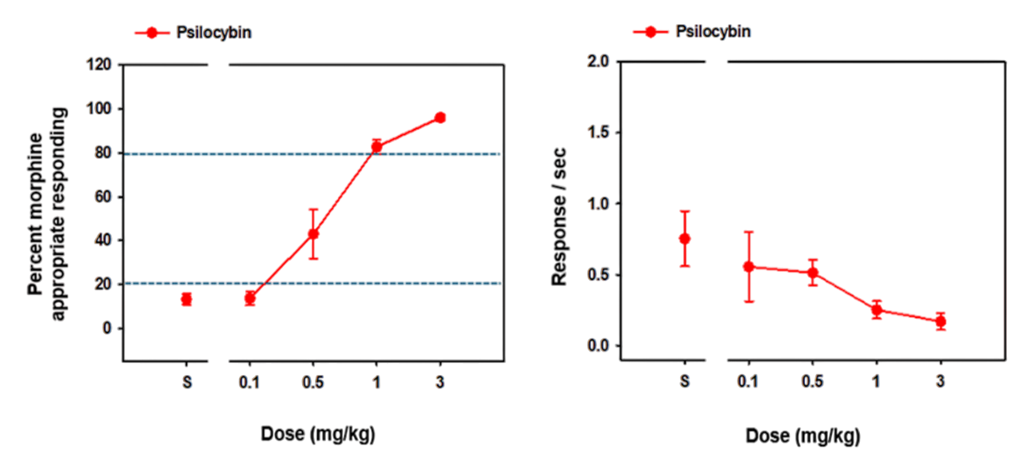
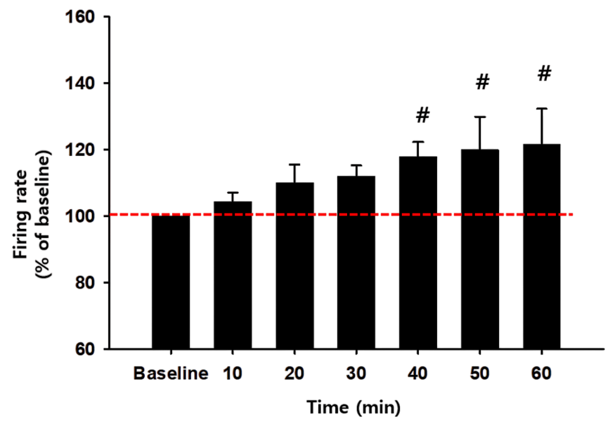
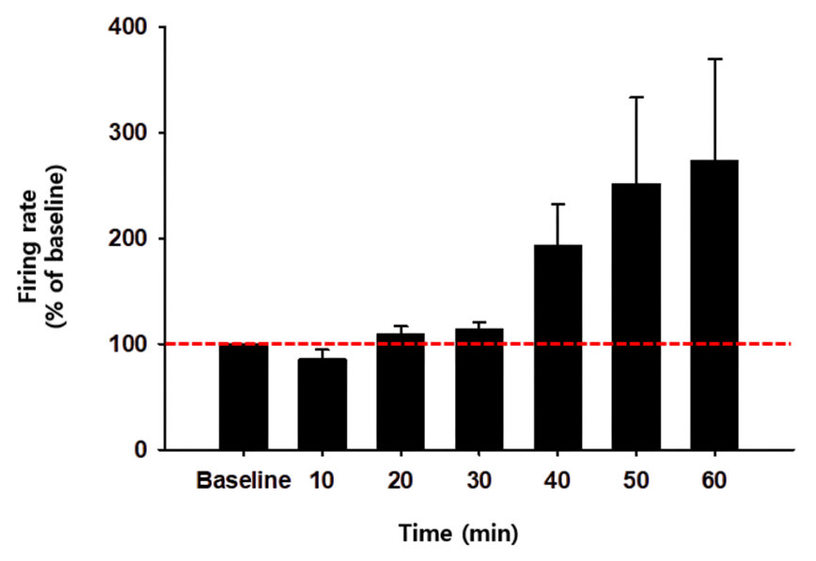
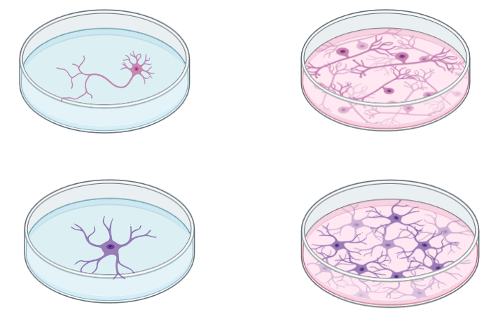
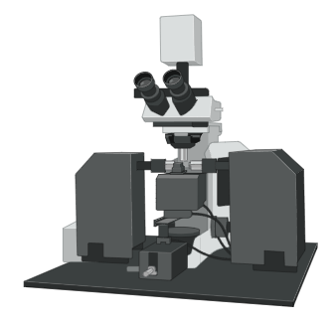

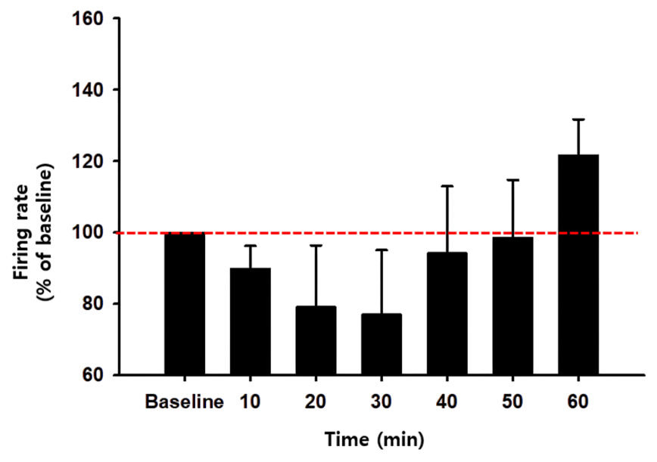
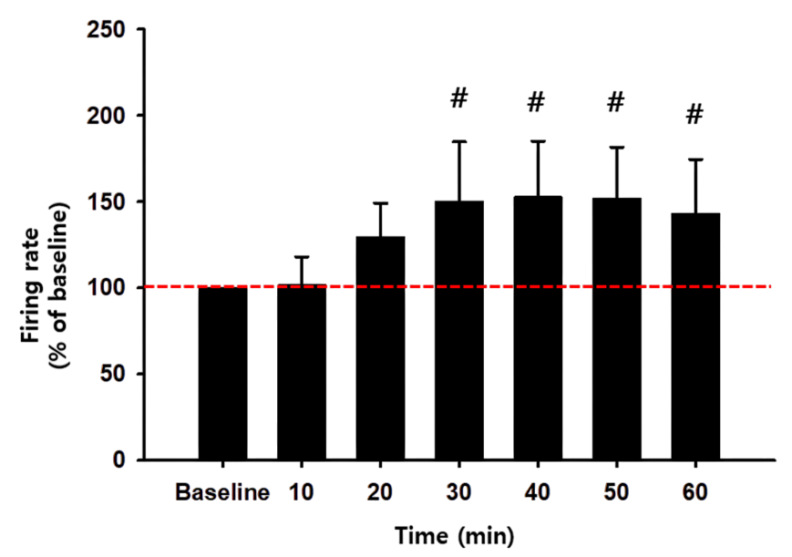
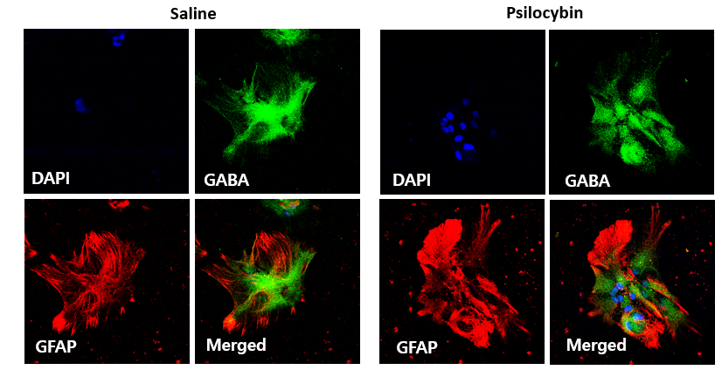
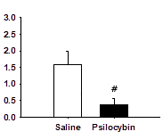
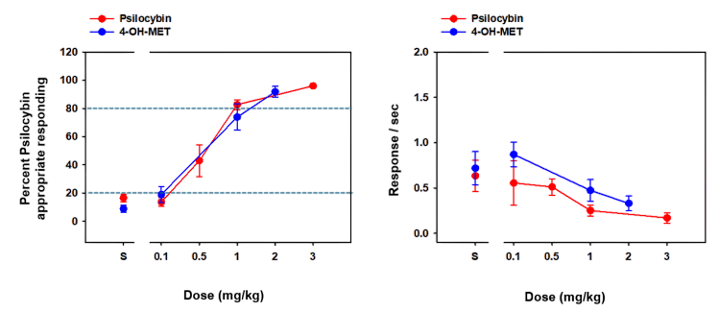
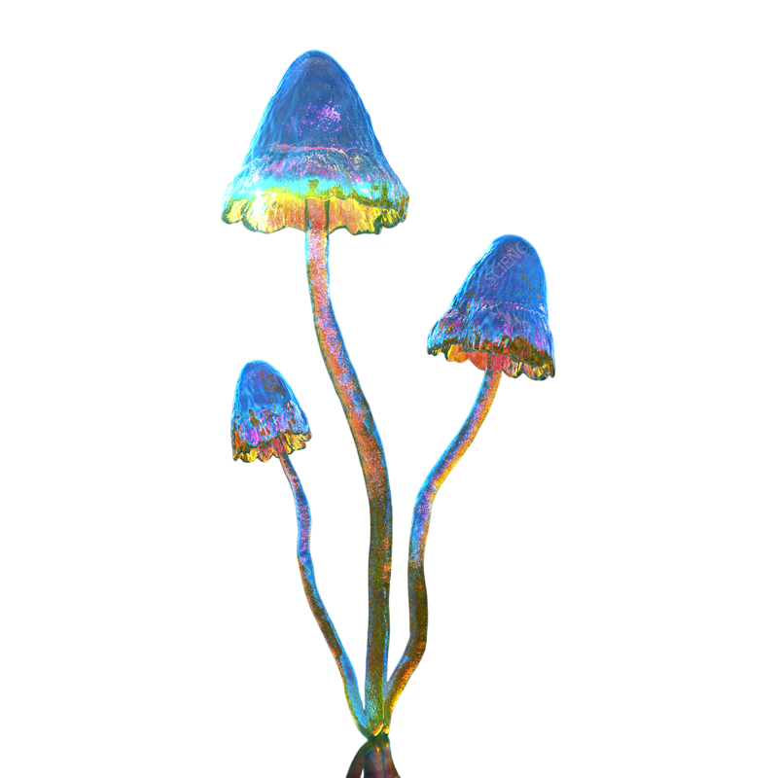
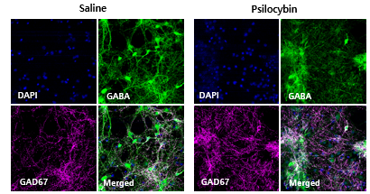
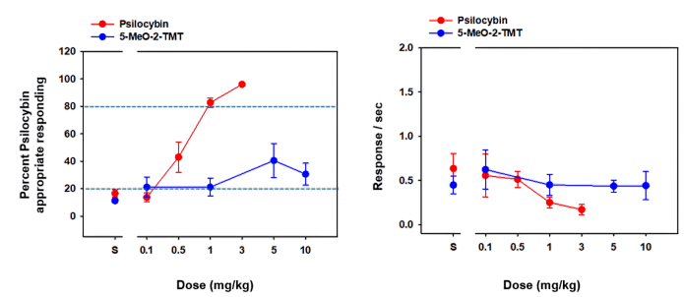
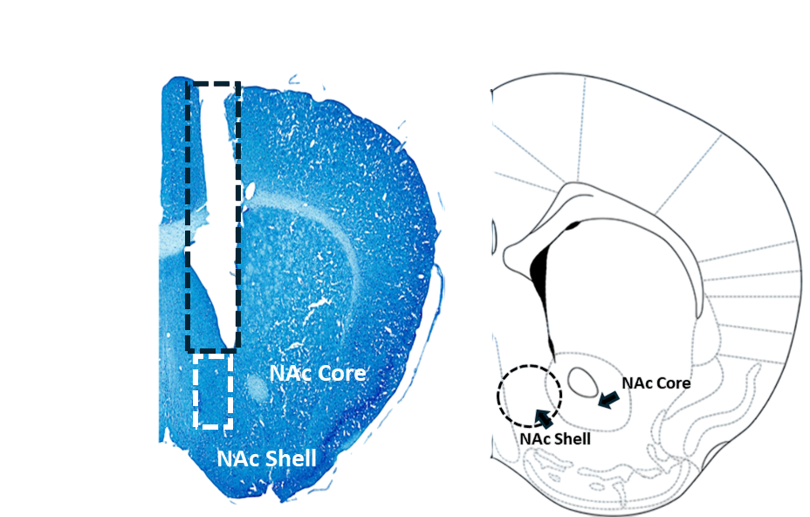
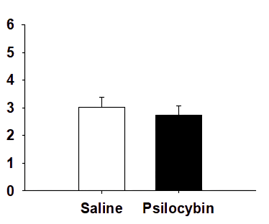
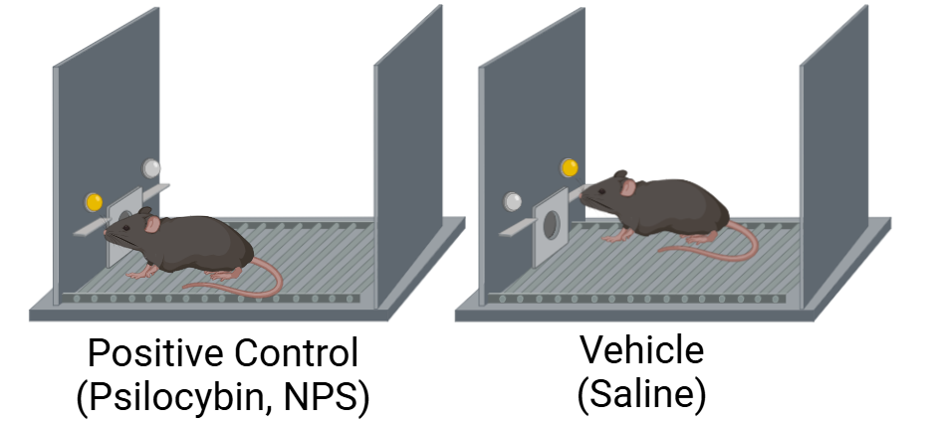
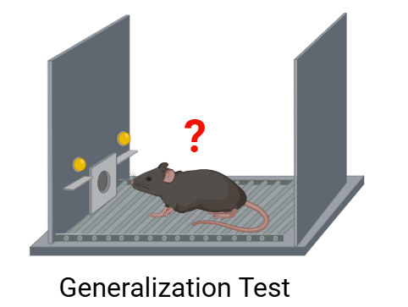
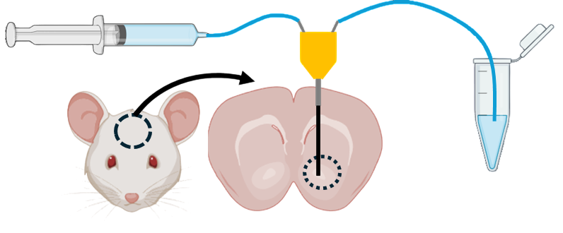
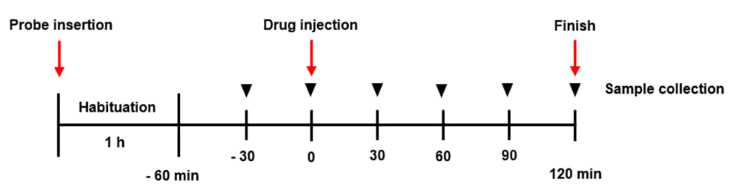
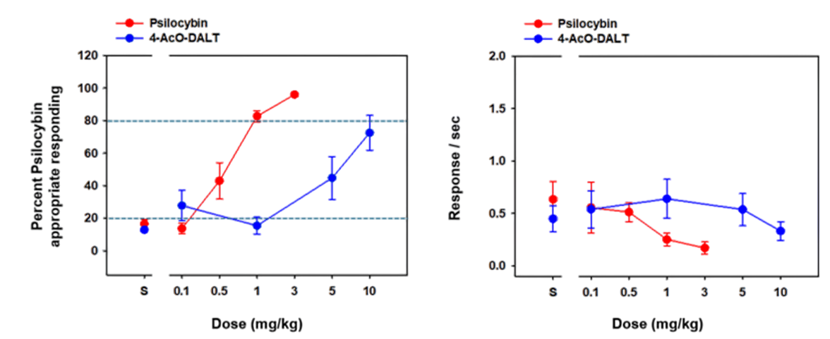
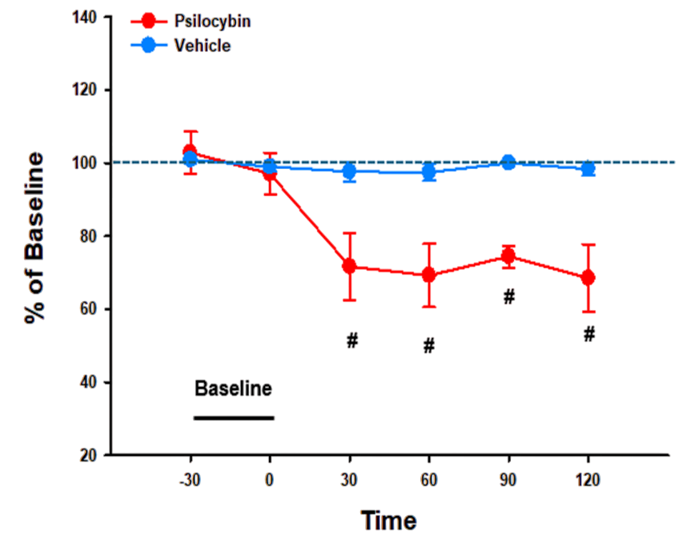
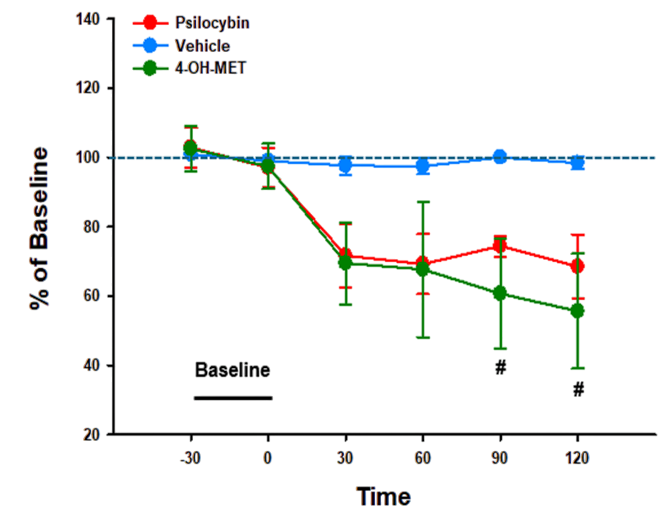
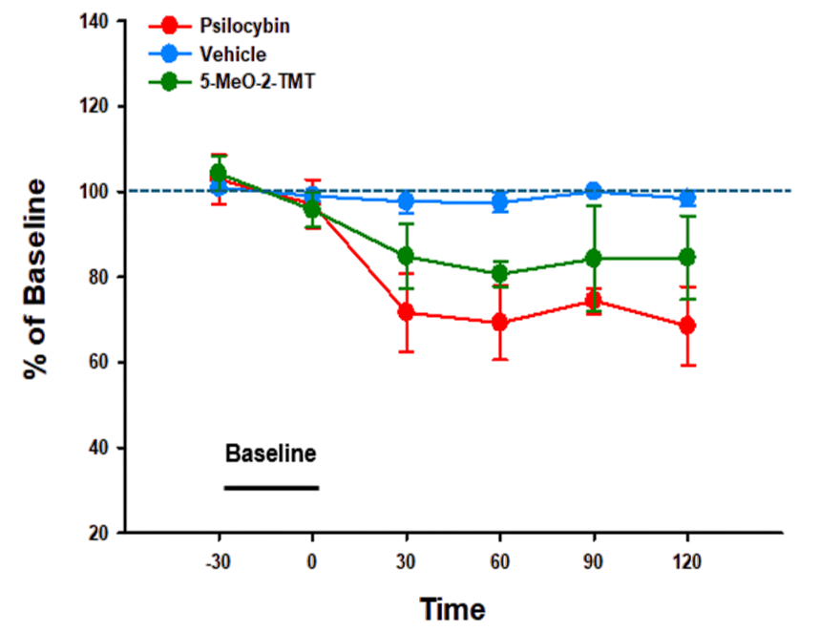
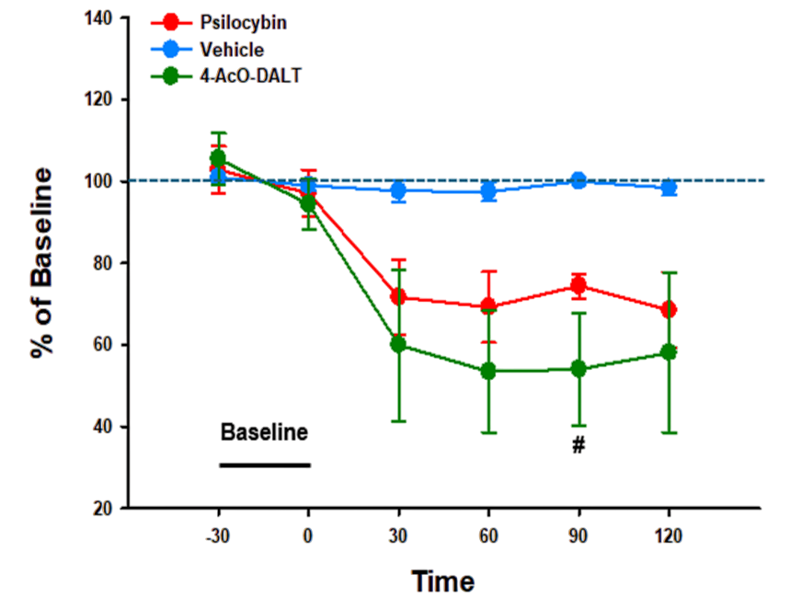
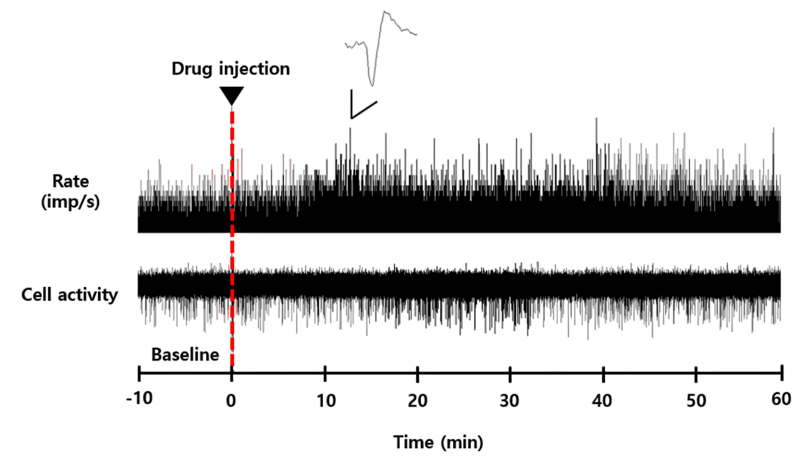
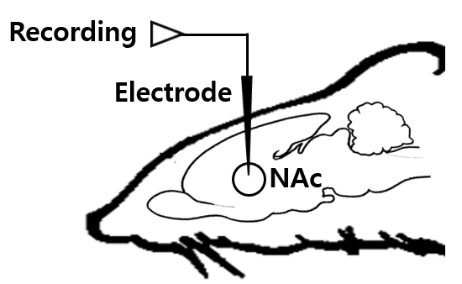
Discriminative Stimulus Properties of Psilocybin and Substituted Tryptamines on Mesolimbic Area
Su min Kang ^{1,2,#}, Dae Si Kang^{1,4,#}, Min Jin Oh^{1,4}, Sejin Jeong^{1,3}, Eum Ji Kim ¹, Jieun Lee^{1,4}, Suchan Chang¹, Ja Wook Koo^{1,4}
¹Emotion, Cognition and Behavior Research Group, Korea Brain Research Institute, Daegu, Republic of Korea
²Department of Physiology, Kyungpook National University, Daegu, Republic of Korea
³Departemet of Life Science, Yeungnam University, Gyeongsan, Republic of Korea
⁴Department of Brain Sciences, Daegu Gyeongbuk Institute of Science and Technology, Daegu, Republic of Korea
Abstract
Substance Use Disorder (SUD) remains a critical and increasingly prevalent global health issue, shaped by complex interactions among biological, psychological, and environmental factors. Tryptamines, a class of hallucinogenic compounds structurally related to serotonin, have gained increasing attention due to their psychoactive properties and increasing presence in illicit drug markets. Although compounds such as psilocybin are generally regarded as having low addictive potential, repeated use may still result in compulsive, reward-driven behaviors. Despite their rising use, the precise impact of tryptamines on the brain’s reward circuitry remains inadequately understood. To explore the behavioral and neurobiological effects of psilocybin and its synthetic analogs, we examined the discriminative stimulus properties of psilocybin in mice and evaluated the substitution potential of synthetic tryptamines, including 4-OH-MET, 5-MeO-2-TMT, and 4-Aco-DALT. We further assessed their influence on neural activity and neurotransmitter release in the nucleus accumbens (NAc), with a focus on the underlying neuronal and astrocytic mechanisms. The psilocybin cue fully or partially generalized to the tested synthetic tryptamines. Systemic administration of psilocybin and its analogs significantly decreased GABA release while increasing neuronal firing rates in the NAc. Immunocytochemical analyses further revealed that psilocybin modulates GABA release primarily through astrocytic, rather than neuronal, mechanisms. Taken together, these findings suggest that psilocybin and its synthetic analogs alter NAc activity by decreasing GABAergic transmission and promoting neuronal excitability, predominantly via astrocyte-mediated mechanisms.
Introduction
Results
Tryptamines are psychoactive substances with hallucinogenic and mind-altering effects, historically used for medicinal and spiritual purposes. Some, including psilocybin, occur naturally in Psilocybe spp. mushrooms, while others such as DMT and synthetic analogs (5-MeO-DALT, 4-AcO-DMT) appear on illicit drug markets. Structurally, tryptamines resemble serotonin (5-HT) and act primarily as agonists at 5-HT2A receptors, mediating hallucinogenic effects. They also interact with 5-HT1A, adrenergic, dopaminergic, and histaminergic receptors, as well as SERT, DAT, and NAT, influencing neurotransmitter release. Despite extensive research, the effects of psilocybin and substituted tryptamines on mesolimbic reward circuits remain unclear. To address this, we tested whether mice can discriminate psilocybin from saline and whether synthetic tryptamines share discriminative stimulus properties. Furthermore, we examined their effects on neural activity and neurotransmitter release within the nucleus accumbens, focusing on neuronal versus astrocytic mechanisms.
Discriminative stimulus effects of Positive control substance
Psilocybin and substituted tryptamines increased the NAc activity
Psilocybin regulates GABA release through modulation of astrocytic mechanism
A
A
B
Psilocybin
4-OH-MET
Neuron
Astrocyte
Treatment
(saline or Psilocybin)
DAPI
Primary cell culture
Harvest and ICC
GABA
10 day
48 h
GFAP
C
D
A
GAD67
Figure 1 : Results of Generalization Test with Psilocybin (Positive Control)
A : Generalization tests (left) and rate of responding in responses (right) with Psilocybin
5-MeO-2-TMT
4-AcO-DART
Material & Method
Discriminative stimulus effects of substituted tryptamines (ST)
GABA/GFAP
A
Psilocybin is a psychedelic compound found in certain mushrooms. It plays a significant role in the treatment of mental health conditions such as addiction, depression, and mood disorders, particularly in terminally ill patients. It is commonly used to alter perception and cognition, providing transformative psychological benefits by potentially reducing anxiety and fear.
Figure 3. Results of Single-unit Extracellular recording with Positive control substances and ST
A : Effects of psilocybin on single-unit extracellular recordings
B : Effects of 4-OH-MET on single-unit extracellular recordings
C : Effects of 5-MeO-2-TMT on single-unit extracellular recordings
D : Effects of 4-AcO-DART on single-unit extracellular recordings
B
Positive Control
(Psilocybin)
Vehicle
New Psychoactive Substance
B
Analysis of GABA release in NAc
GABA/GAD67
Perfusate pumped
Into the brain
Dialysate pumped
out of the brain
Guide
Cannula
Bregma : ±1.2 mm
Probe
membrane
Drug Discrimination Training ( two – lever choice task )
Generalization test
Figure 4. Effects of psilocybin on GABA release in the Astrocyte
A : Effects of psilocybin and saline on intensity of GFAP positive pixels
B : Effects of psilocybin and saline on intensity of GAD67 positive pixels
Food Training
Fixed ratio Training
Discrimination Training
Test Session
(Generalization test)
C
1 week
2 week ~
4 week ~
A
B
Discussion
Drug-discrimination
Food training: Time reduction training, lever adaptation training through fixed ratio training (FR10).
Drug discrimination training: Training to discriminate between a positive control substance (training substance) and a negative control substance.
Test session: Assessment of the generalization extent of new psychoactive substances in relation to the positive control substance.
Our study shows that psilocybin and certain substituted tryptamines (4-OH-MET, 4-Aco-DALT) induce psilocybin-like discriminative stimulus effects and increase NAc neuronal activity. These effects are accompanied by reduced extracellular GABA levels, suggesting that decreased GABAergic tone contributes to NAc activation. In ICC analyses revealed that psilocybin selectively decrease GABA release compared to neurons. This highlights a critical role for astrocytes in modulating GABAergic signaling and mediating psilocybin’s effects on neural circuits. Overall, our findings emphasize the importance of astrocyte-neuron interactions in regulating reward circuitry and subjective drug effects, providing insight into the cellular basis of psychedelic action.
Microdialysis
Liquid chromatography-Mass Spectrometry(LC-MS)
Immunocytochemistry (ICC)
Extracellular recording
Figure 2. Results of generalization tests with Positive control substances and ST
A : Generalization tests with 4-OH-MET for discriminative stimulus effects of psilocybin.
B : Generalization tests with 5-MeO-2-TMT for discriminative stimulus effects of psilocybin.
C : Generalization tests with 4-AcO-DART for discriminative stimulus effects of psilocybin.
C
D
Table 1. ED50 Values (95% CI) of Test Compounds
Test Compound | ED₅₀ (mg/kg) | Generalization Test
Psilocybin | 0.57 ± 0.09 | Generalization ( 82.7% in 1mg/kg)
4-OH-MET | 0.61 ± 0.18 | Generalization ( 91.8% in 2mg/kg)
5-MeO-2-TMT | - | Partial – generalization ( 40.5% in 5mg/kg)
4-AcO-DALT | 5.44 ± 1.28 | Partial – generalization ( 72.5% in 10mg/kg)
Table 1. Comparison of ED50 and Generalization Test Results for Positive Controls and ST
Psilocybin (1 mg/kg, 82.7%): Full generalization in discriminative stimulus tests of psilocybin.
4-OH-MET (2 mg/kg, 91.8%): Full generalization in discriminative stimulus tests of psilocybin.
5-MeO-2-TMT (5 mg/kg, 40.5%): Partial generalization in discriminative stimulus tests of psilocybin.
4-AcO-DALT (10 mg/kg, 72.5%): Partial generalization in discriminative stimulus tests of psilocybin.
Figure 4. Effects of psilocybin and substituted tryptamines on extracellular levels of GABA in the NAc
A : Analysis of GABA concentration with Psilocybin
B : Analysis of GABA concentration with 4-OH-MET
C : Analysis of GABA concentration with 5-MeO-2-TMT
D : Analysis of GABA concentration with 4-AcO-DART
Acknowledgements
This research was supported by KBRI (Ministry of Science and ICT, 25-BR-07-01 & 25-BR-05-05), the Ministry of Food and Drug Safety (MFDS, 24212MFDS223), the National Research Foundation of Korea (NRF, funded by the Korea government,RS-2024-00508718 & 2021R1A2C2094627) and National Research Foundation of Korea (NRF, funded by the Korea government, MSIP, RS-2024-00349070).

